Slide 1
Neural Lexical Search with Learned Sparse Retrieval
SIGIR 2025 Tutorial

Slide 2
Introduction
SIGIR 2025 Tutorial
presented by Sean MacAvaney

Slide 3



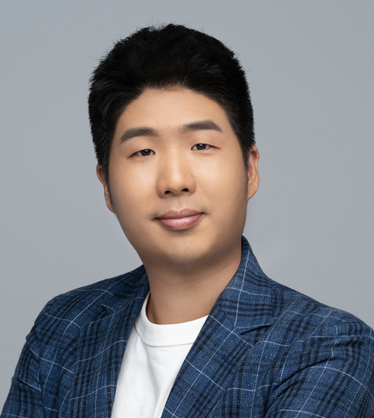
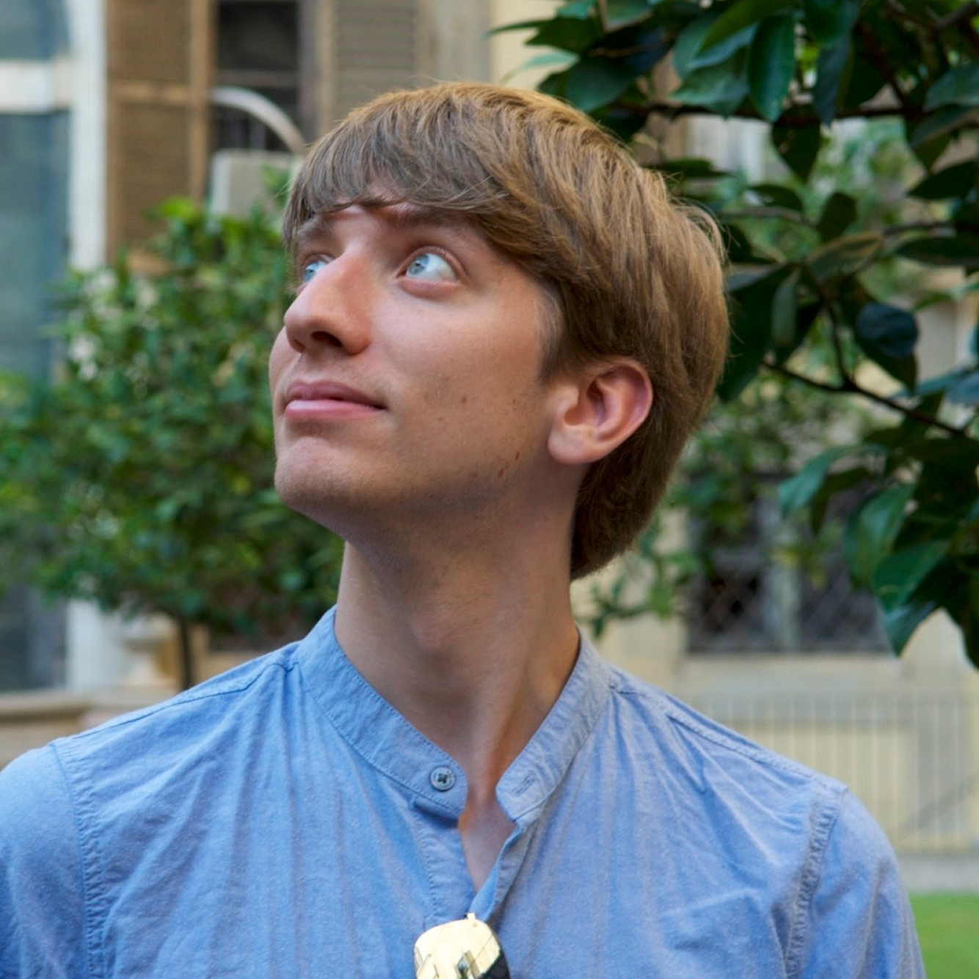
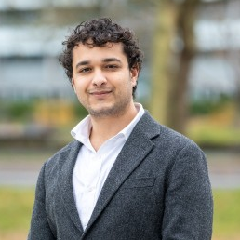

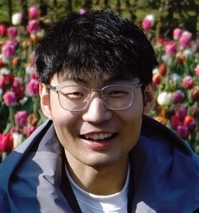
Your Instructors
Andrew Yates
Johns Hopkins University
HLTCOE
Carlos Lassance
Cohere
Cosimo Rulli
ISTI-CNR
Eugene Yang
Johns Hopkins University
HLTCOE
Sean MacAvaney
University of Glasgow
Siddharth Singh
University of Amsterdam
Thống Nguyen
University of Amsterdam
Yibin Lei
University of Amsterdam

Slide 4
Schedule
Introduction ← now
Datasets and Evaluation
LSR Framework
Training LSR
Modalities
English Text
Multilingual Text
Multimodal Data
Indexing & efficiency
Hybrid dense-sparse retrieval
Conclusion

Slide 5
Background

Slide 6


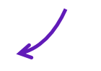

Most of this tutorial
Relevance Models
model.scorer()
Retrieval Engines
Covered in the second half
Step 1: model.doc_encoder() >> indexer
Step 2: model.query_encoder() >> retriever

Slide 7
Relevance Model Paradigms (Scoring Perspective)
(score)
(score)
(score)
dense vector
dense vector
dense vector
dense vector
dense vector
dense vector
dense vector
dense vector
dense vector
dense vector
dense vector
Model
Model
Model
Model
Model
Query + Doc.
Query
Doc.
Query
Doc.
Cross-Encoding
Jointly encodes Q&D,
score as classification
Single-Vector Dense
Encode Q&D into dense vector,
score as vector similarity
Multi-Vector Dense
Encode Q&D into multiple vectors, aggregate vector similarities

Slide 8
Relevance Model Paradigms (Scoring Perspective)
(score)
sparse vector
sparse vector
Model
Model
Query
Doc.
Learned Sparse
Encode Q&D into sparse vectors,
score as vector similarity

Slide 9
Why Sparse?
Why Learned?
Why now?

Slide 10
Why Sparse?
Why Learned?
Why now?
← now

Slide 11

Dense vs Sparse
~100-5,000 dimensions
(typical: 768)
Dimensions are latent.
Typically scored with Inner Product (dot)
Example: (TAS-B)
[0.03, -0.27, 0.47, -0.11, 0.39, 0.47, 0.45, 0.58, 0.01, -0.46, -0.45, 0.16, -0.14, -0.10, -0.27, 0.11, -0.33, -0.12, 0.40, 0.13, 0.06, -0.14, 0.18, -0.09, -0.01, 0.14, 0.05, -0.03, -0.17, -0.02, 0.03, 0.48, 0.15, 0.10, -0.24, 0.16, 0.15, -0.06, -0.38, 0.47, -0.08, -0.05, -0.40, 0.34, 0.32, 0.23, -0.06, -0.18, 0.66, -0.02, -0.49, 0.62, -0.27, -0.05, -0.23, 0.04, 0.09, -0.26, 0.49, -0.14, 0.16, 0.09, -0.12, 0.25, -0.07, 0.23, 0.16, 0.40, -0.34, -0.40, ...]
dense vector
10,000+ dimensions
(but mostly 0’s)
Dimensions can be
associated with concepts.
Typically scored with Inner Product (dot)
Example: (SPLADE)
{rivers: 2.8494, italy: 2.5118, northern: 2.4177, river: 2.3237, italian: 1.9444, north: 1.6943, waters: 0.9240, geography: 0.7435, milan: 0.6761, canal: 0.6707, water: 0.6420, lake: 0.6206,
province: 0.5962, ##jord: 0.5876, volcano: 0.4929, region: 0.4590, map: 0.4397, terrain: 0.4315, trent: 0.3932, roman: 0.3724, location: 0.3408, beach: 0.3125, andrea: 0.3034, europe: 0.2541, holland: 0.2314, fishing: 0.2000, asia: 0.1867, wine: 0.1820, ...}
sparse vector
Model
Model
Content
Content

Slide 12
Dense vs Sparse
~100-5,000 dimensions
(typical: 768)
Dimensions are latent.
Typically scored with Inner Product (dot)
Example: (TAS-B)
[0.03, -0.27, 0.47, -0.11, 0.39, 0.47, 0.45, 0.58, 0.01, -0.46, -0.45, 0.16, -0.14, -0.10, -0.27, 0.11, -0.33, -0.12, 0.40, 0.13, 0.06, -0.14, 0.18, -0.09, -0.01, 0.14, 0.05, -0.03, -0.17, -0.02, 0.03, 0.48, 0.15, 0.10, -0.24, 0.16, 0.15, -0.06, -0.38, 0.47, -0.08, -0.05, -0.40, 0.34, 0.32, 0.23, -0.06, -0.18, 0.66, -0.02, -0.49, 0.62, -0.27, -0.05, -0.23, 0.04, 0.09, -0.26, 0.49, -0.14, 0.16, 0.09, -0.12, 0.25, -0.07, 0.23, 0.16, 0.40, -0.34, -0.40, ...]
dense vector
10,000+ dimensions
(but mostly 0’s)
Dimensions can be
associated with concepts.
Typically scored with Inner Product (dot)
Example: (SPLADE)
{rivers: 2.8494, italy: 2.5118, northern: 2.4177, river: 2.3237, italian: 1.9444, north: 1.6943, waters: 0.9240, geography: 0.7435, milan: 0.6761, canal: 0.6707, water: 0.6420, lake: 0.6206,
province: 0.5962, ##jord: 0.5876, volcano: 0.4929, region: 0.4590, map: 0.4397, terrain: 0.4315, trent: 0.3932, roman: 0.3724, location: 0.3408, beach: 0.3125, andrea: 0.3034, europe: 0.2541, holland: 0.2314, fishing: 0.2000, asia: 0.1867, wine: 0.1820, ...}
sparse vector
Model
Model
Content
Content
Same Query (any guesses?)

Slide 13
Dense vs Sparse
~100-5,000 dimensions
(typical: 768)
Dimensions are latent.
Typically scored with Inner Product (dot)
Example: (TAS-B)
[0.03, -0.27, 0.47, -0.11, 0.39, 0.47, 0.45, 0.58, 0.01, -0.46, -0.45, 0.16, -0.14, -0.10, -0.27, 0.11, -0.33, -0.12, 0.40, 0.13, 0.06, -0.14, 0.18, -0.09, -0.01, 0.14, 0.05, -0.03, -0.17, -0.02, 0.03, 0.48, 0.15, 0.10, -0.24, 0.16, 0.15, -0.06, -0.38, 0.47, -0.08, -0.05, -0.40, 0.34, 0.32, 0.23, -0.06, -0.18, 0.66, -0.02, -0.49, 0.62, -0.27, -0.05, -0.23, 0.04, 0.09, -0.26, 0.49, -0.14, 0.16, 0.09, -0.12, 0.25, -0.07, 0.23, 0.16, 0.40, -0.34, -0.40, ...]
dense vector
10,000+ dimensions
(but mostly 0’s)
Dimensions can be
associated with concepts.
Typically scored with Inner Product (dot)
Example: (SPLADE)
{rivers: 2.8494, italy: 2.5118, northern: 2.4177, river: 2.3237, italian: 1.9444, north: 1.6943, waters: 0.9240, geography: 0.7435, milan: 0.6761, canal: 0.6707, water: 0.6420, lake: 0.6206,
province: 0.5962, ##jord: 0.5876, volcano: 0.4929, region: 0.4590, map: 0.4397, terrain: 0.4315, trent: 0.3932, roman: 0.3724, location: 0.3408, beach: 0.3125, andrea: 0.3034, europe: 0.2541, holland: 0.2314, fishing: 0.2000, asia: 0.1867, wine: 0.1820, ...}
sparse vector
Model
Model
Content
Content
Query: rivers of northern italy

Slide 14
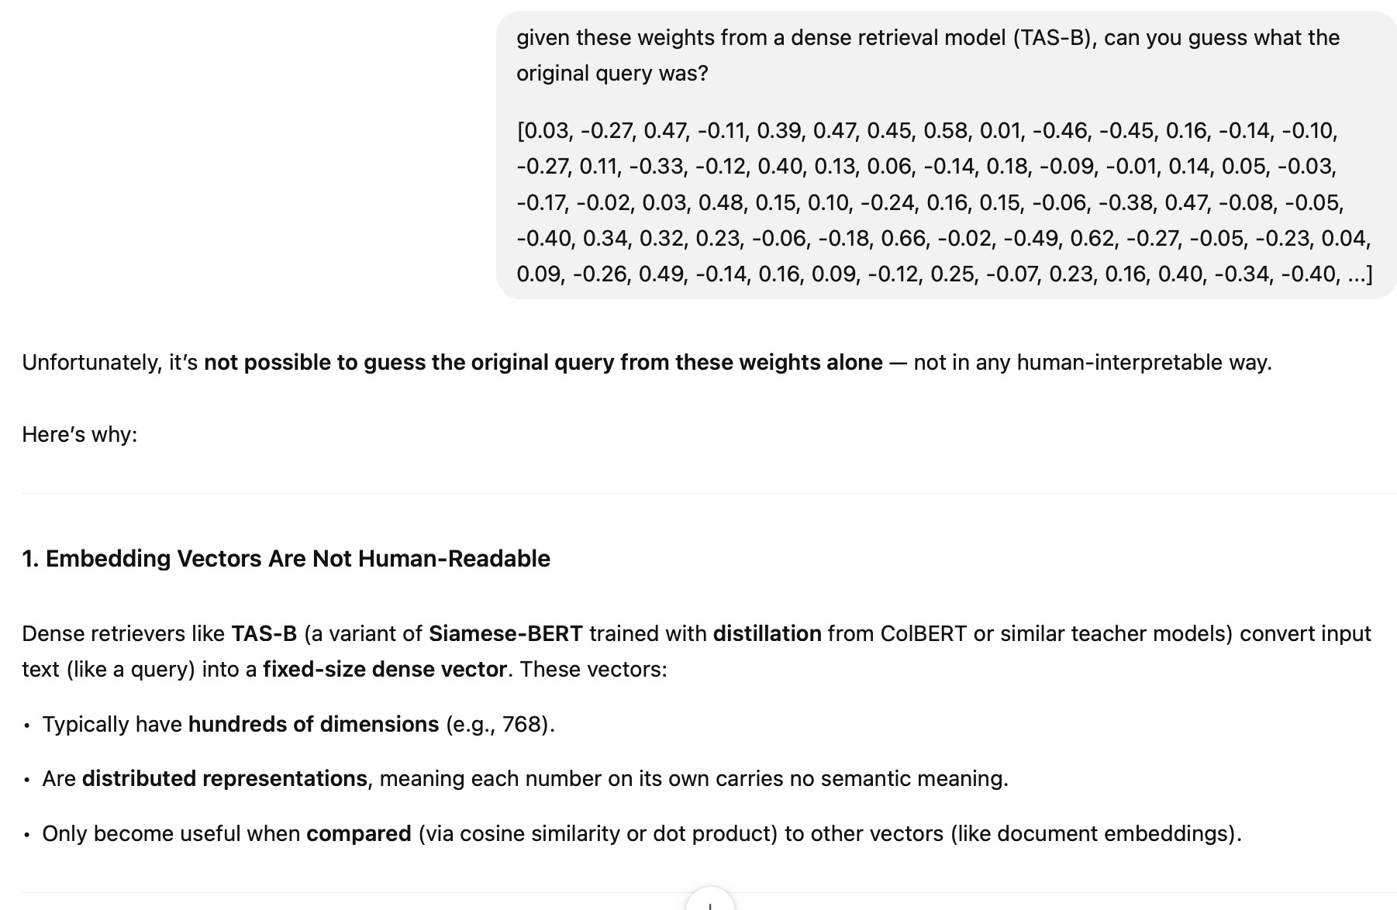
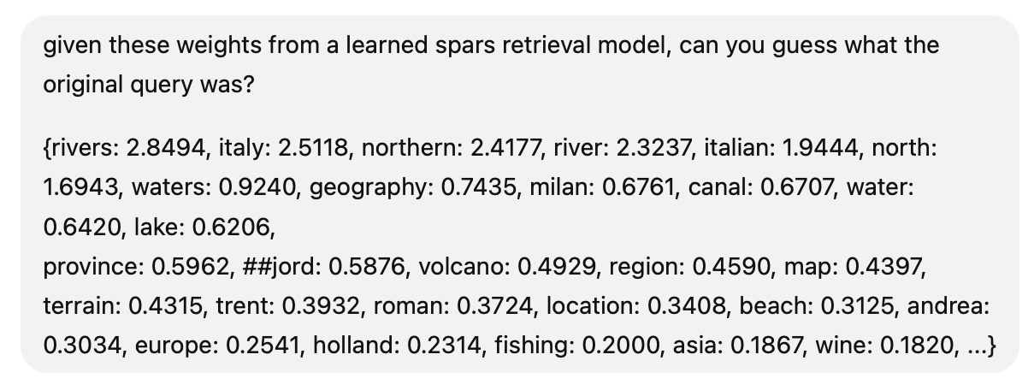
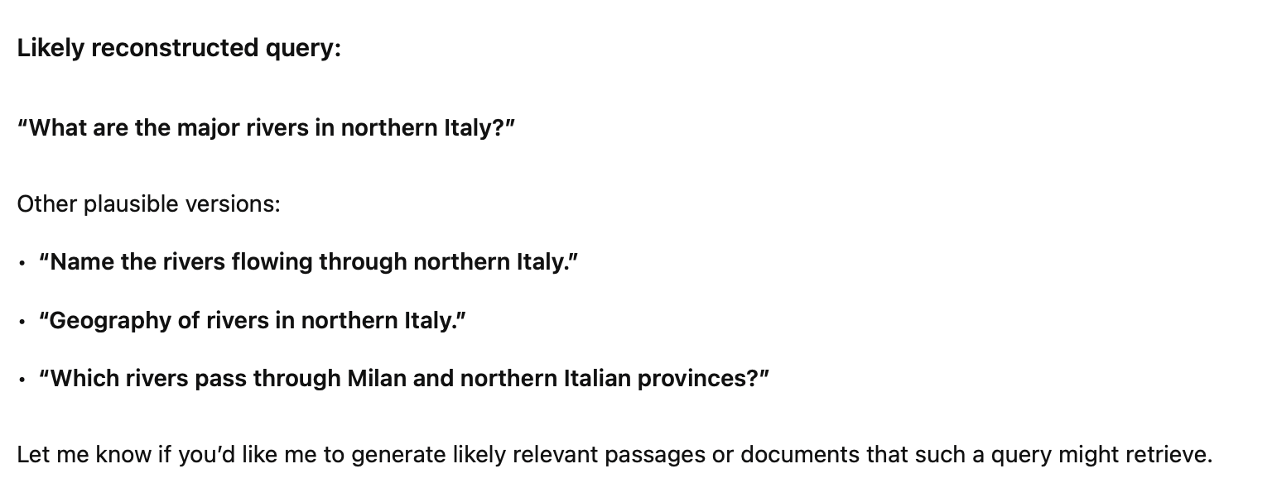

Slide 15
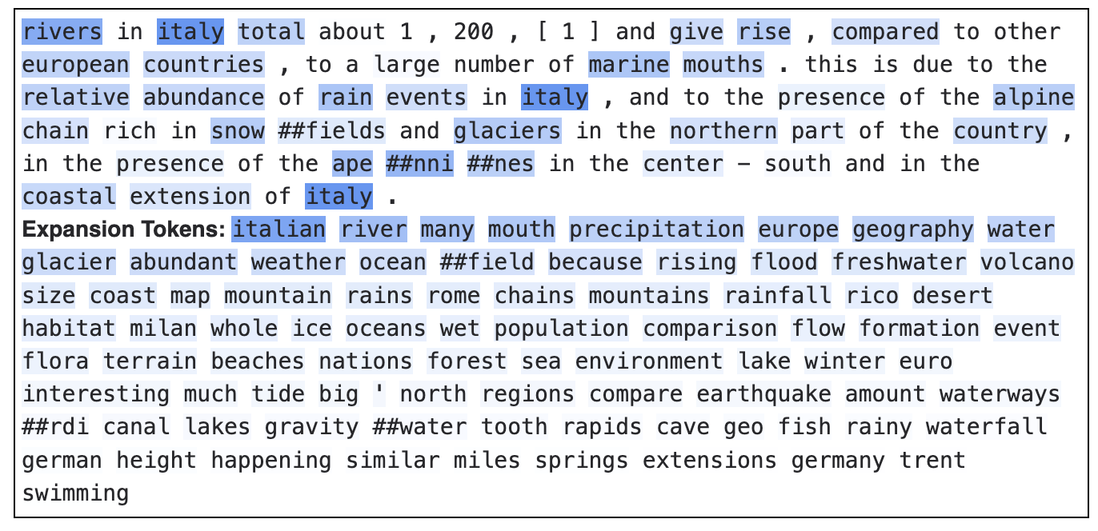
Why Sparse?
1. Intuition / Interpretability
Comapred to dense vectors, sparse vectors that are aligned with terms in a vocabulary can be easily reasoned about.
The terms with the highest weights are the most important in the document
https://huggingface.co/spaces/terrierteam/splade

Slide 16
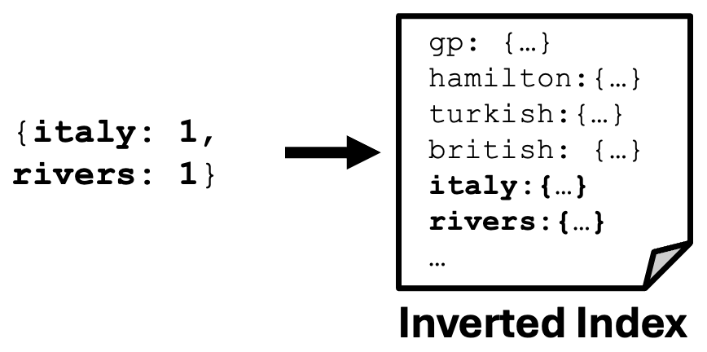
Why Sparse?
Why Sparse?
2. Practical / Efficiency
Sparse vectors can be processed faster than dense ones, leveraging
decades of optimizations (and new ones, too!)
Fits in well with existing inverted index infrastructure (e.g., Lucene, Solr, etc.)
Can completely ignore docs without these query terms

Slide 17
Why Sparse?
3. Philosophical
A piece of content (queries/documents/etc) is only “about” a limited number of concepts.
Corollary: A piece of content is completely unrelated to most concepts
(i.e., it’s sparse in the space of concepts).
Representations that reflect this sparsity (arguably) better reflect reality.

Slide 18
Why Sparse?
Why Learned?
Why now?
← now

Slide 19
We already have (non-learned) sparse models!
Rivers in Italy total about 1,200, and give rise, compared to other European countries,
to a large number of marine mouths. This is due to the relative abundance of rain events in Italy, and to the presence of the Alpine chain rich in snowfields and glaciers in the northern part of the country, in the presence of the Apennines in the center-south and in the coastal extension of Italy.
(TF) →
{italy: 3, rivers: 1, alpine: 1, mouths: 1, snowfields: 1, ...}

Slide 20
We already have (non-learned) sparse models!
Rivers in Italy total about 1,200, and give rise, compared to other European countries, to a large number of marine mouths. This is due to the relative abundance of rain events in Italy, and to the presence of the Alpine chain rich in snowfields and glaciers in the northern part of the country, in the presence of the Apennines in the center-south and in the coastal extension of Italy.
(TF) →
{italy: 3, rivers: 1, alpine: 1, mouths: 1, snowfields: 1, ...}

Slide 21
We already have (non-learned) sparse models!
Rivers in Italy total about 1,200, and give rise, compared to other European countries, to a large number of marine mouths. This is due to the relative abundance of rain events in Italy, and to the presence of the Alpine chain rich in snowfields and glaciers in the northern part of the country, in the presence of the Apennines in the center-south and in the coastal extension of Italy.
(TF) →
{italy: 3, rivers: 1, alpine: 1, mouths: 1, snowfields: 1, ...}

Slide 22
Are Passage 1 and 2 equally “about” rivers?
Passage 1:
Rivers in Italy total about 1,200, and give rise, compared to other European countries, to a large number of marine mouths. This is due to the relative abundance of rain events in Italy, and to the presence of the Alpine chain rich in snowfields and glaciers in the northern part of the country, in the presence of the Apennines in the center-south and in the coastal extension of Italy.
{rivers: 1, ...}
Passage 2:
While a noun names a person, place, thing, or idea a proper noun gets more specific. It gives us the actual name of the person, place, thing, or idea. The actual names of people are proper nouns.So are the names of states, streets, rivers, oceans, countries, companies, institutions, churches, and more.hile a noun names a person, place, thing, or idea a proper noun gets more specific. It gives us the actual name of the person, place, thing, or idea. The actual names of people are proper nouns.
{rivers: 1, ...}

Slide 23
Are Passage 1 and 2 equally “about” rivers?
Passage 1:
Rivers in Italy total about 1,200, and give rise, compared to other European countries, to a large number of marine mouths. This is due to the relative abundance of rain events in Italy, and to the presence of the Alpine chain rich in snowfields and glaciers in the northern part of the country, in the presence of the Apennines in the center-south and in the coastal extension of Italy.
{rivers: 1, ...}
Passage 2:
While a noun names a person, place, thing, or idea a proper noun gets more specific. It gives us the actual name of the person, place, thing, or idea. The actual names of people are proper nouns.So are the names of states, streets, rivers, oceans, countries, companies, institutions, churches, and more.hile a noun names a person, place, thing, or idea a proper noun gets more specific. It gives us the actual name of the person, place, thing, or idea. The actual names of people are proper nouns.
{rivers: 1, ...}
No way! Passage 1 is way more “about” rivers.

Slide 24
Why Learned?
1. Term statistics don’t tell the whole story
The context is really important for determining how much text is “about” a concept.
Signals like TF and IDF provide valuable signals, but they’re far from perfect.
(Especially for short texts.)
Text processing methods, especially language models, can help make better predictions of “aboutness”.
Passage 1: (w/ LSR)
{..., rivers: 1.76, ...}
Passage 2: (w/ LSR)
{..., rivers: 1.07, ...}

Slide 25
Why Learned?
2. Learned language models are (practically) built for this!
A major limitation of existing sparse models is lexical mismatch, where queries can’t match documents with conceptually similar (but different) terms.
Neural Language Models are trained to predict likely words to fit text.
{rivers: 0.8, waterways: 0.4, streams: 0.2, ...}
Neural Language Model (e.g., BERT, GPT)
Rivers in Italy total about 1,200, and give rise, compared to

Slide 26
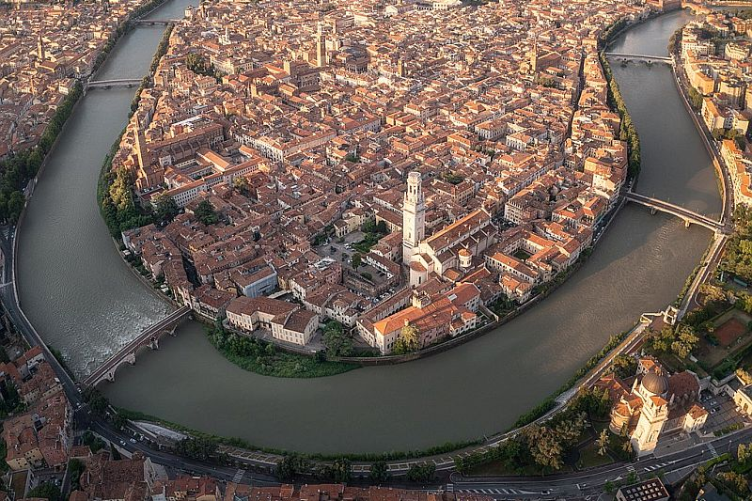
Why Learned?
3. Multi-(Language|Modal|etc.)
Machine learning allows us to map various modalities, languages, etc. into the same sparse representation space.
{rivers: 1.7, …}
{rivers: 1.7, …}
{rivers: 1.7, …}
Rivers in Italy total about 1,200, and give rise, compared to...
I fiumi in Italia sono circa 1.200 e, rispetto ad altri paesi europei, danno origine a un elevato numero di foci marine.

Slide 27
Why Sparse?
Why Learned?
Why now?
← now

Slide 28
Why now?
The technology is getting pretty mature!
LSR models are often part of the best-performing systems in IR evaluations.
It’s being integrated into search engine products, e.g., OpenSearch, Pinecone, SentenceTransformers, Solr, etc.
But there’s still more to do!
Supporting richer types of inputs (e.g., multi-modal, multi-lingual, etc.)
Richer types of representations (beyond vocabulary-aligned)
Maybe you could be the one to crack these problems in LSR!

Slide 29
Any Questions?

Slide 30
Datasets and Evaluation
(Crash Course)
SIGIR 2025 Tutorial
presented by Sean MacAvaney

Slide 31
Schedule
Introduction
Datasets and Evaluation ← now
LSR Framework
Training LSR
Modalities
English Text
Multilingual Text
Multimodal Data
Indexing & efficiency
Hybrid dense-sparse retrieval
Conclusion

Slide 32
Relevance Models
model.scorer()
Retrieval Engines
Step 1: model.doc_encoder() >> indexer
Step 2: model.query_encoder() >> retriever

Slide 33
How do you know if your engine is any good?

Slide 34
…
…

Slide 35

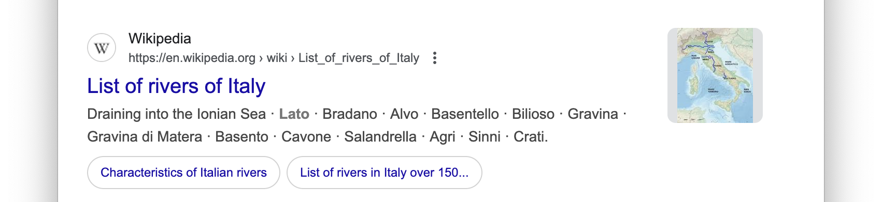

(document_id, score)
(document_id, score)
(document_id, score)
(document_id, score)
(document_id, score) ~=
(document_id, score)
(document_id, score)
(document_id, score)
(document_id, score)
(document_id, score)
…
…
…

Slide 36
(document_id, score)
(document_id, score)
(document_id, score)
(document_id, score)
(document_id, score) ~=
(document_id, score)
(document_id, score)
(document_id, score)
(document_id, score)
(document_id, score)
…
A user could assess if these result pages are good/bad…
…
…

Slide 37
(document_id, score) -
(document_id, score) +
(document_id, score) -
(document_id, score) +
(document_id, score) +
(document_id, score) -
(document_id, score) -
(document_id, score) -
(document_id, score) +
(document_id, score) -
…
For a reusable evaluation
…
…

Slide 38
(document_id, score) -
(document_id, score) +
(document_id, score) -
(document_id, score) +
(document_id, score) +
(document_id, score) -
(document_id, score) -
(document_id, score) -
(document_id, score) +
(document_id, score) -
…
Evaluation
Measure
e.g.,
RR=0.5
…
…

Slide 39
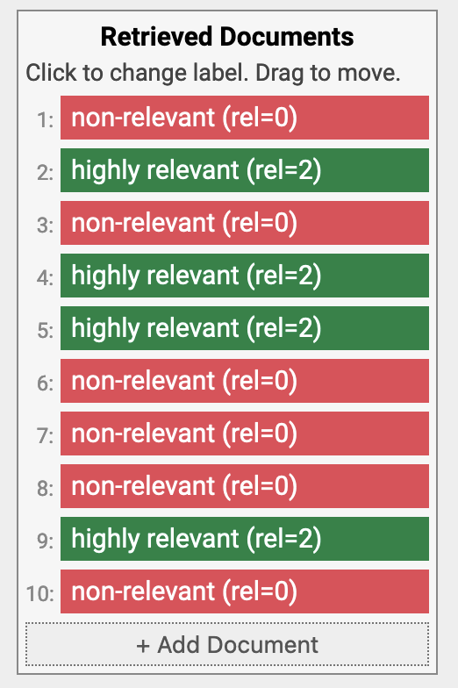
Common Evaluation Measures
(M)RR: (Mean) Reciprocal Rank:
1 / rank of first relevant document
(Take the mean over multiple queries in a test collection)
RR = 1/2 = 0.5
https://demo.ir-measur.es

Slide 40
Common Evaluation Measures
nDCG: normalized Discounted Cumulative Gain
Compares a ranking with its ideal ranking for the known relevant documents
(also considers different grades of relevance).
Järvelin & Kekäläinen. Cumulated gain-based evaluation of IR techniques. TOIS 2002.
nDCG = 0.683
https://demo.ir-measur.es

Slide 41
Common Test Collections
MS MARCO
Short passages (2-3 sentences) and web queries from Bing
100,000s of queries (including a train set)
Shallow assessments (only a few known relevant documents per query)
TREC Deep Learning
Uses MS MARCO corpus
100s of queries
Deep relevance assessments
MS MARCO: A Human Generated MAchine Reading COmprehension Dataset. Bajaj, Xiong, Mrkšić, et al. arXiv 2016.
Overview of the TREC 2019 Deep Learning Track. Craswell, Mitra, Yilmaz, Campos. TREC 2019.

Slide 42
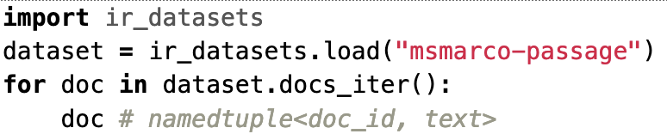
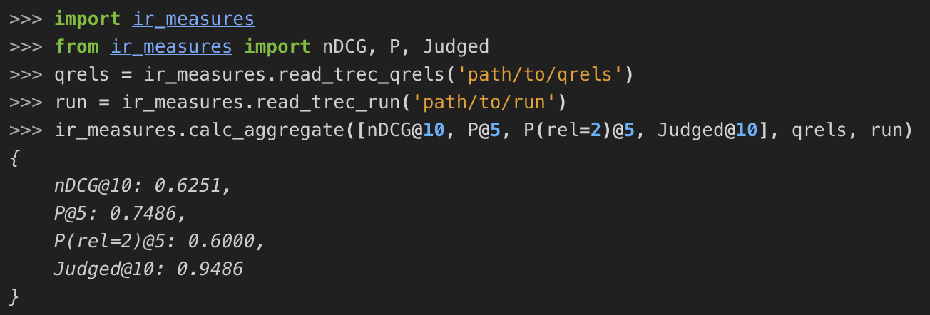
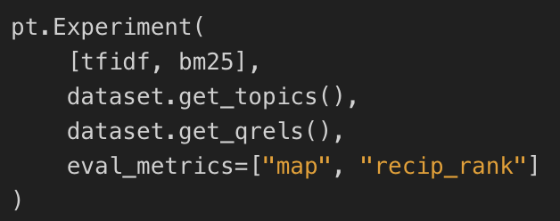
Resources
ir-datasets: https://ir-datasets.com/
Loading and working with datasets
ir-measures: https://ir-measur.es/
Evaluation of datasets
PyTerrier: https://pyterrier.readthedocs.io/
Putting it all togehter

Slide 43
Any Questions?

Slide 44
LSR Framework
SIGIR 2025 Tutorial
presented by Andrew Yates

Slide 45
Schedule
Introduction
Datasets and Evaluation
LSR Framework ← now
Training LSR
Modalities
English Text
Multilingual Text
Multimodal Data
Indexing & efficiency
Hybrid dense-sparse retrieval
Conclusion

Slide 46
Learned Sparse Retrieval Framework
Ingredients
Sparse Encoder
Sparse Regularizer
Supervision
Predicts term weights
(MLP, MLM, etc)
Limits non-zero weights
(FLOPs, TopK, etc)
Training
(negatives, distillation, etc)
A Unified Framework for Learned Sparse Retrieval. Nguyen, MacAvaney, Yates. ECIR 2023.

Slide 47
Learned Sparse Retrieval Framework
Ingredients
Sparse Encoder
Sparse Regularizer
Supervision
Predicts term weights
(MLP, MLM, etc)
Limits non-zero weights
(FLOPs, TopK, etc)
Training
(negatives, distillation, etc)
A Unified Framework for Learned Sparse Retrieval. Nguyen, MacAvaney, Yates. ECIR 2023.

Slide 48
Binary Encoder
“padua best dishes”
Binary Encoder

Slide 49
Binary Encoder
[CLS]
padua
best
dishes
[SEP]
Tokenizer
“padua best dishes”
Binary Encoder

Slide 50
Binary Encoder
dishes
best
padua
0
0
1
1
0
…
1
[CLS]
padua
best
dishes
[SEP]
Tokenizer
“padua best dishes”
Binary Encoder

Slide 51
Binary Encoder
dishes
best
padua
0
0
1
1
0
…
1
expansion
[CLS]
padua
best
dishes
[SEP]
weighting
Tokenizer
“padua best dishes”
Binary Encoder

Slide 52
Binary Encoder
dishes
best
padua
0
0
1
1
0
…
1
All terms are treated equally
“best dishes of padua”
expansion
[CLS]
padua
best
dishes
[SEP]
weighting
Tokenizer
“padua best dishes”
Binary Encoder

Slide 53
Inference-Free Encoders
dishes
best
padua
0
0
1.5
1.3
0
…
1.4
expansion
[CLS]
padua
best
dishes
[SEP]
weighting
Tokenizer
“padua best dishes”
IDF Encoder

Slide 54

Inference-Free Encoders
dishes
best
padua
0
0
1.5
1.3
0
…
1.4
expansion
Weighting based on collection statistics
(not based on semantic relevance)
[CLS]
padua
best
dishes
[SEP]
weighting
Tokenizer
Replace binary encoder with IDF encoder.
Towards Competitive Search Relevance For Inference-Free Learned Sparse Retrievers. Geng et al. arXiv 2025.
“padua best dishes”
IDF Encoder

Slide 55
Inference-Free Encoders
dishes
best
padua
0
0
1.5
1.3
0
…
1.4
expansion
Weighting based on collection statistics
(not based on semantic relevance)
[CLS]
padua
best
dishes
[SEP]
weighting
Tokenizer
Replace binary encoder with IDF encoder.
Towards Competitive Search Relevance For Inference-Free Learned Sparse Retrievers. Geng et al. arXiv 2025.
Replace IDF with learned static weights.
Effective Inference-Free Retrieval for Learned Sparse Representations. Nardini et al. SIGIR 2025.
“padua best dishes”
IDF Encoder

Slide 56
Inference-Free Encoders
dishes
best
padua
0
0
1.5
1.3
0
…
1.4
expansion
Weighting based on collection statistics
(not based on semantic relevance)
[CLS]
padua
best
dishes
[SEP]
weighting
Tokenizer
Replace binary encoder with IDF encoder.
Towards Competitive Search Relevance For Inference-Free Learned Sparse Retrievers. Geng et al. arXiv 2025.
Replace IDF with learned static weights.
Effective Inference-Free Retrieval for Learned Sparse Representations. Nardini et al. SIGIR 2025.
BM25 is also as an inference-free encoder.
“padua best dishes”
IDF Encoder

Slide 57
MLP Encoder
[CLS]
padua
best
dishes
[SEP]
Tokenizer
“padua best dishes”
MLP Encoder

Slide 58
MLP Encoder
Transformer Layers
[CLS]
padua
best
dishes
[SEP]
Tokenizer
“padua best dishes”
MLP Encoder

Slide 59
MLP Encoder
MLP
Transformer Layers
[CLS]
padua
best
dishes
[SEP]
Tokenizer
“padua best dishes”
MLP Encoder

Slide 60
MLP Encoder
dishes
best
padua
0
0
0.8
1.4
0
…
1.5
ReLU + Log1P
MLP
Transformer Layers
[CLS]
padua
best
dishes
[SEP]
Tokenizer
“padua best dishes”
MLP Encoder

Slide 61
MLP Encoder
dishes
best
padua
0
0
0.8
1.4
0
…
1.5
Learning to score input terms by an MLP regression head
ReLU + Log1P
MLP
Transformer Layers
expansion
weighting
[CLS]
padua
best
dishes
[SEP]
Tokenizer
“padua best dishes”
MLP Encoder
Notes:
TFC2: The increase in the retrieval score due to an increase in TF should be smaller for larger TFs.

Slide 62
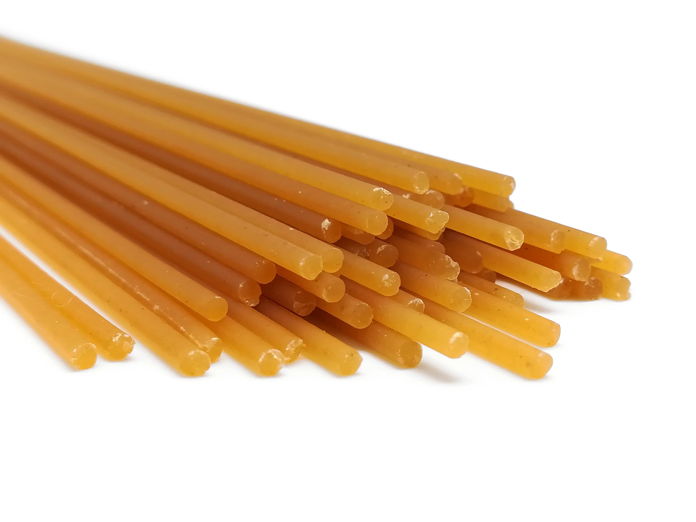
MLP Encoder
dishes
best
padua
0
0
0.8
1.4
0
…
1.5
Learning to score input terms by an MLP regression head
ReLU + Log1P
MLP
Transformer Layers
expansion
Cannot handle term mismatch
(e.g., “best dishes” vs “bigoli”)
weighting
[CLS]
padua
best
dishes
[SEP]
Tokenizer
“padua best dishes”
MLP Encoder
Notes:
TFC2: The increase in the retrieval score due to an increase in TF should be smaller for larger TFs.

Slide 63
MLP Encoder + External Expansion
dishes
best
padua
0
0
0.8
1.4
0
…
1.5
ReLU + Log1P
MLP
Transformer Layers
expansion
weighting
[CLS]
padua
best
dishes
[SEP]
Tokenizer
“padua best dishes”
Expansion Module (e.g., Doc2Query)
MLP Encoder

Slide 64
MLP Encoder + External Expansion
DocT5Query
Generate queries given a document
Document

Slide 65
MLP Encoder + External Expansion
DocT5Query
Generate queries given a document
Document
Predicted Queries

Slide 66
MLP Encoder + External Expansion
DocT5Query
Generate queries given a document
Document
Predicted Queries
MLP Sparse Encoder

Slide 67
MLP Encoder + External Expansion
LLMs
(e.g., GPT)
Prompt LLMs to generate different types of information.
Input
Expansion
MLP Sparse Encoder

Slide 68
MLP Encoder + External Expansion
LLMs
(e.g., GPT)
Prompt LLMs to generate different types of information.
Input
Expansion
MLP Sparse Encoder
Not end-to-end differentiable

Slide 69
MLM Encoder
Transformer Layers
[CLS]
padua
best
dishes
[SEP]
Tokenizer
“padua best dishes”

Slide 70
MLM Encoder
MLM Head
Transformer Layers
[CLS]
padua
best
dishes
[SEP]
Tokenizer
“padua best dishes”

Slide 71
MLM Encoder
…
…
…
…
…
Logits over vocab
MLM Head
Transformer Layers
[CLS]
padua
best
dishes
[SEP]
Tokenizer
“padua best dishes”

Slide 72
MLM Encoder
sparse vector
Column-wise pooling
…
…
…
…
…
Logits over vocab
MLM Head
Transformer Layers
[CLS]
padua
best
dishes
[SEP]
Tokenizer
“padua best dishes”

Slide 73
MLM Encoder
sparse vector
Column-wise pooling
…
…
…
…
…
Logits over vocab
expansion (differentiable)
MLM Head
weighting
Transformer Layers
[CLS]
padua
best
dishes
[SEP]
Tokenizer
“padua best dishes”

Slide 74
MLM Head for Expansion & Weighting
Vocab
Embedding
Table
…
Transformer Layers
[CLS]
padua
best
dishes
[SEP]
“padua best dishes”

Slide 75
MLM Head for Expansion & Weighting
x
padua
Vocab
Embedding
Table
…
padua
Transformer Layers
[CLS]
padua
best
dishes
[SEP]
“padua best dishes”

Slide 76
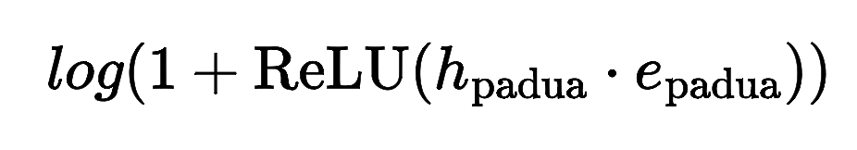
MLM Head for Expansion & Weighting
5.5
padua
Vocab
Embedding
Table
x
Output Sparse Vector
…
Term | Weight
padua | 5.5
padua
Transformer Layers
[CLS]
padua
best
dishes
[SEP]
“padua best dishes”

Slide 77
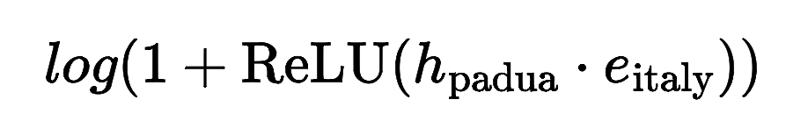
MLM Head for Expansion & Weighting
Vocab
Embedding
Table
3.2
italy
x
Output Sparse Vector
…
Term | Weight
padua | 5.5
italy | 3.2
padua
Transformer Layers
[CLS]
padua
best
dishes
[SEP]
“padua best dishes”

Slide 78
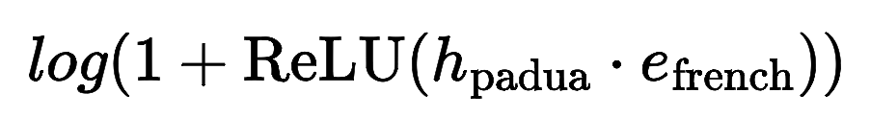
MLM Head for Expansion & Weighting
Vocab
Embedding
Table
0.0
french
x
Output Sparse Vector
…
Term | Weight
padua | 5.5
italy | 3.2
french | 0.0
padua
Transformer Layers
[CLS]
padua
best
dishes
[SEP]
“padua best dishes”

Slide 79
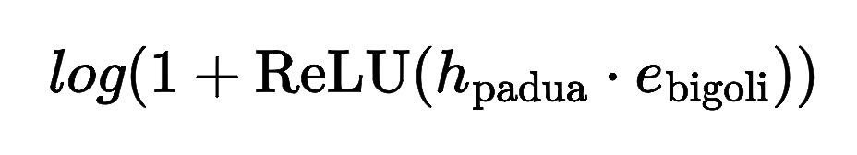
MLM Head for Expansion & Weighting
Vocab
Embedding
Table
Output Sparse Vector
4.1
…
x
bigoli
Term | Weight
padua | 5.5
italy | 3.2
french | 0.0
… | 0.0
bigoli | 4.1
… | …
best
Transformer Layers
[CLS]
padua
best
dishes
[SEP]
“padua best dishes”

Slide 80
MLM Head for Expansion & Weighting
Vocab
Embedding
Table
Output Sparse Vector
4.1
…
x
bigoli
Term | Weight
padua | 5.5
italy | 3.2
french | 0.0
… | 0.0
bigoli | 4.1
… | …
best
Positive
Most of them are zeros
Transformer Layers
[CLS]
padua
best
dishes
[SEP]
“padua best dishes”

Slide 81
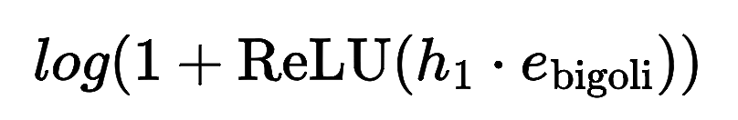
MLM Head with Multimodal Inputs
4.1
bigoli
x
Vocab
Embedding
Table
…
We can compare non-text inputs with an embedding table in the same way.
Image Patches
Output Sparse Vector
Term | Weight
bigoli | 4.1
… | …
… | …
Transformer Layers
Vision Model
(e.g., CLIP or Qwen-VL)
Input:
Image

Slide 82
Summary of Sparse Encoders
Binary Encoder: binary weights, no expansion.
Inference-Free Encoders: IDF weights, no expansion.
MLP Encoder: weighting by a transformer model, no expansion.
MLP Encoder with External Expansion: external expansion.
MLM: end-to-end weighting and expansion by transformer-based MLM.
Static weighting
Learning from
data

Slide 83
Dual Sparse Encoder
x
Shared Encoder
(e.g., MLP, MLM)
Query
Doc

Slide 84
Dual Sparse Encoder
x
x
Shared Encoder
Query Encoder
Document Encoder
(e.g., MLP, MLM)
(e.g, MLP)
(e.g, MLM)
Query
Doc
Query
Doc

Slide 85
Learned Sparse Retrieval Framework
Ingredients
Sparse Encoder
Sparse Regularizer
Supervision
Predicts term weights
(MLP, MLM, etc)
Limits non-zero weights
(FLOPs, TopK, etc)
Provides supervision
(negatives, distillation, etc).

Slide 86
Sparse Regularizers
Exact Sparsity Measure: L₀
0 | 0.5 | 0 | 1.5 | 0 | 8.3 | 0 | 0

Slide 87
Sparse Regularizers
Exact Sparsity Measure: L₀
0 | 0.5 | 0 | 1.5 | 0 | 8.3 | 0 | 0
L₀
Sum
0 | 1 | 0 | 1 | 0 | 1 | 0 | 0
3
Count of non-zero dimensions, not directly differentiable!

Slide 88
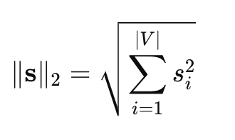
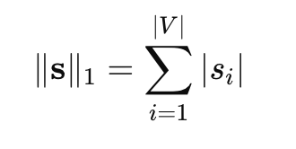
Sparse Regularizers
L₁, L₂:

Slide 89
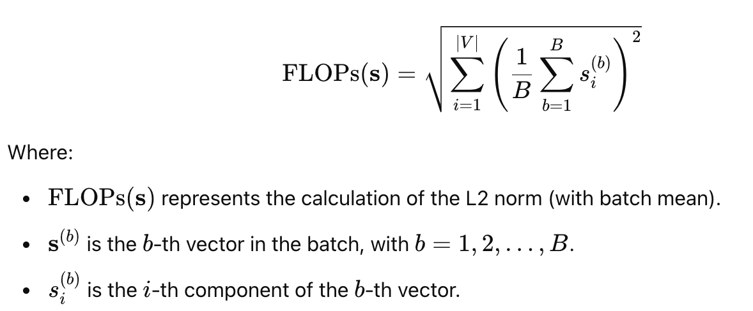
Sparse Regularizers
L₁, L₂:
FLOPs:

Slide 90
Sparse Regularizers
L₁, L₂:
FLOPs:
Top-K: Select top k dimensions with highest values

Slide 91
Sparse Regularizers
L₁, L₂:
FLOPs:
Top-K: Select top k dimensions with highest values
Side effect:
Encourage term weights to be small

Slide 92
Questions?
Next
Ingredients
Sparse Encoder
Sparse Regularizer
Supervision
Predicts term weights
(MLP, MLM, etc)
Limits non-zero weights
(FLOPs, TopK, etc)
Training
(negatives, distillation, etc)

Slide 93
Training
SIGIR 2025 Tutorial
presented by Carlos Lassance

Slide 94
Schedule
Introduction
Datasets and Evaluation
LSR Framework
Training LSR ← now
Modalities
English Text
Multilingual Text
Multimodal Data
Indexing & efficiency
Hybrid dense-sparse retrieval
Conclusion

Slide 95
Outline - LSR Training
Supervision
  Introduction
  Losses
Distillation case-studies
  Well behaved model
  Model with high scores
  Model collapse
Initialization of LSR with MLM head
  Pre-initialized MLM head
  Middle training

Slide 96
Supervision
Training Batch
[Query, Doc₁, Doc₂, …, Doc_{k}]
…
…
Negative

Slide 97
Supervision
Training Batch
[Query, Doc₁, Doc₂, …, Doc_{k}]
…
…
Negative
Negative Quality:
BM25
In-Batch Negatives
Mined Hard Negatives

Slide 98
Supervision
Training Batch
[Query, Doc₁, Doc₂, …, Doc_{k}]
…
…
Negative
Negative Quality:
BM25
In-Batch Negatives
Mined Hard Negatives
Negative Quantity:
More is better
Limited by GPU memory

Slide 99
Supervision
S₁
x
Training Batch
Sparse Query Encoder
Sparse Document Encoder
[Query, Doc₁, Doc₂, …, Doc_{k}]
…
…
Negative
Query
Doc₁

Slide 100
Supervision
S₁
S₂
x
x
Training Batch
Sparse Query Encoder
Sparse Document Encoder
[Query, Doc₁, Doc₂, …, Doc_{k}]
…
…
Negative
Query
Doc₁
Doc₂

Slide 101
Supervision
S₁
S₂
…
S_{n}
x
x
x
…
Training Batch
Sparse Query Encoder
Sparse Document Encoder
[Query, Doc₁, Doc₂, …, Doc_{k}]
…
…
Negative
Query
Doc₁
Doc₂
…
Doc_{k}

Slide 102
Supervision
L₁ L₂ … L_{k}
S₁
S₂
…
S_{n}
Loss
x
x
x
…
Training Batch
Sparse Query Encoder
Sparse Document Encoder
[Query, Doc₁, Doc₂, …, Doc_{k}]
…
…
Negative
Query
Doc₁
Doc₂
…
Doc_{k}

Slide 103
Supervision
L₁ L₂ … L_{k}
S₁
S₂
…
S_{n}
Loss
x
x
x
…
Training Batch
Sparse Query Encoder
Sparse Document Encoder
[Query, Doc₁, Doc₂, …, Doc_{k}]
…
…
Negative
Query
Doc₁
Doc₂
…
Doc_{k}

Slide 104
Supervision
L₁ L₂ … L_{k}
S₁
S₂
…
S_{n}
Loss
x
x
x
Label and Loss:
…
Training Batch
Sparse Query Encoder
Sparse Document Encoder
[Query, Doc₁, Doc₂, …, Doc_{k}]
…
…
Negative
Query
Doc₁
Doc₂
…
Doc_{k}

Slide 105
Supervision
1 0 … 0
S₁
S₂
…
S_{n}
Loss
x
x
x
Label and Loss:
No Distillation
  Dataset provided Labels
  (Usually Binary)
  Any Classification/Ranking Loss
  (e.g., Cross Entropy)
…
Training Batch
Sparse Query Encoder
Sparse Document Encoder
[Query, Doc₁, Doc₂, …, Doc_{k}]
…
…
Negative
Query
Doc₁
Doc₂
…
Doc_{k}

Slide 106
Supervision
T₁ T₂ … T_{k}
S₁
S₂
…
S_{n}
Loss
x
x
x
Label and Loss:
No Distillation
  Dataset provided Labels
  (Usually Binary)
  Any Classification/Ranking Loss
  (e.g., Cross Entropy)
Distillation
  Teacher scores as labels
  (e.g., Cross-Encoder)
  Loss:
    MSE
    MarginMSE
    KL
…
Training Batch
Sparse Query Encoder
Sparse Document Encoder
[Query, Doc₁, Doc₂, …, Doc_{k}]
…
…
Negative
Query
Doc₁
Doc₂
…
Doc_{k}

Slide 107

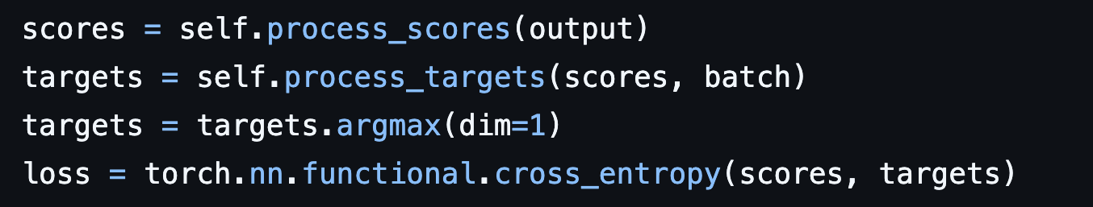
Supervision - Cross Entropy / InfoNCE
https://github.com/webis-de/lightning-ir/

Slide 108
Supervision - Cross Entropy / InfoNCE
Scores are logits for a classifier
https://github.com/webis-de/lightning-ir/

Slide 109
Supervision - Cross Entropy / InfoNCE
Scores are logits for a classifier
Scales to many negatives
https://github.com/webis-de/lightning-ir/

Slide 110
Supervision - Cross Entropy / InfoNCE
Scores are logits for a classifier
Scales to many negatives
Does not differentiate between levels of negative
https://github.com/webis-de/lightning-ir/

Slide 111
Supervision - Cross Entropy / InfoNCE
Does not differentiate between levels of negative
Q: What city should I visit in Italy?
P: Padua is a city in Italy, famous for the Giro del Venetto…

Slide 112
Supervision - Cross Entropy / InfoNCE
Does not differentiate between levels of negative
Q: What city should I visit in Italy?
P: Padua is a city in Italy, famous for the Giro del Venetto…
N1: Paris is the capital of France, known for the…

Slide 113
Supervision - Cross Entropy / InfoNCE
Does not differentiate between levels of negative
Q: What city should I visit in Italy?
P: Padua is a city in Italy, famous for the Giro del Venetto…
N1: Paris is the capital of France, known for the…
N2: Rome is the capital of Italy.

Slide 114
Supervision - Cross Entropy / InfoNCE
Does not differentiate between levels of negative
Q: What city should I visit in Italy?
P: Padua is a city in Italy, famous for the Giro del Venetto…
N1: Paris is the capital of France, known for the…
N2: Rome is the capital of Italy.
N1 and N2 are not equal

Slide 115
Supervision - Cross Entropy / InfoNCE
Does not differentiate between levels of negative
Q: What city should I visit in Italy?
P: Padua is a city in Italy, famous for the Giro del Venetto…
N1: Paris is the capital of France, known for the…
N2: Rome is the capital of Italy.
N1 and N2 are not equal
How to decide relevance between P and N2?

Slide 116
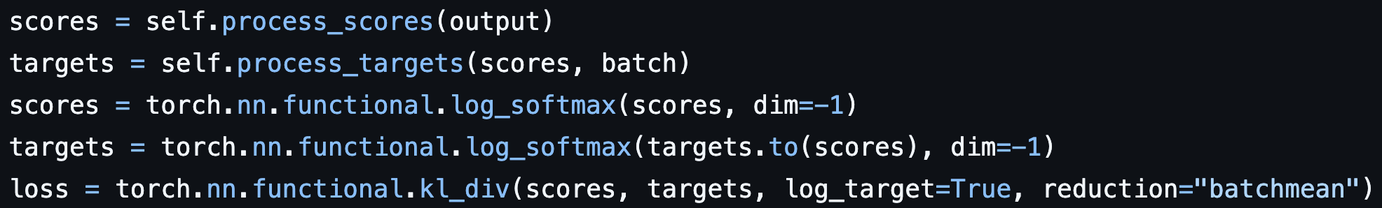
Supervision - KL-Divergence
https://github.com/webis-de/lightning-ir/

Slide 117
Supervision - KL-Divergence
Uses precomputed scores to define relevancy
Kl-Divergence and Cross entropy are highly related
Needs to convert scores to a probability distribution
(here with softmax)
https://github.com/webis-de/lightning-ir/

Slide 118
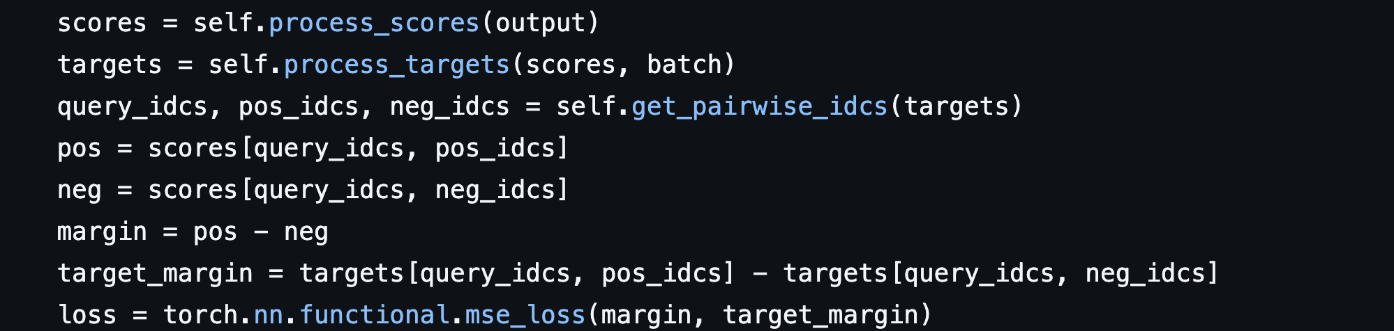
Supervision - Margin-MSE
https://github.com/webis-de/lightning-ir/

Slide 119
Supervision - Margin-MSE
Uses precomputed scores to define relevancy
Does not require converting to a probability distribution, only that margins are similar
Requires models to have similar scoring ranges
https://github.com/webis-de/lightning-ir/

Slide 120
Supervision - Margin-MSE
Q: What city should I visit in Italy?
P: Padua is a city in Italy, famous for the Giro del Venetto…
N1: Paris is the capital of France, known for the…
N2: Rome is the capital of Italy.
https://github.com/webis-de/lightning-ir/

Slide 121
Outline - LSR Training
Supervision
  Introduction
  Losses
Distillation case-studies
  Well behaved model
  Model with high scores
  Model collapse
Initialization of LSR with MLM head
  Pre-initialized MLM head
  Middle training

Slide 122
Distillation
Margin-MSE
KlDiv with softmax distribution

Slide 123
Distillation
Original scores: 25, 10, 5, 2
Margin-MSE
KlDiv with softmax distribution
15, 20, 23
1, 0, 0, 0

Slide 124
Distillation
Original scores: 25, 10, 5, 2
LSR model performs well on the query
LSR scores: 20, 5, 0, 0
Margin-MSE
KlDiv with softmax distribution
15, 20, 23
1, 0, 0, 0
15, 20, 20
1, 0, 0, 0

Slide 125
Distillation
Original scores: 25, 10, 5, 2
LSR model performs well on the query
LSR scores: 20, 5, 0, 0
Margin-MSE
KlDiv with softmax distribution
15, 20, 23
1, 0, 0, 0
15, 20, 20
1, 0, 0, 0
0 + 0 + 9 = 9
0

Slide 126
Distillation
Original scores: 25, 10, 5, 2
LSR model performs well on the query
LSR scores: 20, 5, 0, 0
Margin-MSE
KlDiv with softmax distribution
15, 20, 23
1, 0, 0, 0
15, 20, 20
1, 0, 0, 0
0 + 0 + 9 = 9
0
Only way to achieve 0 loss is expansion

Slide 127
Distillation
Original scores: 25, 10, 5, 2
LSR model has high scores
LSR scores: 1000, 900, 0, 0
Margin-MSE
KlDiv with softmax distribution
15, 20, 23
1, 0, 0, 0
10^2, 10^3, 10^3
1, 0, 0, 0
10^4 + 10^6 + 10^6 ≈ 10^6
0

Slide 128
Distillation
Original scores: 25, 10, 5, 2
LSR model has high scores
LSR scores: 1000, 900, 0, 0
Margin-MSE
KlDiv with softmax distribution
15, 20, 23
1, 0, 0, 0
10^2, 10^3, 10^3
1, 0, 0, 0
10^4 + 10^6 + 10^6 ≈ 10^6
0
High initial scores may break Margin-MSE

Slide 129
Distillation
Original scores: 25, 10, 5, 2
LSR model has high scores
LSR scores: 1000, 900, 0, 0
Margin-MSE
KlDiv with softmax distribution
15, 20, 23
1, 0, 0, 0
10^2, 10^3, 10^3
1, 0, 0, 0
10^4 + 10^6 + 10^6 ≈ 10^6
0
High initial scores may break Margin-MSE
On the other hand KL-div seems to not care

Slide 130
Distillation
Original scores: 25, 10, 5, 2
LSR model has high scores and ranks the positive 2nd
LSR scores: 1000, 1003, 0, 0
Margin-MSE
KlDiv with softmax distribution
15, 20, 23
1, 0, 0, 0
2, 10^3, 10^3

Slide 131
Distillation
Original scores: 25, 10, 5, 2
LSR model has high scores and ranks the positive 2nd
LSR scores: 1000, 1003, 0, 0
Margin-MSE
KlDiv with softmax distribution
15, 20, 23
1, 0, 0, 0
2, 10^3, 10^3
0.05, 0.95, 0, 0

Slide 132
Distillation
Original scores: 25, 10, 5, 2
LSR model has high scores and ranks the positive 2nd
LSR scores: 1000, 1003, 0, 0
Margin-MSE
KlDiv with softmax distribution
15, 20, 23
1, 0, 0, 0
2, 10^3, 10^3
0.05, 0.95, 0, 0
10^4, 10^6, 10^6 = 10^6
3.52

Slide 133
Distillation
Original scores: 25, 10, 5, 2
LSR model has high scores and ranks the positive 2nd
LSR scores: 1000, 1003, 0, 0
Margin-MSE
KlDiv with softmax distribution
15, 20, 23
1, 0, 0, 0
2, 10^3, 10^3
0.05, 0.95, 0, 0
10^4, 10^6, 10^6 = 10^6
3.52
High sensitivity to positive

Slide 134
Distillation
Original scores: 25, 10, 5, 2
What happens to a collapsed model?
LSR scores: 1000, 1003, 0, 0
Collapsed model: 0, 0, 0, 0
Margin-MSE
KlDiv with softmax distribution
KlDiv with softmax distribution
15, 20, 23
1, 0, 0, 0
1, 0, 0, 0
2, 10^3, 10^3
0.05, 0.95, 0, 0
0.25, 0.25, 0.25, 0.25
10^4, 10^6, 10^6 = 10^6
3.52
3.27

Slide 135
Distillation
Original scores: 25, 10, 5, 2
What happens to a collapsed model?
LSR scores: 1000, 1003, 0, 0
Collapsed model: 0, 0, 0, 0
Margin-MSE
KlDiv with softmax distribution
KlDiv with softmax distribution
15, 20, 23
1, 0, 0, 0
1, 0, 0, 0
2, 10^3, 10^3
0.05, 0.95, 0, 0
0.25, 0.25, 0.25, 0.25
10^4, 10^6, 10^6 = 10^6
3.52
3.27
Collapsed model has lower loss than a decent model

Slide 136
Distillation
Original scores: 25, 10, 5, 2
What happens to a collapsed model?
LSR scores: 1000, 1003, 0, 0
Collapsed model: 0, 0, 0, 0
Margin-MSE
KlDiv with softmax distribution
Margin-MSE all 0’s
15, 20, 23
1, 0, 0, 0
15, 20, 23
2, 10^3, 10^3
0.05, 0.95, 0, 0
10, 5, 2
100, 25, 4 = 129 < 10^6
10^4, 10^6, 10^6 = 10^6
3.52
Collapsed model has lower loss than a decent model

Slide 137
Training collapse
Training collapses when any input -> only zeros
Might happen due to high scores
  Loss of all zeros < Loss of a good model
Or in the case of overregularization
  Loss of all zeros < Loss of any nonzero model

Slide 138
LSR Distillation - Conclusion
While they work for LSR, there’s a few caveats
MSE-Margin
  May force less sparse LSR
KL-Div
  Training is prone to collapse
  May be less representative of first-stage training
Combining both can lead to a good trade-off (e.g. SPLADE-v3)
SPLADE-v3: New baselines for SPLADE
Lassance, Dejean, Formal and Clichant. Arxiv. 2024 https://arxiv.org/abs/2403.06789.

Slide 139
Outline - LSR Training
Supervision
  Introduction
  Losses
Distillation case-studies
  Well behaved model
  Model with high scores
  Model collapse
Initialization of LSR with MLM head
  Pre-initialized MLM head
  Middle training

Slide 140
Pre-initialized MLM Head
x
cherry
Vocab
Embedding
Table
…
[MASK]
Transformer Layers
[CLS]
tokyo
[MASK]
blossom
[SEP]
“tokyo [MASK] blossom”
“tokyo cherry blossom”

Slide 141
Pre-initialized MLM Head
x
cherry
Vocab
Embedding
Table
Output before softmax
…
Term | Weight
[MASK] | 3.5
japan | 3.2
cherry | 4.7
. | 3.0
sakura | 4.1
! | 1.0
[MASK]
Transformer Layers
[CLS]
tokyo
[MASK]
blossom
[SEP]
“tokyo [MASK] blossom”
“tokyo cherry blossom”

Slide 142
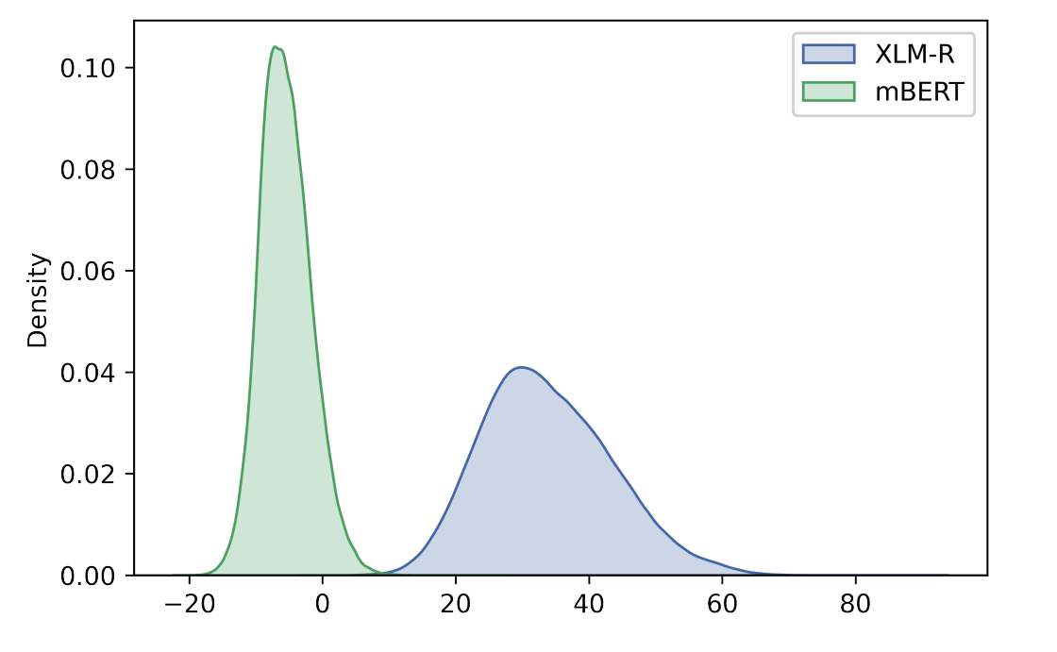
When initialization causes problems - SPLADE-X
LSR model has high scores
MLM score
Learning a Sparse Representation Model for Neural CLIR.
Nair, Yang, Lawrie, Mayfield and Oard. DESIRES. 2022.

Slide 143
When initialization causes problems - SPLADE-X
We will talk more about these models in multilingual!
LSR model has high scores
MLM score
Learning a Sparse Representation Model for Neural CLIR.
Nair, Yang, Lawrie, Mayfield and Oard. DESIRES. 2022.

Slide 144
Middle training - MLM + Flops
Integrate FLOPS regularization into the pretraining
  “Pushing the score mass to the left in the previous figure”
Leads to a model that is easier to train
  LSR models are sparser and collapse less
  Actually improves dense models as well
Also works if pretraining a model from scratch
An efficiency study for SPLADE models. Lassance and Clinchant. SIGIR 2022
An Experimental Study on Pretraining Transformers from Scratch for IR. Lassance, Dejean and Clinchant. ECIR 2023

Slide 145
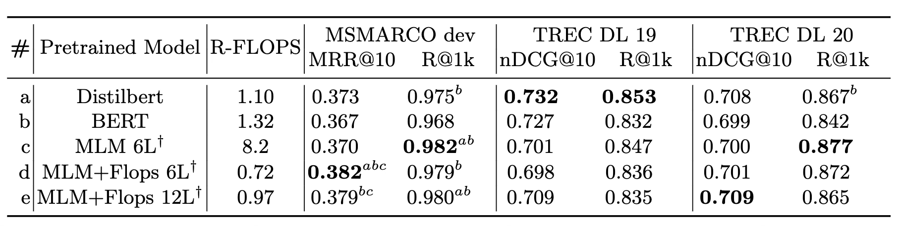
Pretraining with MLM + Flops
An Experimental Study on Pretraining Transformers from Scratch for IR. Lassance, Dejean and Clinchant. ECIR 2023

Slide 146
Middle training - BLADE
We will talk more about these models in multilingual!
Cross-lingual retrieval, bilingual system
  English queries, passages in other languages
Changes MLM encoder tokens filtering
  Bi-lingual model, only “English” and “target” tokens are used
Adds MLM and parallel pretraining
  (Sort of) Fix the MLM initialization problem from before
  Trains with comparable passages in Wikipedia
BLADE: combining vocabulary pruning and intermediate pretraining for scaleable neural CLIR Nair, Yang, Lawrie, Mayfield and Oard. SIGIR. 2023.

Slide 147
Conclusion
Models may be initially easier to train
  MLM is closer to LSR than to dense retrieval
LSR training can be finicky
  MLP-encoder heavily depends on exact match
  MLM-encoder can collapse / lead to over-expansion (more on that on multimodal!)
Interactions with distillation are under-studied
  Margin-MSE needs requires over-expansion
  KL-Div may not be ideal for a more general first stage

Slide 148

Questions

Slide 149
Modalities: Text LSR
SIGIR 2025 Tutorial
Siddharth Singh
Notes:
Ok, cominciamo!

Slide 150
Schedule
Introduction
Datasets and Evaluation
LSR Framework
Training LSR
Modalities
Text ← Now
Multilingual Text
Multimodal Data
Indexing & efficiency
Hybrid dense-sparse retrieval
Conclusion
Notes:
To recap our schedule, the infamously notorious Sean MacAvaney hooked us with a gripping introduction to LSR. He who shall not be named has shown us a very nice three-pronged framework for analyzing LSR models, and talked about different types of encoders.
And the legendary Dr. Lassance has shown us how to get started training LSR models.
We’re now going to switch gears a bit and talk about what retrieval modalities we can use LSR for. This is a vibrant area of focus with a lot going on, and my section today is going to focus on LSR for monolingual text retrieval. As much I’d like to do Italian, our guinea pig language today will be English. For the Anglophobic among you, Eugene will thankfully adding some linguistic diversity in the next section.
Since we’re talking about actual models today, I’ll be doing some switching between higher level ideas and some pretty technical descriptions. So, please don’t hesitate to ask for clarification.

Slide 151
The Most Important Slide
How do we output a sparse vector with weighted, non-negative dimensions?
What parts of the LSR framework matter to get the right terms and the right weights?
Hint: Mostly the encoder!
…and what aspects of the text retrieval setup affect LSR performance?
Hint: Mostly how we encode the query side or the document side - or both!
Notes:
The first is our overarching goal: we to input some information to our LSR system, and output a representation vector with weighted, non-negative dimensions.
The second point is a question: what parts of the LSR Framework will help us make sure we get the right terms and the right weighting for these terms. You guys have seen that the framework consists of a sparse encoder, a sparse regularizer, and the right kind of supervision.
What I’d really like to communicate today is that good expansion and weighting are really important, and are mostly dependent on what type of encoder we choose, though training and supervision are of course important.
The final point is another question: having chosen the right architecture for our LSR system, we want to to think about the particularities of the text retrieval task. We want to know what aspects of LSR system design most affect performance. And what I’d really like to communicate about this is: this really has to do with how we use our encoder to encode either the query side, document side, or both.
We’ve also put together a really fun, interactive demo that synthesizes these concepts. So I urge you guys to mess around with it during the coffee break!

Slide 152
Roadmap
Background
Architectures
Results
Notes:
Presentation-wise, I’ve mapped these three points to three subsections. We’ll start out by talking about some key concepts and landmarks in the development of Text LSR systems.
We’ll then talk about a number of contemporary LSR systems, while comparing and contrasting their architectures and approaches.
Finally, we’ll talk about how these approaches impact retrieval performance on well-known benchmarks. And we’ll briefly discuss some directions of interest in Text LSR research.

Slide 153
Background
Notes:
So let’s start with some background!

Slide 154
Following Up
“How do we output a sparse vector with weighted, non-negative dimensions?”
Do these dimensions need to correspond to words?
Let’s look at one of the first LSR systems.
What made this method unique?
Notes:
I’d like to follow up on our first key idea. How do we output a sparse vector with weighted, non-negative dimensions?
As many of you are now aware, most LSR systems have these dimensions correspond to words in natural language. I have a thought-provoking question for you guys.
Do these dimensions actually need to correspond to words in natural language?
If I can get a show of hands: who thinks they do? Who thinks they don’t?
If you think they don’t, I suppose you are an original thinker. In fact, what could be considered the first LSR system did NOT use words as dimensions in its sparse vector.
Let’s take a look, and think about what makes our system important in the LSR lineage.

Slide 155
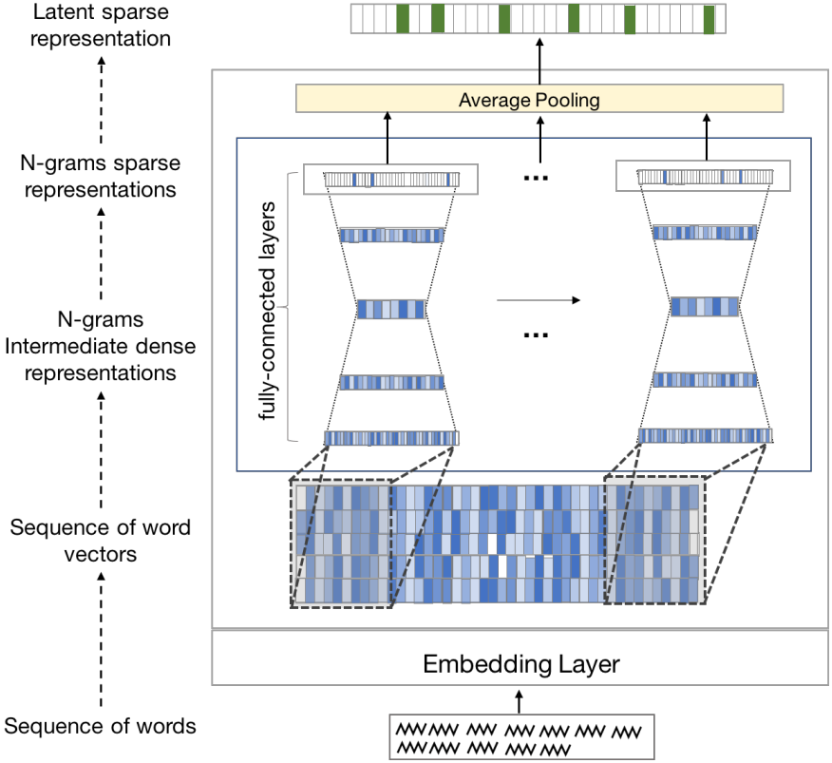
Standalone Neural Ranking Model (SNRM)
Approach
  Windows of static embeddings
  N-grams to sparse vector
  (similar to MLM head)
Sparse vector is not grounded (latent)
From Neural Re-Ranking to Neural Ranking: Learning a Sparse Representation for Inverted Indexing. Zamani, Dehghani, Croft, Learned-Miller, Kamps. CIKM 2018
Notes:
The model in question is called “Standalone Neural Ranking Model” or SNRM.
Beyond being a first in LSR, it's notable in that it’s NOT a Transformer-based architecture.
Instead, It uses a feedforward neural network to process text by first looking at ngrams.
For each ngram, the model grabs the pre-learned word embeddings for each word in that sequence from its embedding layer.
These individual word vectors are then concatenated together to form one larger vector representing that specific ngram.
This concatenated vector is then fed through the feedforward neural network itself.
This network first compresses the information and then expands it into a high-dimensional, but sparse, vector.
This gives us a sparse representation for that single ngram.
To get the representation for the whole document or query, SNRM simply averages the sparse vectors from all the ngrams within it.
The key output is this final high-dimensional sparse vector.
Each dimension in this vector space is called by them as a 'latent term' – it represents some learned semantic concept rather than just a word-token.
These latent terms are sparse enough that SNRM can build our efficient inverted index over them.

Slide 156
Standalone Neural Ranking Model (SNRM)
Approach
  Windows of static embeddings
  N-grams to sparse vector
  (similar to MLM head)
Sparse vector is not grounded (latent)
Related work using latent vectors:
KALE: Using a K-Sparse Projector for Lexical Expansion.
Borges, Martins, Callan. ICTIR 2023.
Zamani et al. (See Slide 6)
Notes:
Another similar, notable paper - from a bit later - that explores this idea of using latent or artificial terms for efficient retrieval is KALE.
KALE takes a different approach starting from dense vectors, specifically the output from a DistilBERT language model.
It uses a simple projector applied to these dense vectors, followed by a TopK operation to generate sparse representations.
These sparse vectors essentially create terms over a new vocabulary space – these artificial terms not found in the original text. Like SNRM, the benefit is that these artificial terms can then be stored efficiently in standard inverted indices.
At query time, KALE also generates corresponding new query terms to be searched alongside the original lexical terms.
So in sum, SNRM isn’t the only LSR system using latent terms, but is pioneering because it was the first to use a neural base model and we get our inverted index in the end.
It’s also pioneering in that it uses a type of expansion, in that we are activating related terms beyond exact matches.
This is the last thing I’ll be saying artificial terms but I think I should add that based on some conversations with people, there seems to be a resurgence of interest in 2025 using latent terms. But that’s a “word on the street” type of thing, nonetheless something to keep in mind as you mingle at SIGIR 2025.

Slide 157
Grounding
But why might (representations or dimensions corresponding to) words be good?
Let’s consider information in the abstract
Humans already have ways of sending and receiving information
Generally speaking, these can include: symbols, images, and words
“Grounding” for the purposes of LSR: exploiting the fundamental units of these structured systems for an inverted index
Notes:
Ok, so the opposite question, why might it be a good idea to have vector dimensions correspond to terms in a vocabulary?
I think one compelling argument is for Grounding. In an abstract sense, we can either have a latent representation of information, or can have it relate to an existing, structured system; like words!
This act of relating the representation to an existing system is called “grounding.”
Now, grounding isn't necessary to use an inverted index, because posting lists could be attached to a latent “dimension 1” rather than the grounded “Padua”, as we just saw.
It also isn't required for a LSR encoder, but the transparency and interpretability are nice.
Though it's a nice to have rather than a strict requirement, performant modern LSR methods are all currently grounded.

Slide 158
Grounding LSR
Interpretable and amenable to SoA neural architectures (Transformer pre- -training is word-based)
Term expansion and weighting easily done with a Transformer backbone
Let’s look at the first Transformer-based method
Notes:
Moreover, grounding in natural language goes hand-in-hand with the Start of the Art in NLP, here meaning Transformer pretraining with either masked language modeling or causal language modeling.
And a transformer backbone has proven to work quite well for weighting and expansion.
As we said, SNRM didn’t use vector dimensions corresponding to subunits of meaning grounded in a larger meaning making system, but set the stage for the “learned sparse” part of LSR. I reiterate that it wasn’t a Transformer-based model.
So, let’s take a look at the first Transformer-based LSR system, and we’ll see from there how the advantages it confers for term weighting and expansion, and later how those advantages have been built upon.

Slide 159
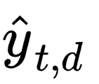
Indexing with DeepCT
Index
New document: "Researchers Researchers … finding finding … that that … cinnamon cinnamon ... reduces ... "
Term Frequencies:
10 0 20 10 90 80 90 100 40 20 0 10 40
Predicted Scores
0.1 0.0 0.2 0.1 0.9 0.8 0.9 1.0 0.4 0.2 0.0 0.1 0.4
D × 1
D × 1
...
D × 1
DeepCT (BERT)
Text d:
Researchers are finding that cinnamon reduces blood sugar levels naturally when taken daily...
Context-Aware Sentence/Passage Term Importance Estimation for First Stage Retrieval. Dai, Callan. arXiv 2019
Notes:
This pioneering Transformer-based model is called the Deep Contextualized Term Weighting Framework, or DeepCT.
DeepCT is not only innovative as a Transformer-based model, but also because it predicts term weights. The training objective here is to predict a contextual importance weight.
To get this objective, the DeepCT model is run over every single passage in the collection. For each term within a passage, it predicts this contextual importance weight – basically, how important that word is in that specific context.
Since standard indexes use integer counts, these predicted weights are then scaled, maybe multiplied by 100 and rounded, to create an integer value we call TF_DeepCT. This new TF_DeepCT value then directly replaces the original term frequency (TF) in the inverted index postings.
Later, Cosimo will talk about inverted indexes designed for LSR that don’t have this integer value requirement.
Because DeepCT is the ancestor of all performant LSR models, we’ll revisit it in just a second when we compare architectures. The point here is that it was the first LSR system to use words and predict term weights. Let’s remember though, that DeepCT doesn’t do expansion on either the query or document side.

Slide 160
2. Architectures
Notes:
Ok, we got a solid background in the conceptual and design history of Text LSR. We covered SNRM, a pioneering pre-transformer model to get a sense of higher-level design choices for LSR, namely the “learned” part of LSR. We also saw that SNRM had a type of term expansion, albeit with latent terms.
We also discussed grounding. We then saw DeepCT, which was groundbreaking in that it gave us the Transformer backbone and showed us how to weight terms contextually therein. But it also raised bigger questions that define today's LSR landscape: what if we don't just weight existing terms contextually, but expand them too? Should we process queries and documents the same way? How do we balance performance with efficiency?
These questions really mark our shift from understanding LSR's foundations to examining how modern systems have answered them. Today's LSR models all build on DeepCT's Transformer approach, but they've pushed far beyond simple term weighting. What we'll see next is how different answers to these core questions - expansion versus weighting, query-side versus document-side processing - have created distinct families of LSR systems. Each family represents a different philosophical approach to our three-pronged framework, and understanding these differences is key to choosing the right system for your needs.
To reiterate, the things to look out for are the encoding strategy (weighting, expansion, or just a binary encoder), and whether this happens on the document, query side, or both.

Slide 161
Transformer-based LSR methods that…
Weight query & document tokens** (no expansion)
Method | Query Encoder | Document Encoder | Supervision: Level
DeepCT | MLP | MLP | Term
uniCOIL | MLP | MLP | Passage
Padua
dishes
best
0
0
0.8
1.4
0
…
1.5
MLP
**SPLADE-Lexical also works like this! Check out the demo :-)
Transformer Layers
[CLS]
Padua
best
dishes
[SEP]
Tokenizer
Context-Aware Sentence/Passage Term Importance Estimation for First Stage Retrieval. Dai, Callan. arXiv 2019
“Padua best dishes”
A Few Brief Notes on DeepImpact, COIL, and a Conceptual Framework for Information Retrieval Techniques. Lin, Ma. arXiv 2021
MLP Encoder
Notes:
We can now revisit DeepCT, and compare it with uniCOIL, another model that only has document and query weighting, without term expansion. In other words, both of these have the same encoding strategy.
Let’s stop for a second and think about the supervision approach - the third pillar of our LSR conceptual framework - used for DeepCT.
DeepCT uses term-level supervision, where it learns weights based on ground truth weight generated by 'query term-recall' - the percentage of relevant queries containing each term for a given document. For each term in a document, DeepCT calculates QTR(t,d) = |Qd,t| / |Qd|, where Qd is the set of all queries for which the document d is judged relevant, and Qd,t is the subset of those queries that contain term t.
The key insight is that terms frequently appearing in queries that successfully retrieve a document are likely more important to that document's meaning. This provides a supervision signal derived from actual search behavior.
For example, if the word "diabetes" appears in 80% of the queries for which a particular medical document was judged relevant, DeepCT would learn to give "diabetes" a high weight in that document.
In contrast, a UniCOIL employs passage-level supervision with document-query relevance pairs. So rather than optimizing individual term weights, UniCOIL trains end-to-end to distinguish relevant passages, and you get term weights emerging naturally from the retrieval objective.
This distinction means DeepCT requires more granular supervision data, while UniCOIL uses simpler relevance judgments that align more directly with the final task - making it generally easier to implement and more effective.
But again, these models are similar in that they only do weighting, and they do it both on the query and document side.

Slide 162
Transformer-based LSR methods that…
Expand document tokens (& weight query tokens)
sparse vector
…
…
…
…
…
Method | Query Encoder | Document Encoder | Supervision: Level
uniCOIL w/ dT5q | MLP | expMLP | Passage
EPIC | MLP | MLM | Passage
MLM Head
Transformer Layers
Expands input text before using an MLP encoder
[CLS]
Padua
best
dishes
[SEP]
Tokenizer
Expansion via Prediction of Importance with Contextualization. MacAvaney, Nardini, Perego, Tonelloto, Goharian, Frieder. SIGIR 2020.
“Padua best dishes”
A Few Brief Notes on DeepImpact, COIL, and a Conceptual Framework for Information Retrieval Techniques. Lin, Ma. arXiv 2021
MLM Encoder
Notes:
Now moving on to models that on the document side expand and weight terms, and on the query side weight terms.
Two well-known models here are EPIC and uniCOIL, uniCOIL with a doc2query variant using T5.
Referring now back to our LSR framework, we can see that these models differ on the choice of sparse encoder for the document side.
While EPIC uses a masked language model, uniCOIL uses an expansion MLP head.
This just adds a preprocessing step to expand the document with relevant terms, which can be used from source external to the model (in this case doc2query with T5).
This output can then be encoded with an MLP to get our weights!

Slide 163
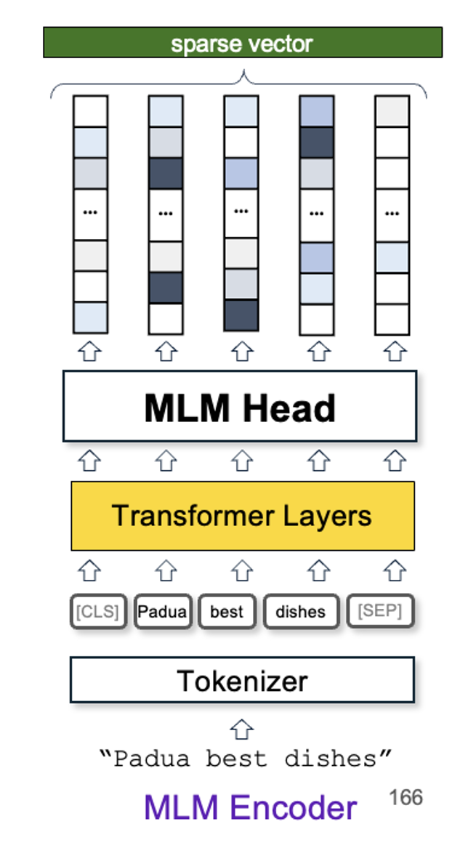
Transformer-based LSR methods that…
Expand document tokens (& only tokenize the query)
**MLM using only BERT’s CLS token
Method | Query Encoder | Document Encoder | Supervision: Level
DeepImpact | Binary | expMLP | Passage
TILDE | Binary | clsMLM** | Term
TILDEv2 | Binary | expMLP | Passage
SPARTA | Binary | MLM | Passage
Learning Passage Impacts for Inverted Indexes. Mallia, Khattab, Tonellotto, Suel. SIGIR 2021
TILDE: Term Independent Likelihood Model for Passage Re-Ranking. Zhuang, Zuccon. SIGIR 2021
Fast Passage Re-Ranking with Contextualized Exact Term Matching and Efficient Passage Expansion. Zhuang, Zuccon. ReNeuIR 2022
SPARTA: Efficient Open-Domain Question Answering via Sparse Transformer Matching Retrieval. Zhao, Lu, Lee. NAACL 2021
Notes:
Next, we see a family of models that don’t do any weighting, and expansion on the document side.
We can conceive of this family of models as a simplification of the previous.
The MLP encoder used for queries on the previous slide are thrown out.
In fact DeepImpact can be viewed as the uniCOILdT5q without a query encoder.
Likewise, SPARTA could be seen as EPIC without a query encoder.
Comparing “within the family” that we see here, TILDE replaces the MLM head in SPARTA using an clsMLM head.
As Andrew - sorry, he who shall not be named - covered, this type of encoder is a simplified version of the MLM encoder that only takes the logits of the [CLS] token as the output vector.

Slide 164
Transformer-based LSR methods that…
Expand query and document tokens
*Negatives & loss
improved
**Additional
datasets
Method | Query Encoder | Document Encoder | Supervision: Level | Supervision: Negatives | Supervision: Labels
SPLADEv2 | MLM | MLM | Passage | BM25 (m) | Human
Distil SPLADE | MLM | MLM | Passage | Hard | Teacher
SPLADE v3* | MLM | MLM | Passage | Hard | Teacher
Mistral** SPLADE | MLM | MLM | Passage | In-batch | Human
SPLADE v2: Sparse Lexical and Expansion Model for Information Retrieval. Formal, Piwowarski, Lassance, Clinchant. arXiv, 2021
SPLADE-v3: New Baselines for SPLADE. Lassance, Dejean, Formal, Clinchant. arXiv, 2024
Mistral-SPLADE: LLMs for Better Learned Sparse Retrieval. Doshi, Kumar, Murthy, Vignesh, Sen. arXiv, 2024
CSPLADE: Learned Sparse Retrieval with Causal Language Models. Zhichao Xu, Aosong Feng, Yijun Tian, Haibo Ding, Lin Lee Cheong. arXiv:2504.10816, 2025.
Scaling Sparse and Dense Retrieval in Decoder-Only LLMs. Hansi Zeng, Julian Killingback, Hamed Zamani. arXiv:2502.15526, 2025.
Notes:
For the final subfamily of models, we have weighting and expansion for both query and document sides.
You can see that these are all SPLADE variants, which some of you are probably familiar with.
Unlike EPIC that just picks the top-k terms, these Splade models use FLOPs regularizer - part of our sparse regularizer toolkit - during training to keep things sparse.
It's a second loss used during training, saying 'let's not get too wild with adding terms.'
Both Splade-max and distilSplade-max use the same MLM setup for queries and documents. What's neat here is they do end-to-end expansion and weighting for everything - no separate steps needed.
The main difference between the two is about training. Regular Splade-max trains with in-batch BM25 negatives, while distilSplade-max uses this distillation approach with hard negatives they've mined.
In a nutshell, they're giving us full expansion and weighting, but making sure we don't pay too heavy a computational price for it by avoiding a separate doc2query step for expansion.
I’d also like to draw your attention the two papers at the bottom. These are CSplade: Learned Sparse Retrieval with Causal Language Models and Scaling Sparse and Dense Retrieval in Decoder-Only LLMs.
These two papers are from 2025, and both are similar to Mistral-Splade in that they use an autoregressive setup for the backbone. We’ll be talking more about other interesting lines of work for LSR at the end of this section.

Slide 165
Method | Query Encoder | Document Encoder | Supervision: Level | Supervision: Negatives | Supervision: Labels
DeepCT | MLP | MLP | Term | - | -
uniCOIL | MLP | MLP | Passage | BM25 (m) | Human
uniCOIL dT5q | MLP | expMLP | Passage | BM25 (m) | Human
EPIC | MLP | MLM | Passage | BM25 | Human
DeepImpact | Binary | expMLP | Passage | BM25 | Human
TILDE | Binary | clsMLM | Term | - | -
TILDE v2 | Binary | expMLP | Passage | BM25 (m) | Human
SPARTA | Binary | MLM | Passage | BM25 | Human
SPLADE variants | MLM | MLM | Passage | BM25 / Hard | Teacher
Notes:
So this is our overall summary of the Transformer models we’ve looked at. Query encoders are one of three options:
(i) binary (ii) MLP or (iii) MLM.
Document encoders have a little more variety, with the expMLP doing term expansion before encoding, and clsMLM using the output logits of the CLS token as our vector.
Supervision here is at the passage level, where the term weights emerge as a byproduct of the model learning to distinguish relevant from non-relevant passages. These models say, 'I need to identify relevant documents,' and the term weights are whatever values help accomplish that goal. The weights arise organically through end-to-end optimization.
The exceptions here are, DeepCT and TILDE, which explicitly supervise those term weights directly. They specifically train to predict 'this term should have X importance' based on predetermined signals like term recall. They're optimizing for getting those specific term weight values right, not just the final retrieval outcome.
In all cases, the supervision labels come from human annotators, with the exception of some SPLADE variants, while negatives for contrastive loss are mined using BM25, in some cases multiple negatives or hard negatives are employed, as again in the case of some SPLADE variants.

Slide 166
3. Results

Slide 167
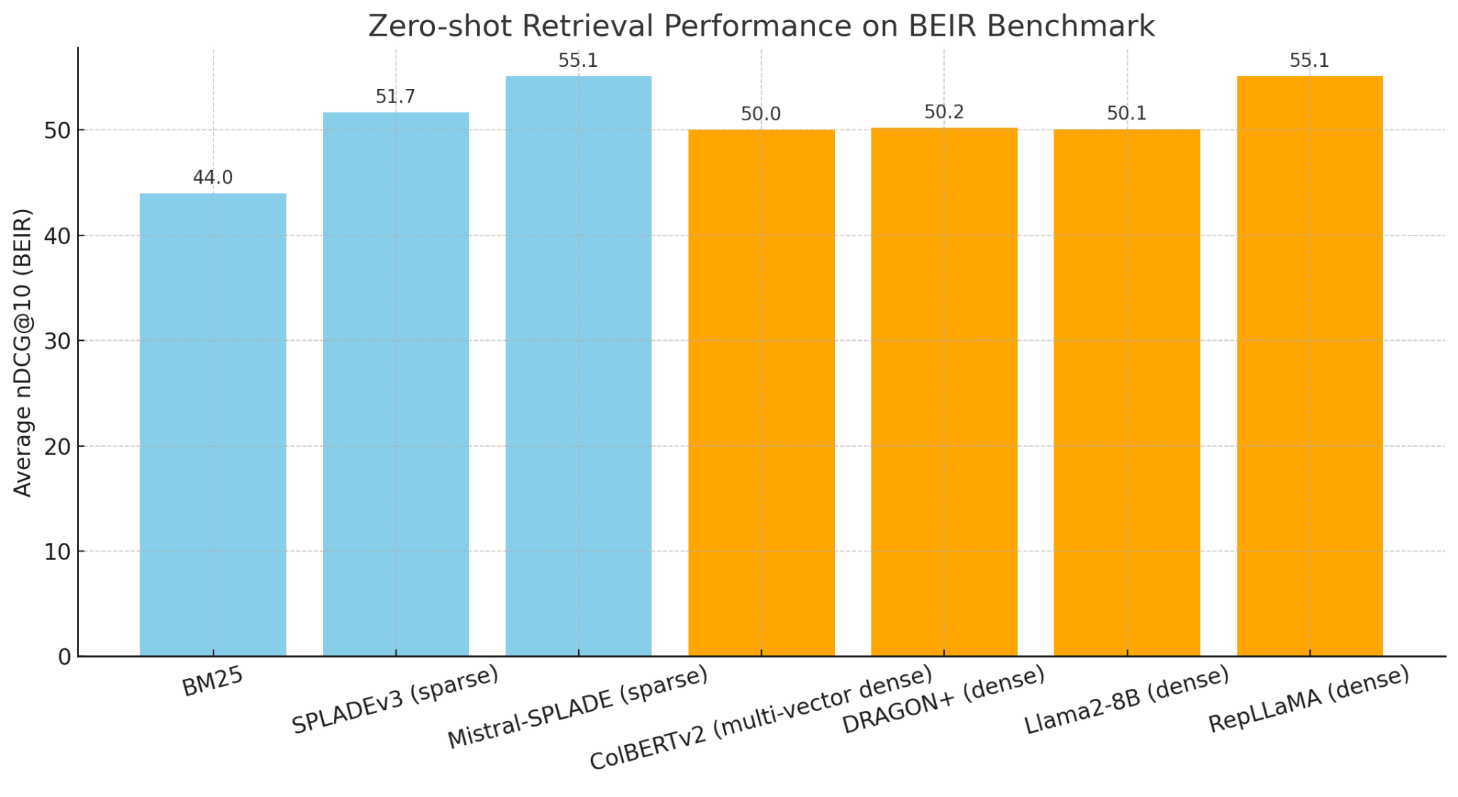
Is LSR competitive?
How to Train Your DRAGON: Diverse Augmentation Towards Generalizable Dense Retrieval. Lin, Chen, Zhao, Yu, King, Li, Ji. arXiv 2024
Making Large Language Models a Better Foundation for Dense Retrieval. Zeng, Zhang, Chen, Yang, Zhao, Lin. arXiv 2024
Fine-Tuning LLaMA for Multi-Stage Text Retrieval. Ma, Luan, Xu, Lin. SIGIR 2024
Notes:
And before we move on. I’ve just added some top 5 scorers from the BEIR leaderboard.
This the average NDCG@10 across 13 out of domain datasets.
And we can see that systems employing LSR come in with pretty competitive performance.
It’s cool that Mistral-SPLADE has the same performance as RepLLaMA.
This is really just me evangelizing to you guys about LSR. I guess that’s my job!

Slide 168
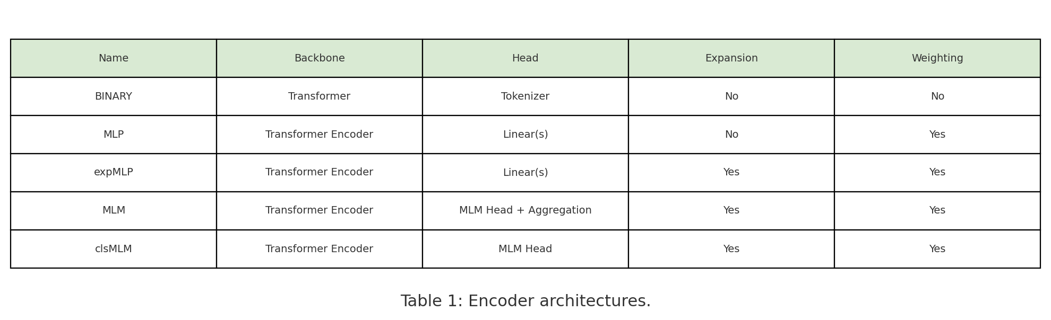
Quick Refresher
‘
A Unified Framework for Learned Sparse Retrieval. Nguyen, MacAvaney, Yates. ECIR 2023
Notes:
Now, to connect the architectures we’ve covered to our results. We’ve seen a number of Transformer-based models, grouped together by their approaches to weighting and expansion. We spent some contrasting between these groupings and within them, and tied everything back to our LSR Framework.
This was an overview to get ourselves acquainted with the essentials and lineage of some of the most popular models for LSR.
Let’s now think how these characteristics impact performance. Are these approaches competitive on benchmark datasets?
Again, we’ll be mostly looking at the effects of weighting vs. expansion on the query vs. document side. This is a summary of only the most important points.
We're going to freeze the setup and make single changes to see the difference in performance. And, there are 11 experiments in total, again controlling for variations in weighting and expansion on the query and document side. I’ve included the five here that really hammer home the main idea, which you are about to see!
And this is just a refresher of the different types of architectures that we looked at.
They all fundamentally use a transformer backbone.
I think the most interesting part of the table are the final two columns, that review whether each encoding strategy weights tokens, expands them, or neither.
Let’s look at some keys findings about this, with the added variable of document vs. query weighting incorporated.

Slide 169
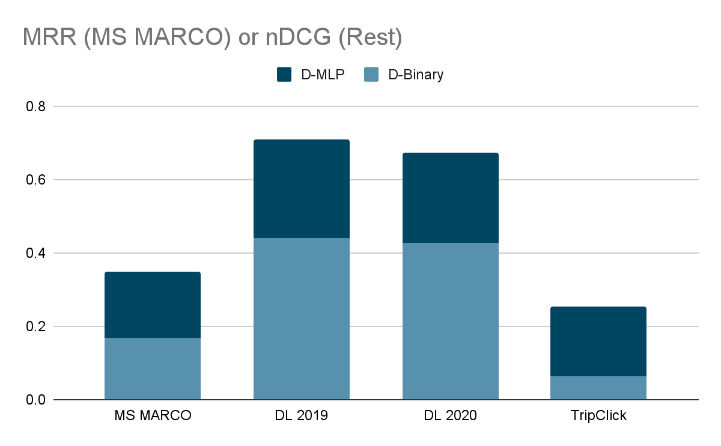
Document weighting is important
(though without, about 10% lower than BM25)
Query
expansion
weighting
Document
No weighting (binary)
Weighting
Notes:
This is our first controlled experiment. We want to see how document weighting using an MLP affects our results, so we have expansion and weighting on the query side, that’s controlled.
Then we introduce a binary baseline. The results are a
Significant increase in performance
Our metric for the first is MSMARCO mean reciprocal rank; for the other 3 it’s NDCG.
We have the performance of a binary document weighting in light blue, and an MLP using weighting in Navy.
We can see considerable improvement across the board when we only use document weighting.
And actually, as we’ll see, document weighting ends up being the crucial determinant of performance because models without this fail on all MSMarco, DL 2019, and DL 2020.
It’s worth noting that even with a binary encoder, results are only about 10% lower than with BM25. This isn’t a great approach, but only using expansion/weighting on the query side does get you somewhere. The model isn’t totally failing with a binary doc encoder, though you’d be a little better off just using BM25.
Curious, let’s look Now at expansion.

Slide 170
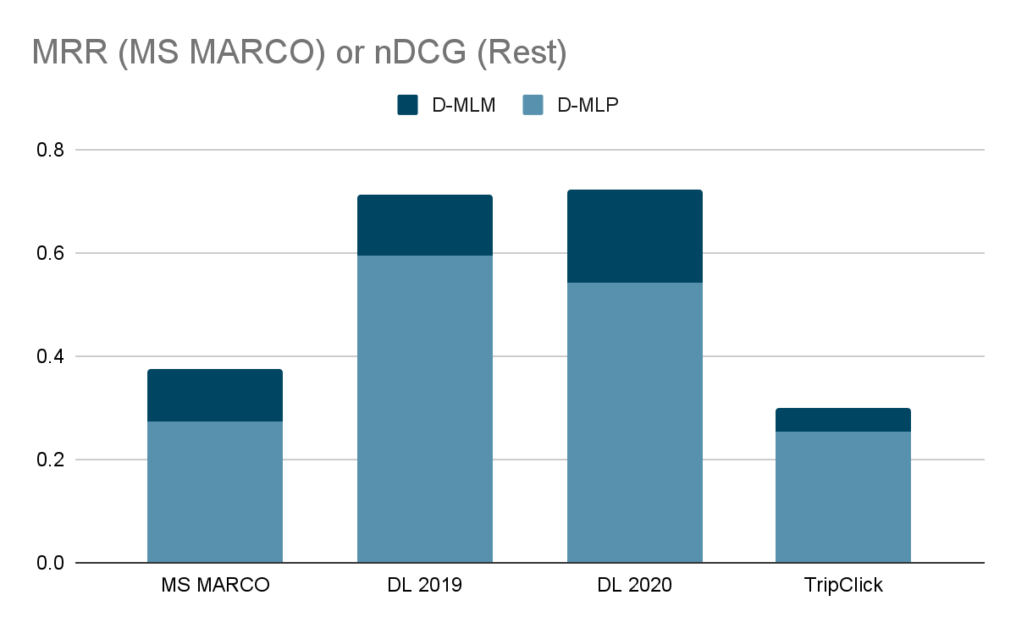
Document expansion helps…
Query
expansion
weighting
Document
Weighting
Weighting + Expansion
Notes:
Here, we are weighting query terms, but not expanding them. On the document side, we are comparing how expansion and weighting improves against just weighting.
We can see here that performance improves across the board, Indicating the importance of document expansion.
And guys, this is probably the biggest takeaway for the rest of this subsection. The second most important slide of the presentation, if you will.

Slide 171
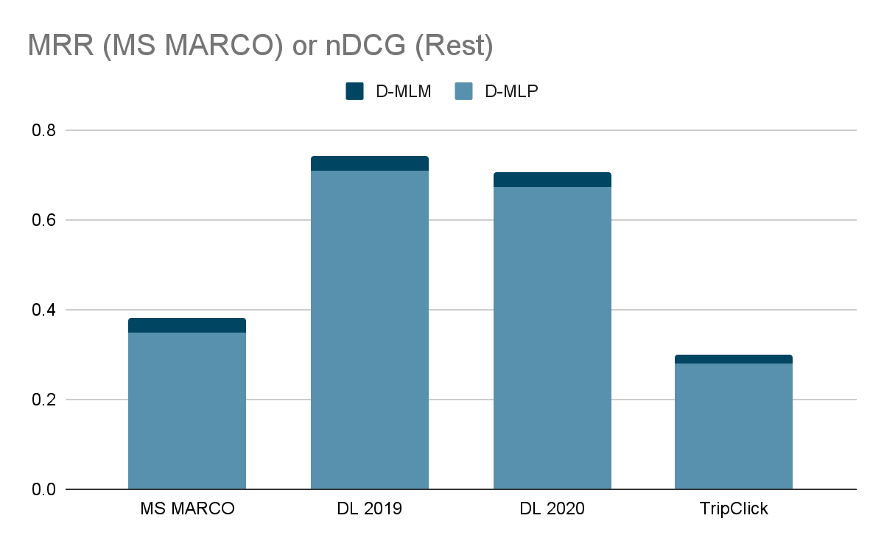
…but only a little when query expansion also present
Query
expansion
weighting
Document
Weighting
Weighting + Expansion
Notes:
However, the performance only increases a small amount when queries are also weighted and expanded.
Now, what happens when our query is already expanded and weighted, and we want to see what happens when we do document expansion?
Against, a weighted document baseline, we don’t see much improvement.
The point here being that adding D expansion doesn't help much when Q is already expanded. There's a slight increase, but you get most of the performance improvement from expansion as long as Q or D has it. It’s not essential to have expansion on both the query and the document side.

Slide 172
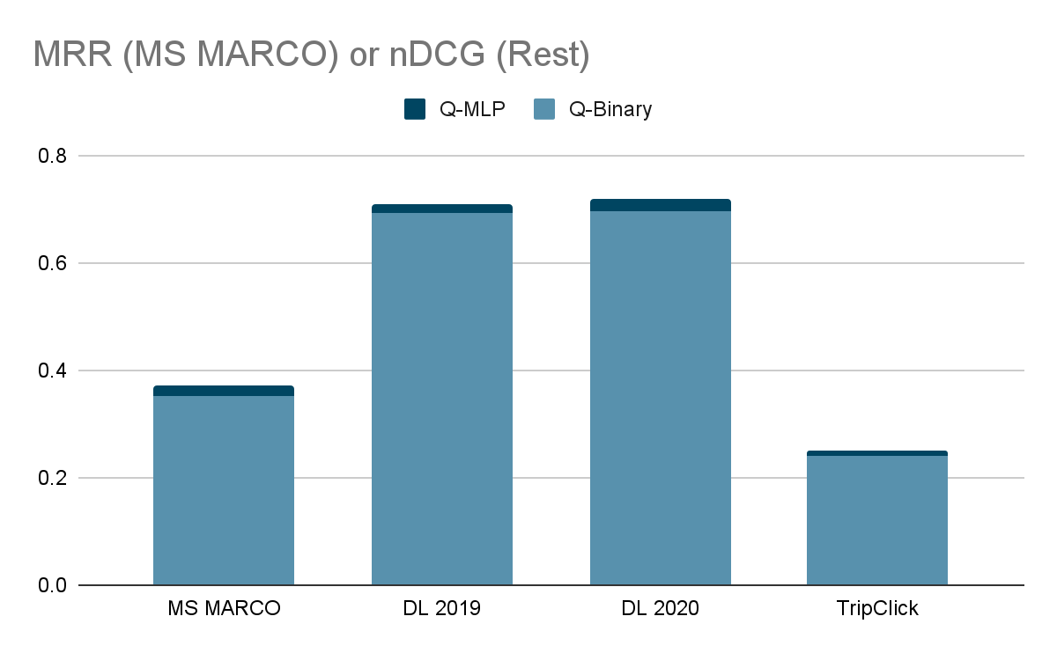
Limited gains from weighting the query w/ doc exp.
Document
expansion
weighting
Query
No weighting (binary)
Weighting
Notes:
Ok, let’s look at what happens when we mess with the query configuration in different ways.
We already know about the cancellation effect of weighting and expansion on both sides. Let’s see what happens when we only weight queries against a weighted and expanded document.
We again see minimal improvements compared to the baseline.
But another way of looking at it is, that on these in-domain datasets, performance is very high with a binary query encoder as long as you have document expansion!

Slide 173
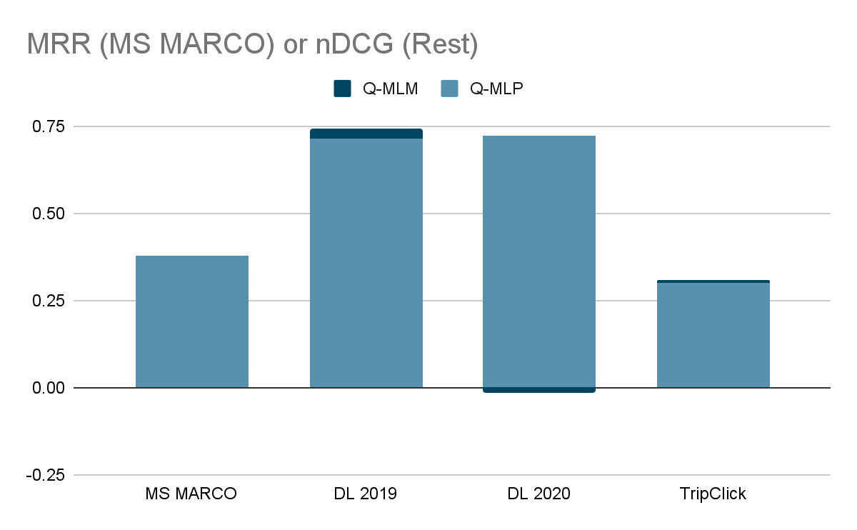
Limited gains from expanding the query w/ doc exp.
Document
expansion
weighting
Query
Weighting
Weighting + Expansion
Notes:
And finally, looking at the query side again, but specifically weighting AND expansion,we see the cancellation effect at work. The navy bit going below zero over DL 2020 - that difference is the performance decrease when weighting and expansion are added, it was just hard to illustrate.
If you're already doing document expansion, adding query expansion barely improves the ranking results but makes the system much slower – latency jumped significantly, by almost 300% on MSMarco and 82% on TripClick.
This cancellation effect suggests that you might not need to implement both expansion methods.

Slide 174
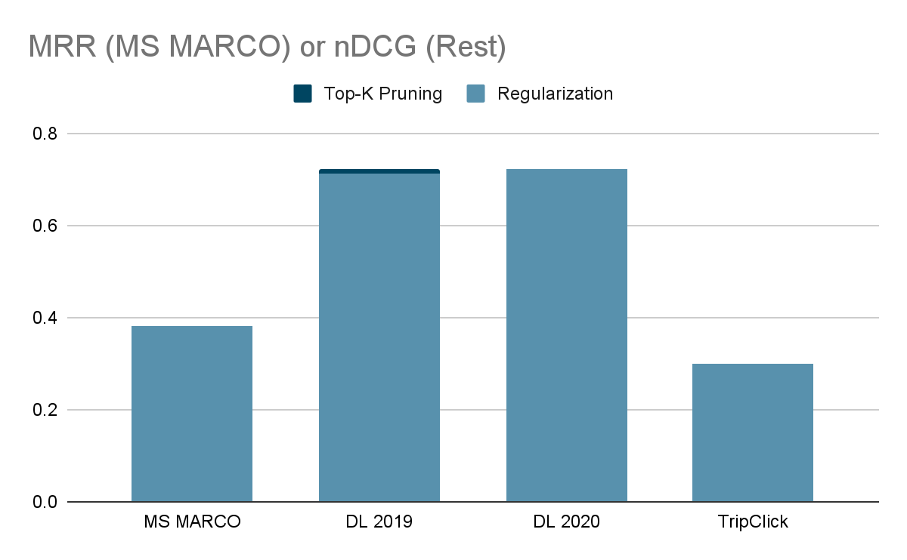
Top-K pruning can be effective
Query
expansion
weighting
Document
expansion
weighting
Pruning vs.
Loss Reg.
Notes:
Finally, in line with the LSR Framework, we look at how changing the choice of sparse regularizer affects our
results.
We see that moving to a top-k pruning strategy at inference time has no impact on performance, save a very minor improvement for DL 2019.
Before we move on to other work, I’d like to summarize a few key findings.

Slide 175
Takeaways
Including document term weighting is most important for a method’s eﬀectiveness
Including query weighting has a small positive impact
Document expansion and query expansion have a cancellation eﬀect.
But you do need document expansion to be competitive
Notes:
Just to reiterate our key takeaways.
With regards to weighting:
Document term weighting is the most important.
Query weighting has a positive impact, but small.
With regards to expansion:
Document expansion and query expansion have a cancellation effect.
You do need expansion - really on the document side - to have a solid performance increase.

Slide 176
Other work (not exhaustive!)
Training without (human-)labeled data.
Enhancing Sparse Retrieval via Unsupervised Learning. Ma, Fun, Yin, Mallia, Lin. SIGIR-AP 2023.
Prompting a LLM to generate sparse representations zero-shot.
PromptReps: Prompting Large Language Models to Generate Dense and Sparse Representations for Zero-Shot Document Retrieval. Zhuang, Ma, Koopman, Lin, Zuccon. EMNLP 2024.
Aggregating passage representations across long documents.
Adapting Learned Sparse Retrieval for Long Documents. Nguyen, MacAvaney, Yates. SIGIR 2023.
Replacing the LSR vocabulary.
1. Learning Sparse Lexical Representations Over Specified Vocabularies for Retrieval.
Dudek, King, Li, Zhang, Bendersky. CIKM 2023.
2. Improved Learned Sparse Retrieval with Corpus-Specific Vocabularies. Yu, Mallia, Petri. ECIR 2024.
Augmenting the LSR vocabulary.
DyVo: Dynamic Vocabularies for Learned Sparse Retrieval with Entities.
Nguyen, Chatterjee, MacAvaney, Mackie, Dalton, Yates. EMNLP 2024.
Notes:
Alright, so beyond the core LSR techniques we've discussed, there's a lot of really interesting work extending these ideas in different directions.
In terms of supervision, getting rid of the need for human labels is a big one. Ma and colleagues showed in 2023 how we can actually enhance sparse retrieval using unsupervised learning – which could save a lot of annotation effort.
Another cool direction leverages the power of Large Language Models. With PromptReps, Zhuang et al. demonstrated you can actually just prompt an LLM to generate sparse representations directly, zero-shot, without needing specific retrieval training for the LLM itself. [This is cool, but you all should know that these zero-shot sparse representations don’t perform nearly as well as supervised models like Mistral-SPLADE and SPLADEv3.
Thinking practically, we often need LSR to work on long documents. Nguyen and the team at SIGIR '23 tackled this, developing ways to aggregate passage representations effectively across longer texts.
Then there's the vocabulary itself – the terms the LSR model uses. Some are exploring completely replacing the standard vocabulary, either using custom ones like Dudek et al. or corpus-specific ones like Yu et al. showed more recently.
And building on that, instead of just replacing, Nguyen and others are looking at augmenting the vocabulary. Their DyVo system dynamically pulls in important entities, like names or places, to enrich the representation. This is done using an MLM head so you can get specific domain vocab.
So, as you can see, it's a really active area with lots of different approaches being explored to boost performance and applicability.

Slide 177
Conclusion: LSR on (English) Text
Questions?
Input: text
Output: sparse vector representation (weighted bag of words)
We looked at
Transformer-based methods and their architectures
Document term weighting is most important for a method’s eﬀectiveness
… but document expansion is also important!
Next: Multilingual LSR
Notes:
So sum up. We just looked at approaches to Text LSR.
We reviewed our three-pronged framework for LSR, and how it applies to designing LSR systems for text.
A pioneering pre-transformer model (SNRM)
A pioneering transformer based model (Deep CT)
A general overview of transformer-based models, and their differences grouped along characteristics of expansion vs. weighting on the document vs. query side.
We also looked at how these transformer based models differ within their architectures and how we can conceptualize these differences in terms of our LSR framework.
We looked at the effects of these differences on performance, across several controlled experiments, and concluded that document weighting is the most important.
Finally, we briefly discussed future directions for LSR work.
I’ll now cede the floor to questions and later, Multilingual LSR - thank you!

Slide 178
Modalities: Multilingual LSR
SIGIR 2025 Tutorial
presented by Eugene Yang

Slide 179
Schedule
Introduction
Datasets and Evaluation
LSR Framework
Training LSR
Modalities
English Text
Multilingual Text ← now
Multimodal Data
Indexing & efficiency
Hybrid dense-sparse retrieval
Conclusion

Slide 180
Multilingual retrieval

Slide 181




Monolingual retrieval: English
EN
EN
Who was
Girolamo Muzio?
EN
EN
EN
{Who: 3, Girolamo: 5, Muzio: 5, was: 1, Latin: 1, ...}

Slide 182



Monolingual retrieval: Italian
IT
IT
Chi era Girolamo Muzio ?
IT
IT
IT
{Chi: 3, Girolamo: 5, Muzio: 5, era: 1, lingua: 1, …}

Slide 183
Cross-lingual retrieval, bilingual system
For accessing information in another language
Cross-language encoding
IT->EN
IT
Chi era Girolamo Muzio ?
EN
EN
EN
Less useful for the users without translation
{who, 3, Girolamo: 5, Muzio: 5, Latin: 1, …}

Slide 184
Cross-lingual retrieval, bilingual system
For accessing information in another language
IT
IT
Chi era Girolamo Muzio ?
EN->IT
IT
EN->IT
{Chi: 3, Girolamo: 5, Muzio: 5, era: 1, lingua: 1, …}
Document Translation

Slide 185
Baseline: Translation + monolingual retrieval
EN
EN
Who was
Girolamo Muzio?
IT->EN
IT->EN
EN
{Who: 3, Girolamo: 5, Muzio: 5, was: 1, Latin: 1, …}

Slide 186


Multilingual retrieval - one model per language
IT
EN
EN
Who was
Girolamo Muzio?
PT
EN
EN
EN
{Who: 3, Girolamo: 5, Muzio: 5, was: 1, Latin: 1, …}
PT
IT

Slide 187
Multilingual retrieval - one model per language
IT
EN
IT
Chi era Girolamo Muzio ?
PT
IT
EN
IT
{Chi: 3, Girolamo: 5, Muzio: 5, era: 1, lingua: 1, …}
PT
IT

Slide 188

Multilingual retrieval - ideal scenario
EN+IT+PT…
IT
Chi era Girolamo Muzio ?
EN+IT+PT…
EN,IT
EN
{Chi: 3, who: 3, Girolamo: 5, Muzio: 5, era: 1, Latin: 1, lingua: 1, …}
IT

Slide 189
Multilingual sparse retrieval: challenges
Lexical matching
  How do you perform lexical match over multiple languages?
Size of MLM encoder
  Number of tokens increases massively (30k->250k)
Training data
  How to distribute training data between languages.

Slide 190
MLP Encoder + External Expansion
Recall from earlier
dishes
best
padua
0
0
0.8
1.4
0
…
1.5
Learning to score input terms by an MLP regression head
MLP
Transformer Layers
expansion
Could not handle term mismatch
(e.g., “best dishes” vs “bigoli”)
weighting
[CLS]
padua
best
dishes
[SEP]
Tokenizer
“padua best dishes”
Expansion Module (e.g., Doc2Query)
MLP Encoder

Slide 191
MLM Encoder
sparse vector
Column-wise pooling
…
…
…
…
…
Logits over vocab
expansion (differentiable)
MLM Head
weighting
Transformer Layers
Recall from earlier
[CLS]
padua
best
dishes
[SEP]
Tokenizer
“padua best dishes”

Slide 192
MLM Encoder
sparse vector
Column-wise pooling
…
…
…
…
…
Logits over vocab
expansion (differentiable)
MLM Head
30k vocab: 23M params
250k vocab: 192M params
weighting
Transformer Layers
Recall from earlier
[CLS]
padua
best
dishes
[SEP]
Tokenizer
“padua best dishes”

Slide 193
Multilingual sparse retrieval: challenges
Lexical matching
  How do you perform lexical match over multiple languages?
Size of MLM encoder
  Number of tokens increases massively (30k->250k)
Training data
  How to distribute training data between languages.

Slide 194
SPLADE-X
Cross-lingual retrieval, bilingual system
  English queries, passages in other languages
Based on SPLADE (MLM encoder, expansion)
Changes encoder from BERT to mBERT
  Size increases (32k -> 110k)
  Filters tokens, so that only “english tokens” are used
Training with translated passages through translate-train
Learning a Sparse Representation Model for Neural CLIR. Nair, Yang, Lawrie, Mayfield and Oard. DESIRES. 2022.

Slide 195
Cross-lingual retrieval, english encoded
EN+IT+PT…
IT
Chi era Girolamo Muzio?
EN
EN
EN
{who, 3, Girolamo: 5, Muzio: 5, Latin: 1, …}
IT
IT*

Slide 196
SPLADE-X - results
Models |  | CLEF-03 (English -> Language), mAP
Model | description | French | Italian | German | Spanish
BM25 | Manual query translation | 40.6 | 38.7 | 29.6 | 43.1
 | Automatic query translation | 37.0 | 30.6 | 26.0 | 40.0
PSQ-HMM | Document translation + HMM ranking | 36.3 | 30.7 | 32.2 | 34.7
SPLADE-X |  | 39.3 | 31.4 | 31.7 | 33.1
Learning a Sparse Representation Model for Neural CLIR. Nair, Yang, Lawrie, Mayfield and Oard. DESIRES. 2022.

Slide 197
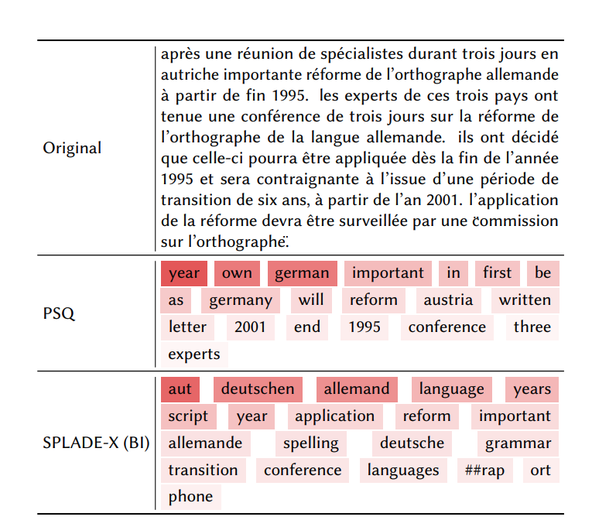
SPLADE-X - examples
Example: positive document for
“german spelling reform”
On the french corpus
Learning a Sparse Representation Model for Neural CLIR. Nair, Yang, Lawrie, Mayfield and Oard. DESIRES. 2022.

Slide 198
SPLADE-X - Not all MLM heads are created equal
MLM initialization matters!
MLM score
Learning a Sparse Representation Model for Neural CLIR.
Nair, Yang, Lawrie, Mayfield and Oard. DESIRES. 2022.

Slide 199
BLADE, improving over SPLADE-X
Cross-lingual retrieval, bilingual system
  English queries, passages in other languages
Changes MLM encoder tokens filtering
  Bi-lingual model, only “English” and “target” tokens are used
Adds MLM and parallel pretraining
  (Sort of) Fix the MLM initialization problem from before
  Trains with comparable passages in Wikipedia
BLADE: combining vocabulary pruning and intermediate pretraining for scaleable neural CLIR Nair, Yang, Lawrie, Mayfield and Oard. SIGIR. 2023.

Slide 200
BLADE - Results
Model |  | CLEF-03 (English -> Language), mAP
 |  | French | Italian | German | Spanish
SPLADE-X | Reproduction Better training | 40.2 | 35.5 | 34.0 | 33.2
BLADE | "+" Bilingual Tokens (BT) | 43.4 | 36.1 | 34.0 | 15.2
 | BT + Comparable Passages | 44.8 | 38.9 | 38.6 | 38.7
Improvements all around
Need better training data
  Translating docs to English and using SPLADE is better (but slower and $$)
BLADE: combining vocabulary pruning and intermediate pretraining for scaleable neural CLIR Nair, Yang, Lawrie, Mayfield and Oard. SIGIR. 2023.

Slide 201
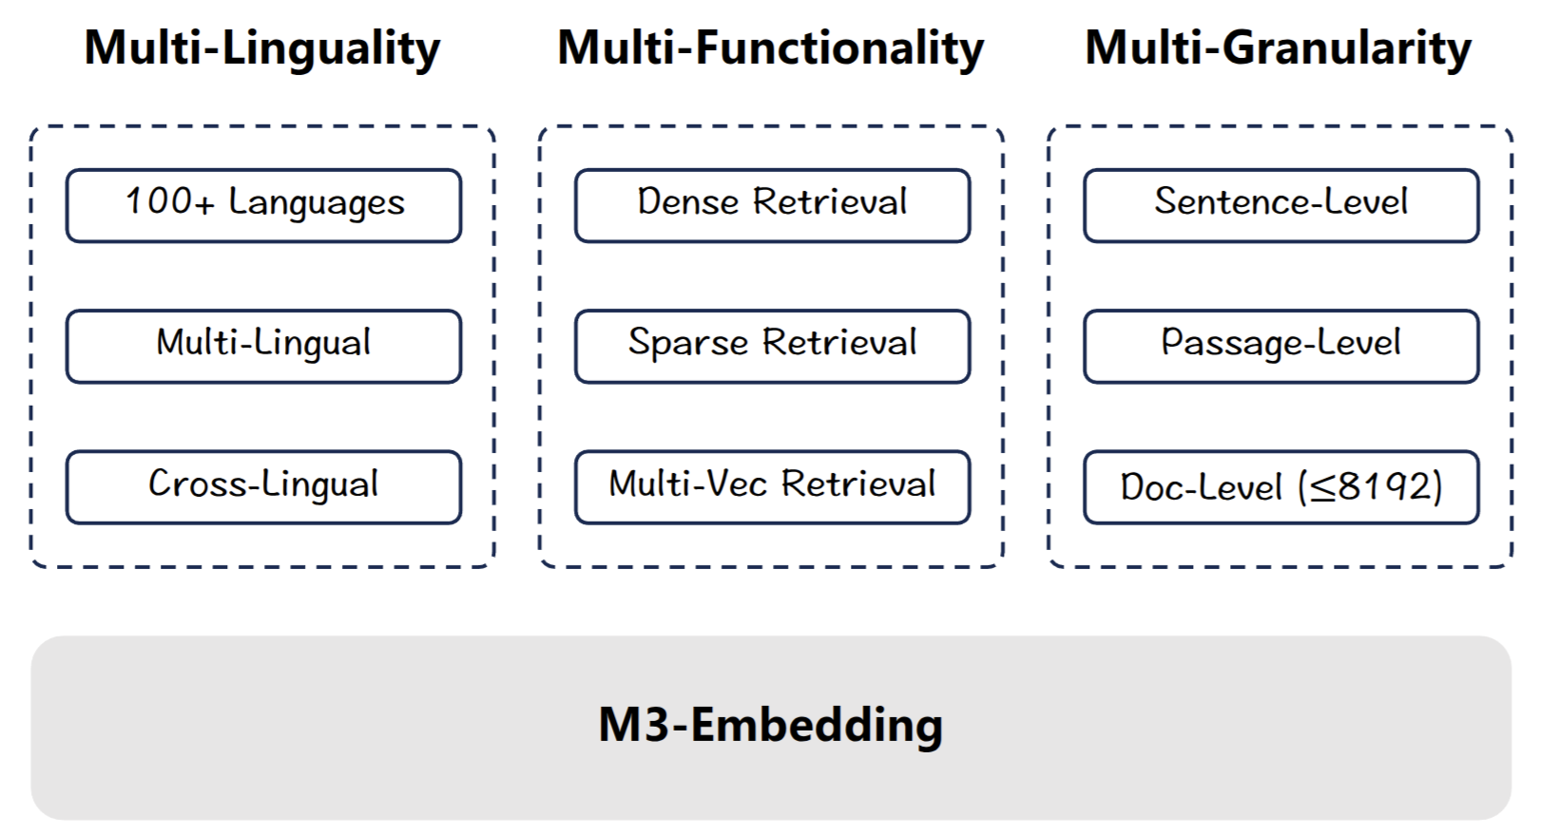
BGE-M3 - Multi Headed retrieval
BGE M3-Embedding: Multi-Lingual, Multi-Functionality, Multi-Granularity Text Embeddings Through Self-Knowledge Distillation
Zhang, Zhang, Long, Xie, Dai, Tang, Lin, Yang, Xie, Huang, Zhang, Li and Zhang, ArXiv 2024

Slide 202
BGE-M3 - Multi Headed retrieval
Will talk more about multi-functionality later
MLP encoder
Focus on Multilinguality here
BGE M3-Embedding: Multi-Lingual, Multi-Functionality, Multi-Granularity Text Embeddings Through Self-Knowledge Distillation
Zhang, Zhang, Long, Xie, Dai, Tang, Lin, Yang, Xie, Huang, Zhang, Li and Zhang, ArXiv 2024

Slide 203
Multilingual retrieval - monolingual, multilingual
IT
EN
EN
Who was
Girolamo Muzio?
PT
EN
EN
EN
[(who, 3), (Girolamo, 5), (Muzio, 5), (Latin, 1)
IT
PT

Slide 204
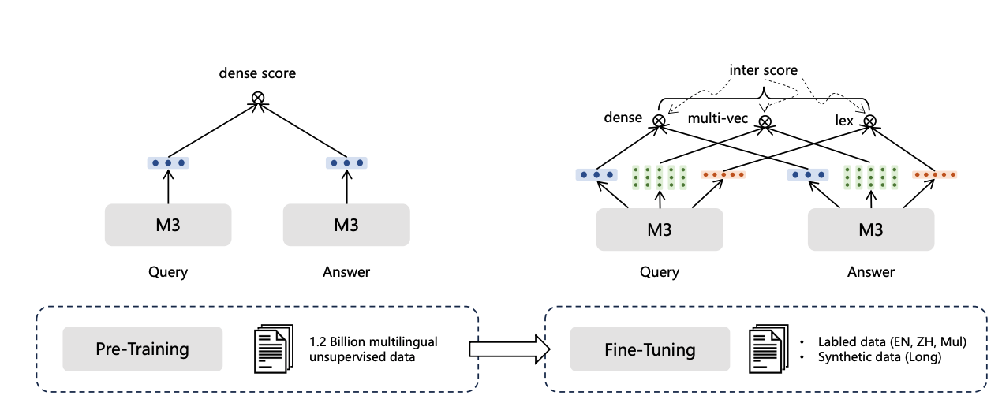
BGE-M3 - Training procedure
More Later
BGE M3-Embedding: Multi-Lingual, Multi-Functionality, Multi-Granularity Text Embeddings Through Self-Knowledge Distillation
Zhang, Zhang, Long, Xie, Dai, Tang, Lin, Yang, Xie, Huang, Zhang, Li and Zhang, ArXiv 2024

Slide 205
BGE-M3 - Results
Model |  | MLDR MonoLingual, 13 languages nDCG@10
BM25 | XLM-R tokenizer | 53.6
mE5-Large |  | 34.2
M3 | Dense | 52.5
 | Sparse | 62.2
BGE M3-Embedding: Multi-Lingual, Multi-Functionality, Multi-Granularity Text Embeddings Through Self-Knowledge Distillation
Zhang, Zhang, Long, Xie, Dai, Tang, Lin, Yang, Xie, Huang, Zhang, Li and Zhang, ArXiv 2024

Slide 206
BGE-M3 - Results
Model |  | MLDR Monolingual, 13 languages nDCG@10
BM25 | XLM-R tokenizer | 53.6
 | Analyzer | 64.1
mE5-Large |  | 34.2
M3 | Dense | 52.5
 | Sparse | 62.2
BGE M3-Embedding: Multi-Lingual, Multi-Functionality, Multi-Granularity Text Embeddings Through Self-Knowledge Distillation
Zhang, Zhang, Long, Xie, Dai, Tang, Lin, Yang, Xie, Huang, Zhang, Li and Zhang, ArXiv 2024

Slide 207
BGE-M3 - Results
Model |  | MLDR Monolingual, 13 languages nDCG@10 | MIRACL Monolingual, 18 languages nDCG@10
BM25 | XLM-R tokenizer | 53.6 | 31.9
 | Analyzer | 64.1 | 38.5
mE5-Large |  | 34.2 | 66.6
M3 | Dense | 52.5 | 69.2
 | Sparse | 62.2 | 53.9
BGE M3-Embedding: Multi-Lingual, Multi-Functionality, Multi-Granularity Text Embeddings Through Self-Knowledge Distillation
Zhang, Zhang, Long, Xie, Dai, Tang, Lin, Yang, Xie, Huang, Zhang, Li and Zhang, ArXiv 2024

Slide 208
BGE-M3 - Results
Model |  | MLDR Monolingual, 13 languages nDCG@10 | MIRACL Monolingual, 18 languages nDCG@10 | MKQA Cross-lingual, 25 languages nDCG@10 | Average
BM25 | XLM-R tokenizer | 53.6 | 31.9 | 39.9 | 41.8
 | Analyzer | 64.1 | 38.5 | 40.9 | 47.8
mE5-Large |  | 34.2 | 66.6 | 70.9 | 57.2
M3 | Dense | 52.5 | 69.2 | 75.1 | 65.6
 | Sparse | 62.2 | 53.9 | 45.3 | 53.8
BGE M3-Embedding: Multi-Lingual, Multi-Functionality, Multi-Granularity Text Embeddings Through Self-Knowledge Distillation
Zhang, Zhang, Long, Xie, Dai, Tang, Lin, Yang, Xie, Huang, Zhang, Li and Zhang, ArXiv 2024

Slide 209
BGE-M3 - Results
Model |  | MLDR Monolingual, 13 languages nDCG@10 | MIRACL Monolingual, 18 languages nDCG@10 | MKQA Cross-lingual, 25 languages nDCG@10 | Average
BM25 | XLM-R tokenizer | 53.6 | 31.9 | 39.9 | 41.8
 | Analyzer | 64.1 | 38.5 | 40.9 | 47.8
mE5-Large |  | 34.2 | 66.6 | 70.9 | 57.2
M3 | Dense | 52.5 | 69.2 | 75.1 | 65.6
 | Sparse | 62.2 | 53.9 | 45.3 | 53.8
 | Dense + Sparse | 64.8 | 70.4 | 75.3 | 70.2
BGE M3-Embedding: Multi-Lingual, Multi-Functionality, Multi-Granularity Text Embeddings Through Self-Knowledge Distillation
Zhang, Zhang, Long, Xie, Dai, Tang, Lin, Yang, Xie, Huang, Zhang, Li and Zhang, ArXiv 2024

Slide 210
Multilingual retrieval: challenges and “solutions”
Lexical matching
  How do you perform lexical match over multiple languages?
  Solutions:
    One language at a time
      MLP (no expansion): BGE-m3, mGTE
      MLM (one model per language): NeuCLIR-SPLADE, MLM+FLOPS SPLADE
    Cross-lingual: Does not work without expansion (“this” -> “isso” does not match)
      MLP: No current solution
      MLM: SPLADE-x, BLADE
BGE M3-Embedding: Multi-Lingual, Multi-Functionality, Multi-Granularity Text Embeddings Through Self-Knowledge Distillation, Zhang et al, ArXiv 2024
mGTE: mGTE: Generalized Long-Context Text Representation and Reranking Models for Multilingual Text Retrieval, Zhang et al, ArXiv 2024
NeuCLIR-SPLADE: NAVER LABS EUROPE @ TREC NEUCLIR 2022 and 2023, Lassance and Clinchant, TREC 2022 and 2023
MLM+FLOPS SPLADE: An Experimental Study on Pretraining Transformers from Scratch for IR. Lassance, Dejean and Clinchant, ECIR 2023

Slide 211
Multilingual retrieval: challenges and “solutions”
Size of MLM encoder
  Number of tokens increases massively (30k->250k)
  Memory cost increases on the output head
    MLM models encode the following matrix: (bs, sequence_length, tokens)
    When tokens increase, this causes OOM
    E.g:
      bs=16, sequence_length=256, tokens=30k -> 122M “numbers”
      bs=16, sequence_length=256, tokens=250k -> 1B “numbers”
  Current solutions:
    mAggRetriever: Enforce representations to convert to only one language.
    mSPLADE-sTok: Create a tokenizer specific to a subset of languages
    Just use an MLP: Previous slide
mAggRetriever: mAggretriever: A Simple yet Effective Approach to Zero-Shot Multilingual Dense Retrieval Lin, Ahmad and Lin. EMNLP 2023
mSPLADE-sTok: Extending English IR methods to multi-lingual IR. Carlos Lassance. ArXiV / WSDM Cup 2023

Slide 212
Conclusion
Still work in progress
  Lexical match is a strong prior
  Keeping it through languages is not trivial
Current solutions either:
  Consider one language at a time
  Need to encode everything in a common language
However, even current solution can achieve good performance (sometimes)
  BGE-m3 and mGTE achieve good results, even if only considering one language at a time
Next: multimodal LSR

Slide 213
Questions

Slide 214
Modalities: Multimodal LSR
SIGIR 2025 Tutorial
presented by Thong Nguyen

Slide 215
Schedule
Introduction
Datasets and Evaluation
LSR Framework
Training LSR
Modalities
English Text
Multilingual Text
Multimodal Data ← now
Indexing & efficiency
Hybrid dense-sparse retrieval
Conclusion
Notes:
This is the whole agenda of our LSR tutorial.
I will be responsible for the Multimodal Section, which will last for 20 minutes.

Slide 216
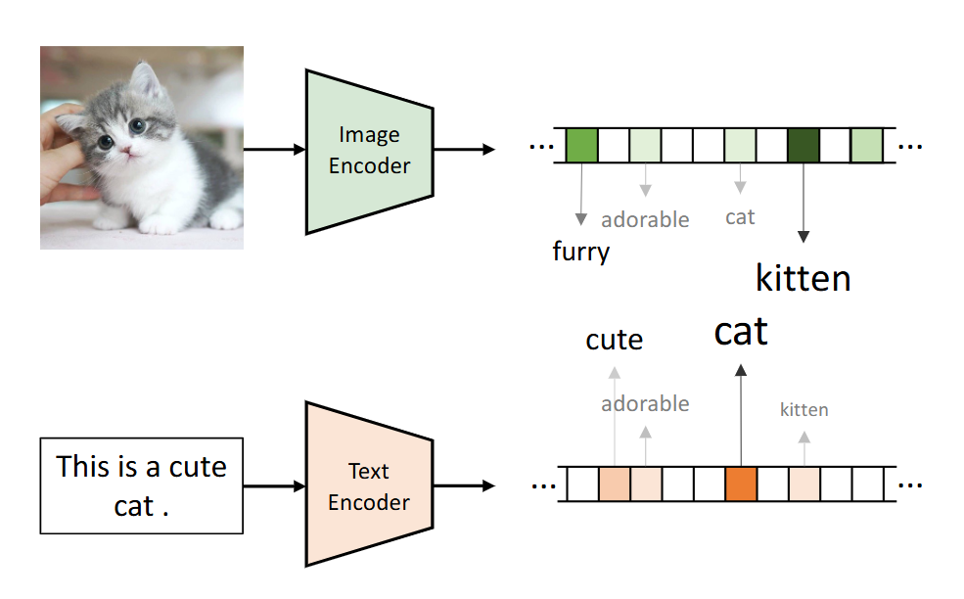
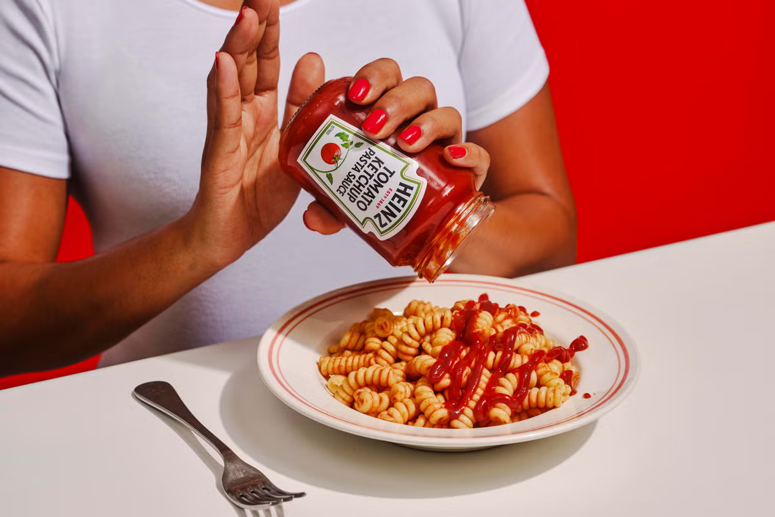

Multimodal LSR
Main goal:
Bridge semantic and modality gap via lexical repersentations
ketchup
man
fork
spaghetti
spaghetti
ketchup
tomato
italy
spaghetti with ketchup

Slide 217
Multimodal LSR: Timeline of Development
[1] VisualSparta: An Embarrassingly Simple Approach to Large-scale Text-to-Image Search with Weighted Bag-of-words, ACL 2021
[2] STAIR: Learning Sparse Text and Image Representation in Grounded Tokens, EMNLP 2023
[3] LexLIP: Lexicon-Bottlenecked Language-Image Pre-Training for Large-Scale Image-Text Retrieval, ICCV 2023
[4] Multimodal Learned Sparse Retrieval with Probabilistic Expansion Control, ECIR 2024
[5] Retrieval-based Disentangled Representation Learning with Natural Language Supervision, ICLR 2024
[6] Rethinking Sparse Lexical Representations for Image Retrieval in the Age of Rising Multi-modal Large Language Models, ECCV 2024 (workshop)
[7]Unified Lexical Representation for Interpretable Visual-Language Alignment, NeurIPS 2024
[8] Interpreting CLIP with Sparse Linear Concept Embeddings, NeurIPS 2024
[9] Towards Unified Human Motion-Language Understanding via Sparse Interpretable Characterization, ICLR 2025
Wide interest in different communities!
(NLP, ML, CV, IR)
Notes:
Go through this slide more quickly

Slide 218
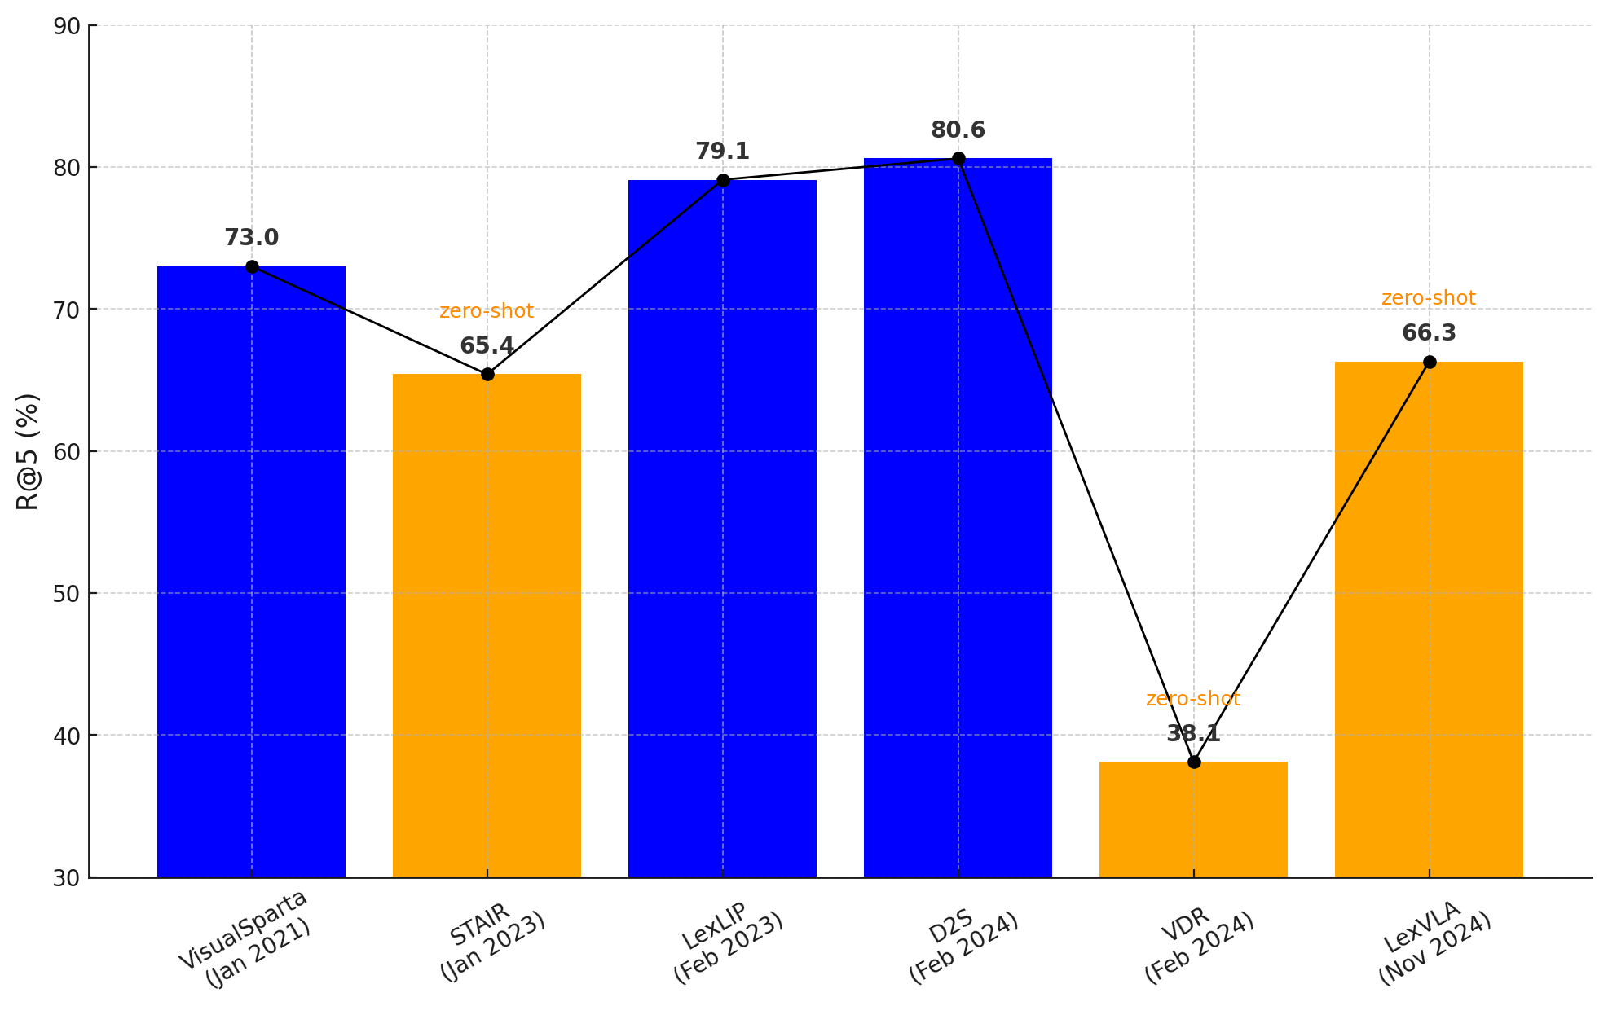
Multimodal LSR: Timeline of Development
MSCOCO 5k

Slide 219
Multimodal LSR: Timeline of Development
MSCOCO 5k
Splade v1
(Jul 2021)

Slide 220
Multimodal LSR: Timeline of Development
MSCOCO 5k
Splade v1
(Jul 2021)
2 years with no new work!

Slide 221
Multimodal LSR: Timeline of Development
MSCOCO 5k
Splade v1
(Jul 2021)
Splade v2
(May 2022)

Slide 222
Multimodal LSR: Timeline of Development
MSCOCO 5k
Splade v1
(Jul 2021)
Splade v2
(May 2022)
Success in text LSR has encouraged adaptation to multimodal domain

Slide 223
Multimodal LSR: Timeline of Development
MSCOCO 5k
Covered in this tutorial

Slide 224
Common benchmarks and metrics
Datasets: MSCOCO 5k [10], Flickr30K
  Caption-image datasets
  Two sub-tasks: Text-2-Image Retrieval, Image-2-Text Retrieval
Metrics:
  Report metric: R@k
  Actual implementation: Hit@k
  In this presentation: R@5 means Hit@5
Dataset | # Images | # Captions | # Captions/image
MSCOCO 5k | 5000 | 25000 | 5
[10] Deep Visual-Semantic Alignments for Generating Image Descriptions CVPR 2015
Notes:
Before going into details about each methods.
In this slide, I will present a foundation for comparison, including datasets and metrics.
For datasets, the literature usually includes MSCOCO 5k and Flickro30k.
Metrics: R@K = Hit@K

Slide 225
MSCOCO 5k
Notes:
This that, I would like to start with visual sparta.

Slide 226
VisualSparta, ACL 2021
VisualSparta extends Sparta [11] from text retrieval to text-to-image retrieval.
From the paper: “Our method is embarrassingly simple because its image representation is essentially a weighted bag-of-words, and can be indexed in a standard Inverted Index for fast retrieval”.
[11] SPARTA: Efficient Open-Domain Question Answering via Sparse Transformer Matching Retrieval NAACL 2021

Slide 227

VisualSparta, ACL 2021
spaghetti
ketchup
with
0
0
1
1
0
…
1
Binary Query Encoder
“spaghetti with ketchup”
NO EXPANSION
Notes:
The presentation on the Image Encoder is not very fluent.

Slide 228
VisualSparta, ACL 2021
MLM: Learn to map the image to relevant terms.
+
External Expansion: from Object Recognition model.
spaghetti
italy
spaghetti
with
ketchup
tomato
ketchup
(keep top k)
0
0
1
1
0
…
1
7.8
0
11.9
1.7
0
…
2.5
Binary Query Encoder
MLM Image Encoder
“spaghetti with ketchup”
image patches
NO EXPANSION
WITH EXPANSION
Notes:
The presentation on the Image Encoder is not very fluent.

Slide 229
VisualSparta, ACL 2021
MLM: Learn to map the image to relevant terms.
+
External Expansion: from object recognition models.
spaghetti
italy
spaghetti
with
ketchup
tomato
ketchup
(keep top k)
0
0
1
1
0
…
1
7.8
0
11.9
1.7
0
…
2.5
Binary Query Encoder
MLM Image Encoder
spaghetti ketchup fork …
“spaghetti with ketchup”
image patches
Object Recognition
NO EXPANSION
WITH EXPANSION
Notes:
The presentation on the Image Encoder is not very fluent.

Slide 230
VisualSparta, ACL 2021
State of the art at the time!
Method | MSCOCO 5k (R@5)
CAMP (Dense, 2019) | 68.9
SCAN (Dense, 2018) | 69.3
CVSE (Dense, 2020) | 66.4
VisualSparta (Sparse, 2021) | 73.0
+6%
Effectiveness (R@5 / Hit@5)

Slide 231
VisualSparta, ACL 2021
State of the art at the time!
Method | MSCOCO 5k (R@5)
CAMP (Dense, 2019) | 68.9
SCAN (Dense, 2018) | 69.3
CVSE (Dense, 2020) | 66.4
VisualSparta (Sparse, 2021) | 73.0
# Images | CVSE (GPU) | CVSE (CPU) | VisualSparta (CPU)
1K | 195.1 | 177.4 | 451.3
5k | 191.0 | 162.0 | 390.5
113K | 101.2 | 5.4 | 275.5
1M | 21.7 | 0.3 | 117.3
Effectiveness (R@5 / Hit@5)
Efficiency ( Query/s)

Slide 232
VisualSparta, ACL 2021
State of the art at the time!
Method | MSCOCO 5k (R@5)
CAMP (Dense, 2019) | 68.9
SCAN (Dense, 2018) | 69.3
CVSE (Dense, 2020) | 66.4
VisualSparta (Sparse, 2021) | 73.0
# Images | CVSE (GPU) | CVSE (CPU) | VisualSparta (CPU)
1K | 195.1 | 177.4 | 451.3
5k | 191.0 | 162.0 | 390.5
113K | 101.2 | 5.4 | 275.5
1M | 21.7 | 0.3 | 117.3
x6 times faster
Effectiveness (R@5 / Hit@5)
Efficiency ( Query/s)

Slide 233
VisualSparta, ACL 2021
Binary Encoder (inference-free)
State of the art at the time!
Method | MSCOCO 5k (R@5)
CAMP (Dense, 2019) | 68.9
SCAN (Dense, 2018) | 69.3
CVSE (Dense, 2020) | 66.4
VisualSparta (Sparse, 2021) | 73.0
# Images | CVSE (GPU) | CVSE (CPU) | VisualSparta (CPU)
1K | 195.1 | 177.4 | 451.3
5k | 191.0 | 162.0 | 390.5
113K | 101.2 | 5.4 | 275.5
1M | 21.7 | 0.3 | 117.3
x6 times faster
Effectiveness (R@5 / Hit@5)
Efficiency ( Query/s)

Slide 234
VisualSparta, ACL 2021
italy
spaghetti
tomato
ketchup
7.8
0
11.9
1.7
0
…
2.5
MLM Image Encoder
Interpretability: How the MLM learn to map the image to relevant terms?
image patches
Next

Slide 235
Expansion and Semantic Deviation
…..
…
“spaghetti with ketchup”
need to match query with image

Slide 236
One-side Expansion
…..
…
“spaghetti with ketchup”
NO EXPANSION
VisualSparta
WITH EXPANSION

Slide 237
One-side Expansion
spaghetti
ketchup
with
…..
…
“spaghetti with ketchup”
NO EXPANSION
VisualSparta
WITH EXPANSION

Slide 238
One-side Expansion
spaghetti
ketchup
spaghetti
ketchup
with
with
…..
…
“spaghetti with ketchup”
NO EXPANSION
VisualSparta
WITH EXPANSION

Slide 239
One-side Expansion
spaghetti
ketchup
spaghetti
ketchup
with
with
…..
…
“spaghetti with ketchup”
NO EXPANSION
VisualSparta
WITH EXPANSION
May hurt effectiveness!

Slide 240
Two-side Expansion
…..
…
“spaghetti with ketchup”
WITH EXPANSION
WITH EXPANSION
[4] Multimodal Learned Sparse Retrieval with Probabilistic Expansion Control, ECIR 2024

Slide 241
Two-side Expansion
Key Challenge:
Semantic Deviation [4]
matching via a randomly activated token
river
river
…..
…
“spaghetti with ketchup”
WITH EXPANSION
WITH EXPANSION
[4] Multimodal Learned Sparse Retrieval with Probabilistic Expansion Control, ECIR 2024
Notes:
There are recent VLMs model that were trained with a language model head on both text and images.
However the semantic division is unclear.

Slide 242
Two-side Expansion
Key Challenge:
Semantic Deviation [4]
matching via a fixed set of random tokens
river
river
…..
…
“spaghetti with ketchup”
…
…
WITH EXPANSION
WITH EXPANSION
[4] Multimodal Learned Sparse Retrieval with Probabilistic Expansion Control, ECIR 2024

Slide 243
When, Why, How?
Key Challenge:
Semantic Deviation [4]
When does it happen?
  Free expansion on both sides (e.g., MLM encoder).
Why does it NOT happen with SPLADE (MLM architecture)?
  SPLADE starts with BERT which has good MLM head initialization. Training starts with most relevant terms activated.
Why does it happen with multimodal data?
  The MLM head (for images) has a randomly initialization! Random terms activated at the beginning.
How to fix it?
Next
[4] Multimodal Learned Sparse Retrieval with Probabilistic Expansion Control, ECIR 2024
Notes:
Optional to present this here:
There are recent VLMs model that were trained with a language model head on both text and images.
However the semantic division is unclear.

Slide 244
Key Challenge:
Semantic Deviation [4]
MSCOCO 5k

Slide 245
LexLIP, ICCV 2023
Key Challenge:
Semantic Deviation [4]
Architecture: MLM Encoder fo both text/image sides
Solution to semantic deviation:
  Pretraining Text/Image Encoder with Masked Token Prediction Task.
Pretraining Data:
  14.3 M text-image pairs.
Methods | MSCOCO (R@5)
VisualSparta | 73.0
LexLIP | 79.1
+8%
[3] LexLIP: Lexicon-Bottlenecked Language-Image Pre-Training for Large-Scale Image-Text Retrieval, ICCV 2023
Notes:
13 miutes

Slide 246
Key Challenge:
Semantic Deviation [4]
MSCOCO 5k

Slide 247
STAIR, EMNLP 2023
Key Challenge:
Semantic Deviation [4]
Architecture: (separate) MLM Encoder for text/image sides
Solution to semantic deviation: Three-step training
  Step 1: Freeze Text Encoder (+Remove Expansion), Train Image Encoder
  Step 2: Freeze Image Encoder, Train Text Encoder with Expansion
  Step 3: Train both Text Encoder and Image Encoder with Expansion
Training Data:
  1.1B text-image pairs
Methods | Zero-shot MSCOCO (R@5)
CLIP | 62.2
STAIR | 65.4
+5%
[2] STAIR: Learning Sparse Text and Image Representation in Grounded Tokens, EMNLP 2023

Slide 248
Training Efficiency
Key Challenge:
Training Efficiency
Training needs a lot of data using large GPU clusters:
  LexLIP: 14.3M text-image pairs
  STAIR: 1.1B text-image pairs
Still not as strong as dense models, trained on even more data.
Dense training is more efficient and easier to scale to larger data.
Methods | MSCOCO (R@5)
VisualSparta (LSR) | 73.0
LexLIP (LSR) | 79.1
BLIP (dense) | 81.8
BLIP-2 (dense) | 87.7

Slide 249
Key Challenge:
Training Efficiency
MSCOCO 5k

Slide 250
D2S (Dense to Sparse)
Key Challenge:
Training Efficiency
Take a pretrained dense encoder and add a MLM head on top
Fine-tune only the MLM head
Use Probabilistic Expansion Control to reduce Semantic Deviation
  Randomly switching between Expansion and No-Expansion modes.
  Expansion probability is increased over time.
2 hours of training with 12GB of VRAM
MLM head
Methods | MSCOCO (R@5)
VisualSparta | 73.0
LexLIP | 79.1
D2S | 80.6
Dense Encoder
(Frozen)
D2S
Text/Image
[4] Multimodal Learned Sparse Retrieval with Probabilistic Expansion Control, ECIR 2024

Slide 251
Summary
Training a Multimodal LSR is more difficult than training a text LSR, due to Semantic Deviation and Training Efficiency.
To reduce Semantic Deviation, several strategies can be employed:
  (1) No Query Expansion (e.g., Visual Sparta)
  (2) Extensive Image Pretraining with MLM (e.g., LexLIP)
  (3) Multi-step or Controled Expansion (e.g., STAIR, D2S)
We can transform a strong off-the-shelf dense model to an effective LSR model (e.g., D2S).

Slide 252
Discussion: Open Challenges
Evaluation:
  Small and saturated benchmarks: MSCOCO contains 5,000 images.
  Queries are generic image captions. The images mainly depict objects or scenes.
  We need real information seeking queries and information-centric images.
Beyond Images:
  Audio, Video, Table, Mixed Modality (e.g., Text-and-Image).
Limit of lexical representation:
  An image can only be represented lexically if it can be effectively and precisely described in words.
  In some cases, this is difficult.

Slide 253
Discussion: Open Challenges
Evaluation:
  Small and saturated benchmarks: MSCOCO contains 5,000 images.
  Queries are generic image captions. The images mainly depict objects or scenes.
  We need real information seeking queries and information-centric images.
Beyond Images:
  Audio, Video, Table, Mixed Modality (e.g., Text-and-Image).
Limit of lexical representation:
  An image can only be represented lexically if it can be effectively and precisely described in words.
  In some cases, this is difficult.

Slide 254
Discussion: Open Challenges
Evaluation:
  Small and saturated benchmarks: MSCOCO contains 5,000 images.
  Queries are generic image captions. The images mainly depict objects or scenes.
  We need real information seeking queries and information-centric images.
Beyond Images:
  Audio, Video, Table, Mixed Modality (e.g., Text-and-Image).
Limits of lexical representation:
  An image can only be represented lexically if it can be effectively and precisely described in words.
  In some cases, this is difficult.

Slide 255
Discussion: Open Challenges
Evaluation:
  Small and saturated benchmarks: MSCOCO contains 5,000 images.
  Queries are generic image captions. The images mainly depict objects or scenes.
  We need real information seeking queries and information-centric images.
Beyond Images:
  Audio, Video, Table, Mixed Modality (e.g., Text-and-Image).
Limits of lexical representation:
  An image can only be represented lexically if it can be effectively and precisely described in words.
  In some cases, this is difficult.

Slide 256
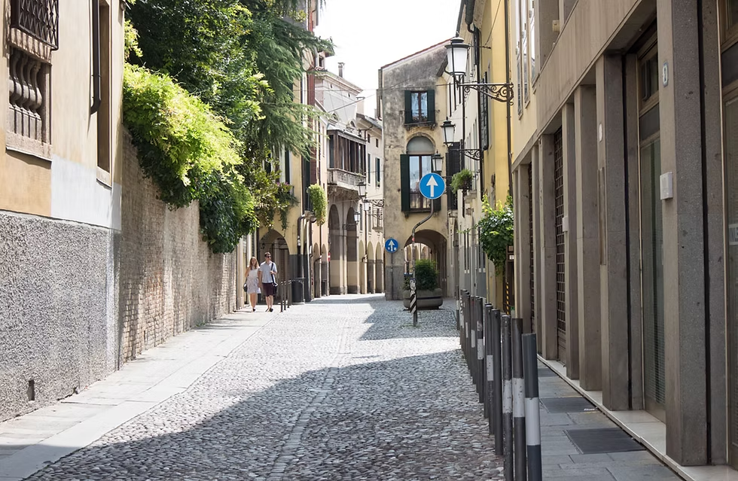
Discussion: Limits of Lexical Representation
Task: Image Search
Can you describe this image by words in detail so someone else (or a model) could find the same or similar images from the same location?

Slide 257
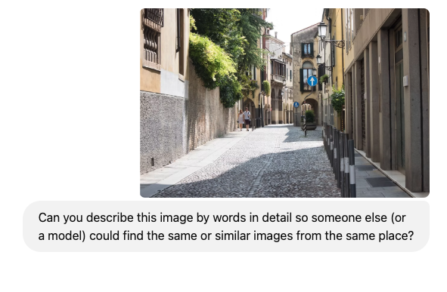
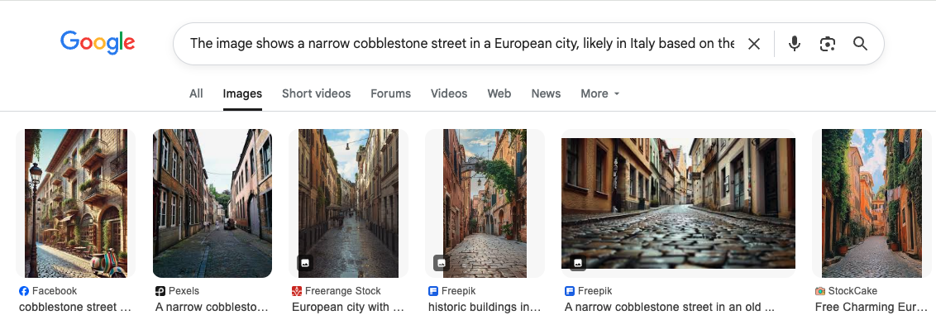
ChatGPT
The image shows a narrow cobblestone street in a European city, likely in Italy based on the architecture and signage. On the right side of the street: There is a row of modern and older-style buildings. …….

Slide 258
ChatGPT
The image shows a narrow cobblestone street in a European city, likely in Italy based on the architecture and signage. On the right side of the street: There is a row of modern and older-style buildings. …….
Relevant images, but not at the same location!

Slide 259

Google
Google Image Search (image as a query) can find the exact image/location in Padua Italy.

Slide 260
Google
Google Image Search (image as a query) can find the exact image/location in Padua Italy.
Can this be solved by lexical presentations alone?

Slide 261

Any Questions?
Next: Indexing
Notes:
Prepare some slides for potential questions (for example, how to convert D2S)?
The benefits of LSR in multimodal?
Time should be around 19 minutes, to give us some buffer!

Slide 262
Indexing and Retrieving
SIGIR 2025 Tutorial
Cosimo Rulli

Slide 263
Schedule
Introduction
Datasets and Evaluation
LSR Framework
Training LSR
Modalities
English Text
Multilingual Text
Multimodal Data
Indexing & efficiency ← now
Hybrid dense-sparse retrieval
Conclusion

Slide 264
Retrieval as Vector Search
LSR encodes text into learned bag of words,
represented as sparse vectors.
Queries and documents are encoded separately.
Retrieval is cast as a k-NN problem on sparse vectors.
big
duck
padua
##oli
0
0.97
1.9
1.1
0
…
0.7
“Bigoli duck sauce Padua”

Slide 265

The Inverted Index
Document ids where terms appear.
E.g., the term “Cat” appears in doc #1, #12
etc..
Collection terms

Slide 266

The Inverted Index
Each term appears with an associated
score, for each document.
The score can be:
  The term frequency (e.g., for BM25).
  The LSR score
At query processing, scan only the inverted lists
of the active query terms.

Slide 267
DaaT vs SaaT
Document-at-a-time
  scan posting lists of all query terms in parallel
  compute score when the same document is seen in one or more posting
  advance in many posting list simultaneously
  maintains a sorted list of results
Score-at-a-time
  documents grouped by impact scores in postings
  visiting each of the posting segments in decreasing order of the segment impact score
  expand the documents in each segment
  update the score of every document with the current term

Slide 268

The inefficiency of Inverted Indexes
Inverted Indexes are inefficient on LSR
embeddings due to:
up to 26.5x
slower
up to 19.8x
slower
Wacky Weights in Learned Sparse Representations and the Revenge of Score-at-a-Time Query Evaluation. Mackenzie, Trotman, Lin. arXiv 2021.

Slide 269
The inefficiency of Inverted Indexes
Inverted Indexes are inefficient on LSR
embeddings due to:
  Document expansion
|D| = 30
|D| = 229
Wacky Weights in Learned Sparse Representations and the Revenge of Score-at-a-Time Query Evaluation. Mackenzie, Trotman, Lin. arXiv 2021.

Slide 270
The inefficiency of Inverted Indexes
Inverted Indexes are inefficient on LSR
embeddings due to:
  Document expansion
  Query expansion
|D| = 30
|Q| = 6
|D| = 229
|Q| = 25
Wacky Weights in Learned Sparse Representations and the Revenge of Score-at-a-Time Query Evaluation. Mackenzie, Trotman, Lin. arXiv 2021.

Slide 271
The inefficiency of Inverted Indexes
Inverted Indexes are inefficient on LSR
embeddings due to:
  Document expansion
  Query expansion
  Distributional differences
|D| = 30
|Q| = 6
|V| = 2.6M
|D| = 229
|Q| = 25
|V| = 30K
Wacky Weights in Learned Sparse Representations and the Revenge of Score-at-a-Time Query Evaluation. Mackenzie, Trotman, Lin. arXiv 2021.

Slide 272
The inefficiency of Inverted Indexes
Inverted Indexes are inefficient on LSR
embeddings due to:
  Document expansion
  Query expansion
  Distributional differences
  Wacky Weights
[Query] Androgen Receptor Define
[Expansion]
[..]
- is
- the
- for
[..]
Wacky Weights in Learned Sparse Representations and the Revenge of Score-at-a-Time Query Evaluation. Mackenzie, Trotman, Lin. arXiv 2021.

Slide 273
Exact vs Approximate Search
Exact search is too slow.
We can give up on exactness for major
efficiency improvements.
A lesson learned from dense k-NN.
Exact methods (e.g. KD-tree) are replaced by
ng-ANN solutions (HNSW).

Slide 274



How can we approximate?
Approximate the representations.
Pruning query and/or documents.
Blocking.
Group together documents and skip
irrelevant blocks.
Proximity Graph
A navigable graph connecting similar
documents.

Slide 275



How can we approximate?
Approximate the representations.
Pruning query and/or documents.
Blocking.
Group together documents and skip
irrelevant blocks.
Proximity Graph
A navigable graph connecting similar
documents.
Seismic
Efficient Inverted Indexes for Approximate Retrieval over Learned Sparse Representations. Bruch, Nardini, Rulli, Venturini. SIGIR 2024.

Slide 276

Pruning
Scores distribution suggests that
we can discard some terms.
Several Strategies:
  per Document
  per Posting Lists
  per Absolute value.
max 2% loss of mRR@10 -> 2x speedup.
max 8% loss of mRR@10 -> 4x speedup.
Lassance, Carlos, et al. "A static pruning study on sparse neural retrievers." SIGIR 2023.
Lassance, Carlos, et al. “Two-Step SPLADE: Simple, Efficient and Effective Approximation of SPLADE”. ECIR 2024.

Slide 277


Concentration of Importance
L₁ norm concentrated in few
components.
Few components yields good
dot product approximation.
Quick candidate identification!
80% of L1 with ~25% of terms.
90% of dp with 15% of terms
Efficient Inverted Indexes for Approximate Retrieval over Learned Sparse Representations. Bruch, Nardini, Rulli, Venturini. SIGIR 2024.

Slide 278

Seismic - How to exploit COI
Static Pruning.
  Build the posting lists.
  Sort them by decreasing score.
  Prune at λ entries.
Query Pruning.
  Sort terms by score.
  Prune at query_cut .
Efficient Inverted Indexes for Approximate Retrieval over Learned Sparse Representations. Bruch, Nardini, Rulli, Venturini. SIGIR 2024.
Notes:
This aggressive pruning both on posting lists and queries is motivated by the concentration of importance property.

Slide 279
Blocking (or Dynamic Pruning)
Crucial Component in Inverted Indexes.
Group, compute an upper bound, safely skips blocks.
🏛️ MaxScore, WAND, BMW, VBMW
Milestones data structures in IR exploit blocking.
Turtle, H., & Flood, J. Query evaluation: strategies and optimizations. Information Processing & Management, 1995.
Broder, A. Z. et al. Efficient query evaluation using a two‑level retrieval process. CIKM 2003.
Ding, S., & Suel, T. Faster top‑k document retrieval using block‑max indexes. SIGIR 2011.
Mallia, A., Ottaviano, G., Porciani, E., Tonellotto, N., & Venturini, R. Faster BlockMax WAND with variable‑sized blocks. SIGIR 2017.

Slide 280
Blocking (or Dynamic Pruning)
Crucial Component in Inverted Indexes.
Group, compute an upper bound, safely skips blocks.
🚀 ASC, BMP, Seismic, SP.
Modern indexes for LSR use it as well.
Qiao, Yifan, et al. "Threshold-driven Pruning with Segmented Maximum Term Weights for Approximate Cluster-based Sparse Retrieval." EMNLP 2024.
Mallia, Antonio, Torsten Suel, and Nicola Tonellotto. "Faster learned sparse retrieval with block-max pruning." SIGIR 2024.
Bruch, Sebastian, et al. "Efficient inverted indexes for approximate retrieval over learned sparse representations." SIGIR. 2024.
Carlson, Parker, et al. "Dynamic Superblock Pruning for Fast Learned Sparse Retrieval." SIGIR 2025.

Slide 281

Seismic - Blocking
Blocking.
Group documents in lists
in β blocks (shallow K-Means)
Notes:
Shallow kmeans works as follow:
- Per each truncated list, randomly sample beta elements and consider them as centroids
- For each element in each truncated list, computed the closest centroid according to the dot product

Slide 282


Seismic - Blocking
Blocking.
Group documents in lists
in β blocks (shallow K-Means)
Summary.
A vector that is an upper-bound for the
dot product.
Notes:
Shallow kmeans works as follow:
- Per each truncated list, randomly sample beta elements and consider them as centroids
- For each element in each truncated list, computed the closest centroid according to the dot product

Slide 283

Seismic - Compress the Summaries
Summaries sizes grow quickly.
Block Pruning.
We prune ɸ(B) keeping its
alpha-mass subvector.
Scalar quantization on ɸ(B).
cut here to keep the 50% (𝞪=0.5) of the l1-norm
Notes:
Summaries tends to grow quickly, highly increasing memory footprint and making the dot product between the query and the summaries extremely expansive.

Slide 284

Proximity Graphs
Widely used in dense ANN.
The most common is HNSW.
Link each document with its friends.
Explore the graph using greed search.
Effectively applied to sparse vectors.
BigANN@NeurIPS 2023.
Malkov, Yu A., and Dmitry A. Yashunin. "Efficient and robust approximate nearest neighbor search using hierarchical navigable small world graphs." IEEE TPAMI 2018.

Slide 285
Seismic vs Graphs
How does Seismic behave compared to
graph solutions?
Competitors.
GrassRMA, PyANN, kANNolo.
MSMARCO, encoder Splade cocondenser.
Average Query Latency, Accuracy@10
kANNolo: Sweet and Smooth Approximate k-Nearest Neighbors Search, Delfino et al, ECIR 2025.

Slide 286

Results
Accuracy
Embeddings
Efficient Inverted Indexes for Approximate Retrieval over Learned Sparse Representations. Bruch, Nardini, Rulli, Venturini. SIGIR 2024.

Slide 287
Results
Accuracy
Embeddings
Competitors
Efficient Inverted Indexes for Approximate Retrieval over Learned Sparse Representations. Bruch, Nardini, Rulli, Venturini. SIGIR 2024.

Slide 288
Results
Accuracy
Embeddings
Competitors
Efficient Inverted Indexes for Approximate Retrieval over Learned Sparse Representations. Bruch, Nardini, Rulli, Venturini. SIGIR 2024.

Slide 289
Results
Accuracy
Embeddings
Competitors
Efficient Inverted Indexes for Approximate Retrieval over Learned Sparse Representations. Bruch, Nardini, Rulli, Venturini. SIGIR 2024.

Slide 290

Seismic vs Inverted Indexes
How does Seismic behave compared to
inverted indexes
Comparison on MSMARCO
Splade embeddings.
Average Query Latency
and MRR@10.
Mallia, Antonio, Torsten Suel, and Nicola Tonellotto. "Faster learned sparse retrieval with block-max pruning." SIGIR 2024.

Slide 291

MSMARCO-v2
Scaling up the size of the collections
Investigating the Scalability of Approximate Sparse Retrieval Algorithms to Massive Datasets
Bruch, Nardini, Rulli, Venturini, Venuta. ECIR 2024.

Slide 292
More related approaches
Accelerating Learned Sparse Indexes Via Term Impact Decomposition. Mackenzie, Mallia, Moffat, Petri. Findings of EMNLP 2022.
Dual Skipping Guidance for Document Retrieval with Learned Sparse Representations. Qiao, Yang, Lin, Xiong, Wang, Yang. arXiv 2022.
Faster Learned Sparse Retrieval with Guided Traversal. Mallia, Mackenzie, Suel, Tonelloto. SIGIR 2022.
Optimizing Guided Traversal for Fast Learned Sparse Retrieval. Qiao, Yang, Lin, Yang. WWW 2023.

Slide 293
The most convenient data structure to store
and search sparse vectors is an inverted index.
LSR’s expansion and “wacky weights” substantially increase query latency using standard query processing approaches, but LSR-specific alternatives exist.
duck
padua
##oli
0
0.97
1.9
1.1
0
…
0.7
“Bigoli duck sauce Padua”

Slide 294
Questions?
The most convenient data structure to store
and search sparse vectors is an inverted index.
LSR’s expansion and “wacky weights” substantially increase query latency using standard query processing approaches, but LSR-specific alternatives exist.
duck
padua
##oli
0
0.97
1.9
1.1
0
…
0.7
“Bigoli duck sauce Padua”

Slide 295
Hybrid dense-sparse retrieval
SIGIR 2025 Tutorial
presented by Yibin Lei

Slide 296
Schedule
Introduction
Datasets and Evaluation
LSR Framework
Training LSR
Modalities
English Text
Multilingual Text
Multimodal Data
Indexing & efficiency
Hybrid dense-sparse retrieval ← now
Conclusion

Slide 297
Hybrid dense-sparse retrieval
Sparse retrievers:
Bag-of-words representations as sparse vectors.
Facilitate lexical matching signal.
Dense retrievers:
Low-dimensional latent space vectors as dense vectors.
Facilitate fuzzy semantic matching signal.
This section
Get best of both worlds for superior performance!

Slide 298

How to combine dense and sparse retrievers?
A simple linear-combination method (used in various works).
Compute Dense Scores: Use the dense model to calculate relevance scores.
Compute Sparse Scores: Use the sparse model to calculate relevance scores.
Normalize Scores: Apply min-max normalization to both dense and sparse scores.
Combine Scores: The final score is a simple linear combination of the dense and sparse scores.
Generate Ranking: Rank documents based on the final scores
BERT-based Dense Retrievers Require Interpolation with BM25 for Effective Passage Retrieval. Wang, Zhuang, Zuccon. ICTIR 2021
In-Batch Negatives for Knowledge Distillation with Tightly-Coupled Teachers for Dense Retrieval. Lin, Yang, Lin. Repl4nlp 2021.
A Few Brief Notes on DeepImpact, COIL, and a Conceptual Framework for Information Retrieval Techniques. Lin, Yang, Lin. Arxiv
A Proposed Conceptual Framework for a Representational Approach to Information Retrieval. Lin. SIGIR Forum 2021.

Slide 299
Hybrid dense-sparse performance
Dataset: MSMARCO
Metric: MRR@10
BM25 performs not so well on MSMARCO.
Unsupervised Sparse Retriever | Expansion | MSMARCO (MRR@10)
BM25 | None | 18.4
A Proposed Conceptual Framework for a Representational Approach to Information Retrieval. Lin. SIGIR Forum 2021.

Slide 300
Hybrid dense-sparse performance
Dataset: MSMARCO
Metric: MRR@10
Leanred sparse representations leads to significant improvements!
Unsupervised Sparse Retriever | Expansion | MSMARCO (MRR@10)
BM25 | None | 18.4
Learned Sparse Retriever | Expansion
BM25 (Nogueira et al., 2019) | doc2query–T5 | 27.7
DeepImpact (Mallia et al., 2021) | doc2query–T5 | 32.6
uniCOIL (Lin et al., 2021) | doc2query–T5 | 35.2
DistilSPLADE-max (Formal et al., 2021) | MLM-based | 36.8
A Proposed Conceptual Framework for a Representational Approach to Information Retrieval. Lin. SIGIR Forum 2021.

Slide 301
Hybrid dense-sparse performance
Dataset: MSMARCO
Metric: MRR@10
Learned dense and sparse representations are on par on the MSMARCO dataset!
Learned Sparse Retriever | Expansion | MSMARCO (MRR@10)
BM25 (Nogueira et al., 2019) | doc2query–T5 | 27.7
DeepImpact (Mallia et al., 2021) | doc2query–T5 | 32.6
uniCOIL (Lin et al., 2021) | doc2query–T5 | 35.2
DistilSPLADE-max (Formal et al., 2021) | MLM-based | 36.8
Learned Dense Retriever
TCT-ColBERTv2 (Lin et al., 2021) |  | 35.9
TAS-B (Hofstätte et al., 2021) |  | 34.7
ColBERT (Khattab et al., 2020) |  | 36.0
A Proposed Conceptual Framework for a Representational Approach to Information Retrieval. Lin. SIGIR Forum 2021.

Slide 302
Hybrid dense-sparse performance
Dataset: MSMARCO
Metric: MRR@10
Hybrid leads to a siginigicant performance boost!
From (27.7, 35.9) to 37.5!
Learned Sparse Retriever | Expansion | MSMARCO (MRR@10)
BM25 (Nogueira et al., 2019) | doc2query–T5 | 27.7
DeepImpact (Mallia et al., 2021) | doc2query–T5 | 32.6
uniCOIL (Lin et al., 2021) | doc2query–T5 | 35.2
Learned Dense Retriever
TCT-ColBERTv2 (Lin et al., 2021) |  | 35.9
Hybrid Dense-Sparse Retriever | Expansion
TCT-ColBERTv2 + BM25 | doc2query–T5 | 37.5
TCT-ColBERTv2 + DeepImpact | doc2query–T5 | 37.8
TCT-ColBERTv2 + uniCOIL | doc2query–T5 | 37.8
A Proposed Conceptual Framework for a Representational Approach to Information Retrieval. Lin. SIGIR Forum 2021.

Slide 303
Hybrid dense-sparse performance
Dataset: MSMARCO
Metric: MRR@10
Hybrid is not sensitive to the effectiveness of individual models!
DeepImpact ≈ uniCOIL
Learned Sparse Retriever | Expansion | MSMARCO (MRR@10)
BM25 (Nogueira et al., 2019) | doc2query–T5 | 27.7
DeepImpact (Mallia et al., 2021) | doc2query–T5 | 32.6
uniCOIL (Lin et al., 2021) | doc2query–T5 | 35.2
Learned Dense Retriever
TCT-ColBERTv2 (Lin et al., 2021) |  | 35.9
Hybrid Dense-Sparse Retriever | Expansion
TCT-ColBERTv2 + BM25 | doc2query–T5 | 37.5
TCT-ColBERTv2 + DeepImpact | doc2query–T5 | 37.8
TCT-ColBERTv2 + uniCOIL | doc2query–T5 | 37.8
A Proposed Conceptual Framework for a Representational Approach to Information Retrieval. Lin. SIGIR Forum 2021.

Slide 304
Challenges
Two separate models are required to generate dense and sparse representations, doubling the encoding time.
The dense and sparse representations need to be stored in two different systems (e.g., Lucene and Faiss).

Slide 305
Challenges
Two separate models are required to generate dense and sparse representations, doubling the encoding time.
The dense and sparse representations need to be stored in two different systems (e.g., Lucene and Faiss).

Slide 306
M3-Embedding: Multi-Functionality Text Embeddings
A single model for producing both dense and sparse representations.
Shared Transformer layers for producing hidden states.
Dense: hidden state of [CLS].
Sparse: representation with MLP Encoder.
dishes
best
padua
Sparse reps
0
0
0.8
1.4
0
…
1.5
MLP
  Dense reps
h_[CLS]
h_padua
h_best
h_dishes
h_[SEP]
Transformer Layers
[CLS]
padua
best
dishes
[SEP]
Tokenizer
BGE M3-Embedding: Multi-Lingual, Multi-Functionality, Multi-Granularity Text Embeddings Through Self-Knowledge Distillation. Chen et al. ACL 2024 Findings.
“padua best dishes”

Slide 307
M3-Embedding: Multi-Functionality Text Embeddings
Dense-sparse hybrid leads to substantial improvements across various datasets.
Linear-combination approach.
No clear winner between dense and sparse representations.
Retriever Type | MIRACL (NDCG@10) | MLDR (NDCG@10) | NarrativeQA (NDCG@10)
Dense | 69.2 | 52.5 | 48.7
Sparse | 53.9 | 62.2 | 57.5
Dense + Sparse | 70.4 | 64.8 | 60.1

Slide 308
Challenges
Two separate models are required to generate dense and sparse representations, doubling the encoding time.
The dense and sparse representations need to be stored in two different systems (e.g., Lucene and Faiss) and perform retrieval seperately.

Slide 309
Retrieval systems for dense and sparse retrieval
Sparse retrieval:
High-dimensional sparse vectors → Inverted index (e.g., Lucene)
Dense retrieval:
Low-dimensional dense vectors → Vector index (e.g., FAISS）
Now: Low-dimensional lexical representations for unified retrieval

Slide 310

DHR: Dense Representation Framework for Lexical and Semantic Matching
A Dense Representation Framework for Lexical and Semantic Matching. Lin, Lin. TOIS.

Slide 311
DHR: Dense Representation Framework for Lexical and Semantic Matching

Slide 312
DHR: Dense Representation Framework for Lexical and Semantic Matching

Slide 313
DHR: Dense Representation Framework for Lexical and Semantic Matching

Slide 314
DHR: Dense Representation Framework for Lexical and Semantic Matching

Slide 315
DHR: Dense Representation Framework for Lexical and Semantic Matching
 | #DIM | MSMARCO (MRR@10)
DHR-SPLADE | 30K | 34.0
DHR-SPLADE | 768 | 34.3
DHR-SPLADE | 256 | 33.8
DHR-SPLADE | 128 | 33.2
DHR substantially reduce the number of dimensions while preserving effectiveness.

Slide 316
DHR: Dense Representation Framework for Lexical and Semantic Matching
Method | Dense #Dim | Sparse #Dim | MSMARCO (MRR@10) | Latency (ms/q)
Linear combination (uniCOIL, ANCE) | 768 | 30K | 37.5 | 291
DHR (uniCOIL, ANCE) | 768 | 768 | 37.8 | 60
DHR (uniCOIL, ANCE) | 768 | 256 | 37.5 | 58
DHR (uniCOIL, ANCE) | 768 | 128 | 36.9 | 57
DHR concatenates the dense and densified sparse representations to form the new representation.
Large latency gain while preserving the effectiveness.

Slide 317

LENS：Lexical Representations with Bags of Clusters
K-means clustering results on vocab embeddings of the LM head.
Enhancing lexicon-based text embeddings with large language models. Lei, Shen, Cao, Yates. ACL 2025.

Slide 318
LENS：Lexical Representations with Bags of Clusters
sparse vector
sparse vector
(reviews, review, reviewed, Review, …)
…
…
…
0.3
0.0
0.0
…
0.8
0.9
reviews
review
reviewed
Logits over token
Logits over cluster
Review
LM Head
Token
embedding
matrix
LM Head
Cluster embedding
(K-means cluster centroid)
matrix
Transformer Layers
Transformer Layers
“padua best dishes”

Slide 319

LENS：Lexical Representations with Bags of Clusters
Reduce dimensions even leads to performance improvements!
Combination approach similar to DHR.
Hybrid retrieval achieves SOTA results on BEIR, even outperform NV-Embed v2.
Demonstrate the effectiveness of hybrid retrieval with a 7B model.

Slide 320
Other work (not exhaustive!)
Dense-sparse retrieval works well for LLM-based training-free representations. PromptReps: Prompting Large Language Models to Generate Dense and Sparse Representations for Zero-Shot Document Retrieval. Zhuang et al. EMNLP 2024.
Dense-sparse retrieval works well for multi-field adaptive retrieval.
Multi-Field Adaptive Retrieval. Li et al. ICLR 2025.
“Dense-sparse” retrieval with a salient phrase aware dense retrieval.
Salient Phrase Aware Dense Retrieval: Can a Dense Retriever Imitate a Sparse One? Chen et al. EMNLP 2022 Findings.
Complement dense retriever with sparse retriever during training time.
Complementing Lexical Retrieval with Semantic Residual Embedding. Gao et al. ECIR 2021.
Use RM3 to combine dense retrievers and BM25.
Leveraging Semantic and Lexical Matching to Improve the Recall of Document Retrieval Systems: A Hybrid Approach. Kuzi et al. arXiv 2020.
Unified model for producing dense and sparse representations.
UnifieR: A Unified Retriever for Large-Scale Retrieval. Shen et al. KDD ADS 2023.

Slide 321
Hybrid dense-sparse retrieval: Conclusion
Learned sparse and dense representations capture distinct relevance signals, and a simple linear combination or concatenation of the two can significantly enhance performance.
Challenges persist, including increased encoding time and the need for separate retrieval systems.
Next: Conclusion

Slide 322
Any Questions?

Slide 323
Conclusion
SIGIR 2025 Tutorial
presented by Sean MacAvaney

Slide 324
Schedule
Introduction
Datasets and Evaluation
LSR Framework
Training LSR
Modalities
English Text
Multilingual Text
Multimodal Data
Indexing & efficiency
Hybrid dense-sparse retrieval
Conclusion ← now

Slide 325
It’s a great time for LSR!
The technology is getting pretty mature!
LSR models are often part of the best-performing systems in IR evaluations.
It’s being integrated into search engine products, e.g., OpenSearch, Pinecone, SentenceTransformers, Solr, etc.

Slide 326
It’s a great time for LSR!
But there’s still more to do!
Supporting richer types of inputs (e.g., multi-modal, multi-lingual, etc.)
Richer types of representations (beyond vocabulary-aligned)
Maybe you could be the one to crack these problems in LSR!

Slide 327
Any Questions?

