Slide 1
Neural Lexical Search with Learned Sparse Retrieval
ECIR 2026 Tutorial

Slide 2
Introduction
ECIR 2026 Tutorial
presented by Sean MacAvaney

Slide 3


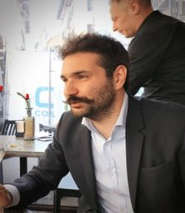
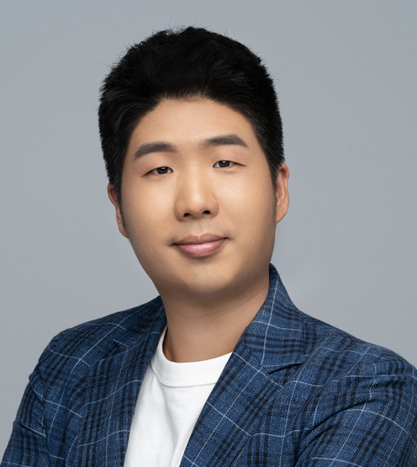
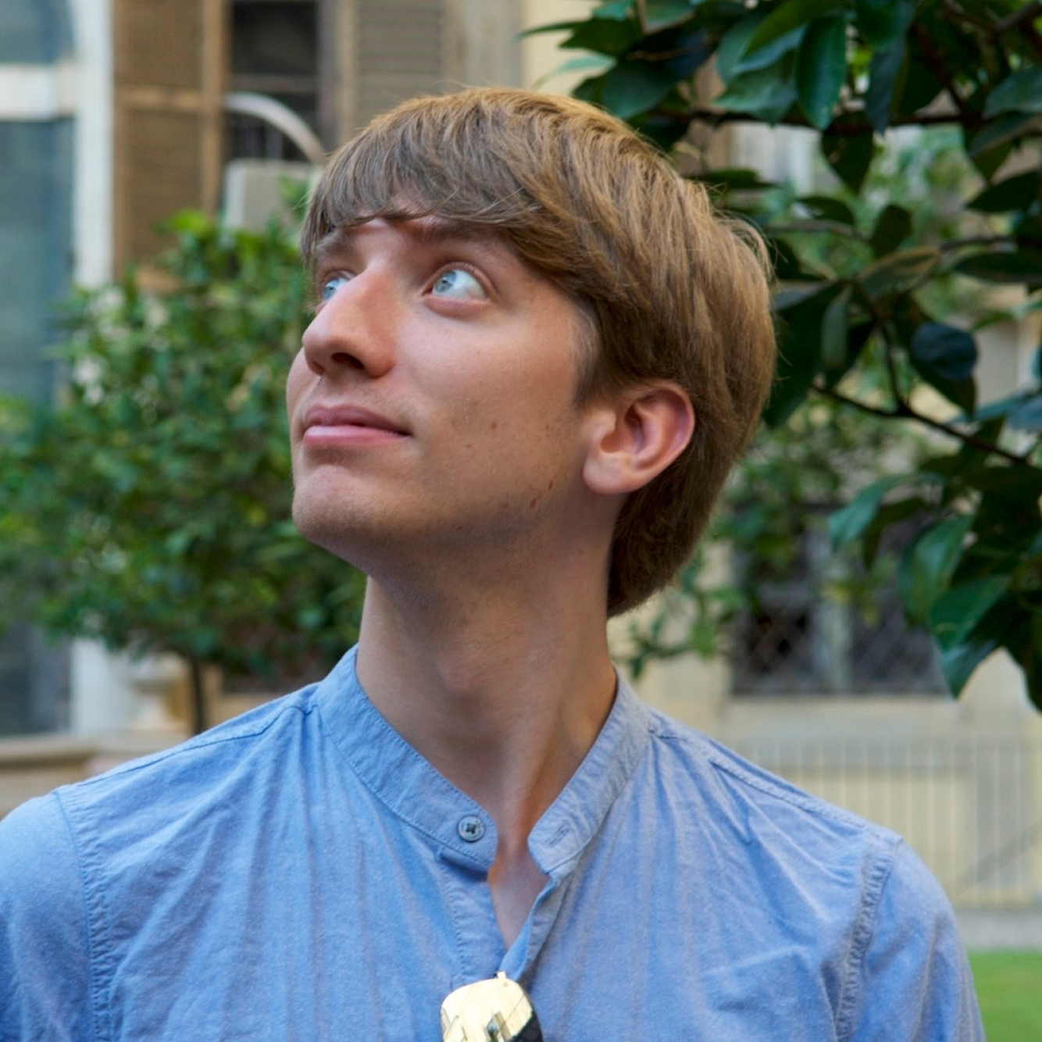
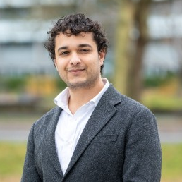

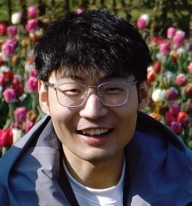
Your Instructors
Andrew Yates
Johns Hopkins University
HLTCOE
Carlos Lassance
Cohere
Cosimo Rulli
ISTI-CNR
Eugene Yang
Johns Hopkins University
HLTCOE
Sean MacAvaney
University of Glasgow
Siddharth Singh
University of Amsterdam
Thống Nguyen
University of Amsterdam
Yibin Lei
University of Amsterdam

Slide 4
Schedule
Introduction ← now
Datasets and Evaluation
LSR Framework
Initialization of LSR
Modalities
English Text
Multilingual Text
Multimodal Data
Indexing & efficiency
Hybrid dense-sparse retrieval
Conclusion

Slide 5



Slide 6
Background

Slide 7
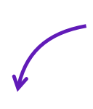
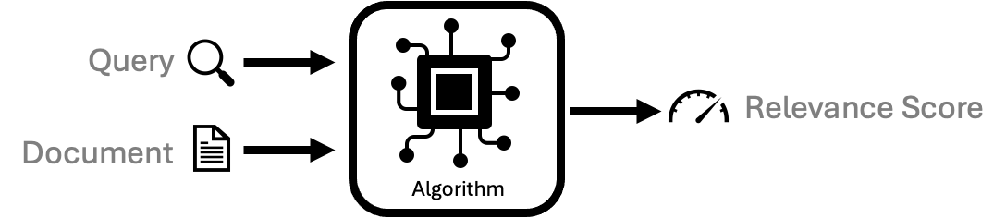
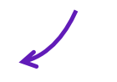

Most of this tutorial
Relevance Models
model.scorer()
Retrieval Engines
Covered in the second half
Step 1: model.doc_encoder() >> indexer
Step 2: model.query_encoder() >> retriever

Slide 8
Relevance Model Paradigms (Scoring Perspective)
(score)
(score)
(score)
dense vector
dense vector
dense vector
dense vector
dense vector
dense vector
dense vector
dense vector
dense vector
dense vector
dense vector
Model
Model
Model
Model
Model
Query + Doc.
Query
Doc.
Query
Doc.
Cross-Encoding
Jointly encodes Q&D,
score as classification
Single-Vector Dense
Encode Q&D into dense vector,
score as vector similarity
Multi-Vector Dense
Encode Q&D into multiple vectors, aggregate vector similarities

Slide 9
Relevance Model Paradigms (Scoring Perspective)
(score)
sparse vector
sparse vector
Model
Model
Query
Doc.
Learned Sparse
Encode Q&D into sparse vectors,
score as vector similarity

Slide 10
Why Sparse?
Why Learned?
Why now?

Slide 11
Why Sparse?
Why Learned?
Why now?
← now

Slide 12

Dense vs Sparse
~100-5,000 dimensions
(typical: 768)
Dimensions are latent.
Typically scored with Inner Product (dot)
Example: (TAS-B)
[0.26, -0.3, 0.25, -0.05, 0.7, 0.52, -0.25, 0.09, -0.41, -0.2, -0.21, 0.24, 0.04, 0.09, -0.08, 0.25, 0.1, 0.01, -0.21, -0.3, 0.28, -0.27, 0.67, 0.24, -0.09, -0.22, -0.2, -0.13, -0.08, -0.06, 0.33, -0.04, 0.23, -0.09, -0.24, -0.14, 0.09, -0.11, -0.19, -0.04, -0.48, 0.08, -0.35, -0.04, -0.1, 0.0, -0.25, 0.19, -0.33, -0.01, -0.23, 0.4, 0.02, 0.15, -0.13, -0.11, -0.41, -0.24, 0.3, -0.18, 0.05, 0.36, 0.06, 0.41, -0.24, -0.31, -0.24, 0.43, 0.19, -0.51, 0.79, 0.35, ...]
dense vector
10,000+ dimensions
(but mostly 0’s)
Dimensions can be
associated with concepts.
Typically scored with Inner Product (dot)
Example: (SPLADE)
{##ft: 2.77, del: 2.73, canal: 2.73, canals: 2.0, river: 0.92,
of: 0.65, beach: 0.56, lake: 0.56, reservoir: 0.43, map: 0.39, marsh: 0.36, geography: 0.34, cave: 0.32, lane: 0.32, boat: 0.31, bridge: 0.31, germany: 0.28, ferry: 0.26, belgium: 0.26,
museum: 0.26, channel: 0.25, ocean: 0.24, tunnel: 0.24,
waterway: 0.23, lagoon: 0.23, beck: 0.21, pool: 0.17, harbor: 0.13, town: 0.13, city: 0.12, harbour: 0.12, zone: 0.11, port: 0.1, ...}
sparse vector
Model
Model
Content
Content

Slide 13
Dense vs Sparse
~100-5,000 dimensions
(typical: 768)
Dimensions are latent.
Typically scored with Inner Product (dot)
Example: (TAS-B)
[0.26, -0.3, 0.25, -0.05, 0.7, 0.52, -0.25, 0.09, -0.41, -0.2, -0.21, 0.24, 0.04, 0.09, -0.08, 0.25, 0.1, 0.01, -0.21, -0.3, 0.28, -0.27, 0.67, 0.24, -0.09, -0.22, -0.2, -0.13, -0.08, -0.06, 0.33, -0.04, 0.23, -0.09, -0.24, -0.14, 0.09, -0.11, -0.19, -0.04, -0.48, 0.08, -0.35, -0.04, -0.1, 0.0, -0.25, 0.19, -0.33, -0.01, -0.23, 0.4, 0.02, 0.15, -0.13, -0.11, -0.41, -0.24, 0.3, -0.18, 0.05, 0.36, 0.06, 0.41, -0.24, -0.31, -0.24, 0.43, 0.19, -0.51, 0.79, 0.35, ...]
dense vector
10,000+ dimensions
(but mostly 0’s)
Dimensions can be
associated with concepts.
Typically scored with Inner Product (dot)
Example: (SPLADE)
{##ft: 2.77, del: 2.73, canal: 2.73, canals: 2.0, river: 0.92,
of: 0.65, beach: 0.56, lake: 0.56, reservoir: 0.43, map: 0.39, marsh: 0.36, geography: 0.34, cave: 0.32, lane: 0.32, boat: 0.31, bridge: 0.31, germany: 0.28, ferry: 0.26, belgium: 0.26,
museum: 0.26, channel: 0.25, ocean: 0.24, tunnel: 0.24,
waterway: 0.23, lagoon: 0.23, beck: 0.21, pool: 0.17, harbor: 0.13, town: 0.13, city: 0.12, harbour: 0.12, zone: 0.11, port: 0.1, ...}
sparse vector
Model
Model
Content
Content
Same Query (any guesses?)

Slide 14
Dense vs Sparse
~100-5,000 dimensions
(typical: 768)
Dimensions are latent.
Typically scored with Inner Product (dot)
Example: (TAS-B)
[0.26, -0.3, 0.25, -0.05, 0.7, 0.52, -0.25, 0.09, -0.41, -0.2, -0.21, 0.24, 0.04, 0.09, -0.08, 0.25, 0.1, 0.01, -0.21, -0.3, 0.28, -0.27, 0.67, 0.24, -0.09, -0.22, -0.2, -0.13, -0.08, -0.06, 0.33, -0.04, 0.23, -0.09, -0.24, -0.14, 0.09, -0.11, -0.19, -0.04, -0.48, 0.08, -0.35, -0.04, -0.1, 0.0, -0.25, 0.19, -0.33, -0.01, -0.23, 0.4, 0.02, 0.15, -0.13, -0.11, -0.41, -0.24, 0.3, -0.18, 0.05, 0.36, 0.06, 0.41, -0.24, -0.31, -0.24, 0.43, 0.19, -0.51, 0.79, 0.35, ...]
dense vector
10,000+ dimensions
(but mostly 0’s)
Dimensions can be
associated with concepts.
Typically scored with Inner Product (dot)
Example: (SPLADE)
{##ft: 2.77, del: 2.73, canal: 2.73, canals: 2.0, river: 0.92,
of: 0.65, beach: 0.56, lake: 0.56, reservoir: 0.43, map: 0.39, marsh: 0.36, geography: 0.34, cave: 0.32, lane: 0.32, boat: 0.31, bridge: 0.31, germany: 0.28, ferry: 0.26, belgium: 0.26,
museum: 0.26, channel: 0.25, ocean: 0.24, tunnel: 0.24,
waterway: 0.23, lagoon: 0.23, beck: 0.21, pool: 0.17, harbor: 0.13, town: 0.13, city: 0.12, harbour: 0.12, zone: 0.11, port: 0.1, ...}
sparse vector
Model
Model
Content
Content
Query: canals of delft

Slide 15
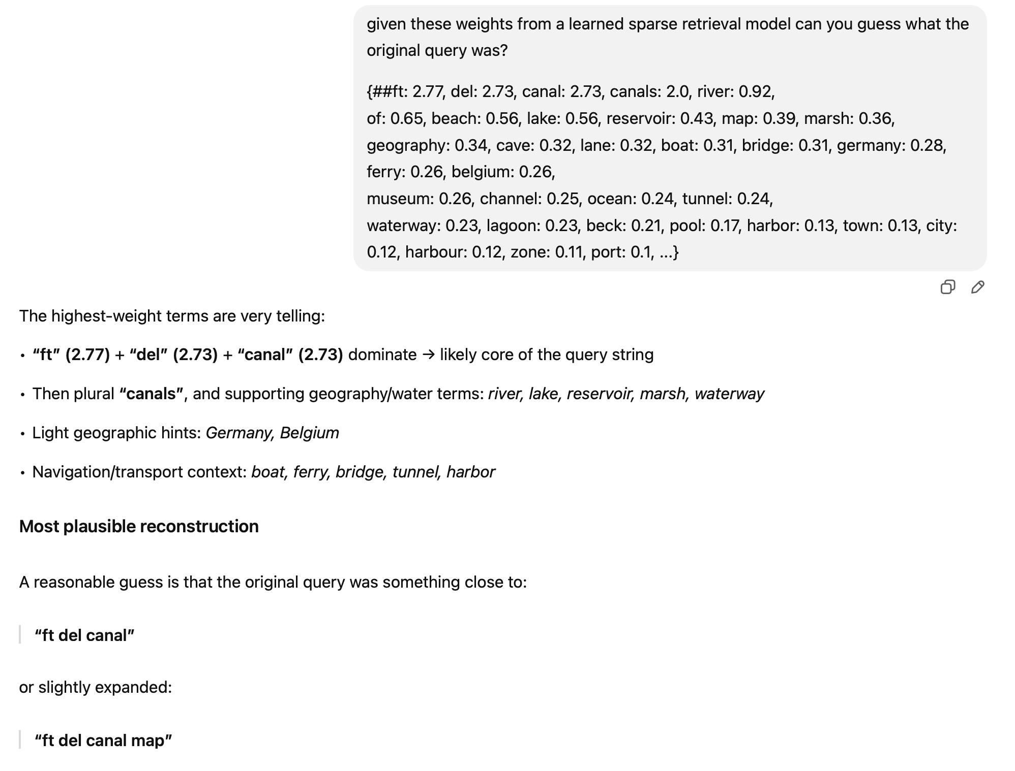
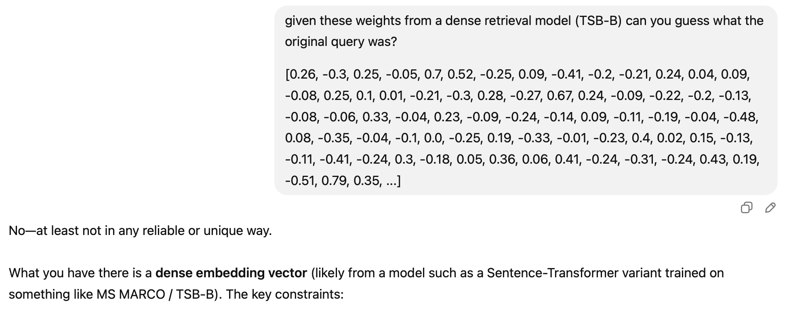
¯\_(ツ)_/¯

Slide 16
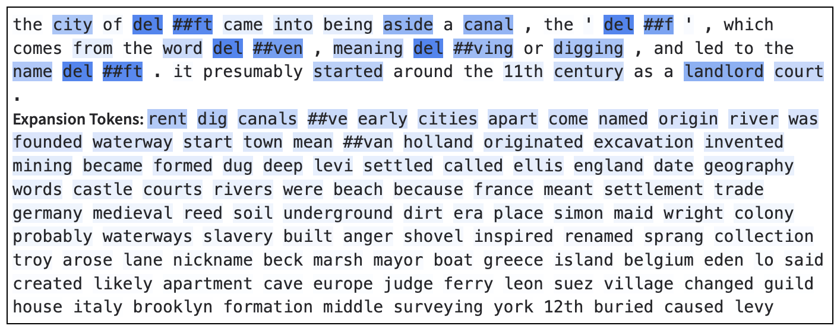
Why Sparse?
1. Intuition / Interpretability
Comapred to dense vectors, sparse vectors that are aligned with terms in a vocabulary can be easily reasoned about.
The terms with the highest weights are the most important in the document

Slide 17
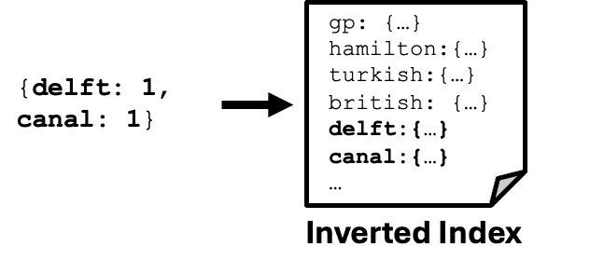
Why Sparse?
2. Practical / Efficiency
Sparse vectors can be processed faster than dense ones, leveraging
decades of optimizations (and new ones, too!)
Fits in well with existing inverted index infrastructure (e.g., Lucene, Solr, etc.)
Can completely ignore docs without these query terms

Slide 18
Why Sparse?
3. Philosophical
A piece of content (queries/documents/etc) is only “about” a limited number of concepts.
Corollary: A piece of content is completely unrelated to most concepts
(i.e., it’s sparse in the space of concepts).
Representations that reflect this sparsity (arguably) better reflect reality.

Slide 19
Why Sparse?
Why Learned?
Why now?
← now

Slide 20
We already have (non-learned) sparse models!
The city of Delft came into being aside a canal, the 'Delf', which comes from the word delven, meaning delving or digging, and led to the name Delft. It presumably started around the 11th century as a landlord court.
(TF) →
{delft: 2, city: 1, of: 1, came: 1, into: 1, being: 1, aside: 1, canal: 1, delf: 1, which: 1, comes: 1, from: 1, word: 1, ...}

Slide 21
We already have (non-learned) sparse models!
The city of Delft came into being aside a canal, the 'Delf', which comes from the word delven, meaning delving or digging, and led to the name Delft. It presumably started around the 11th century as a landlord court.
(TF) →
{delft: 2, city: 1, of: 1, came: 1, into: 1, being: 1, aside: 1, canal: 1, delf: 1, which: 1, comes: 1, from: 1, word: 1, ...}

Slide 22
Are Passage 1 and 2 equally “about” Delft?
Passage 1:
The city of Delft came into being aside a canal, the 'Delf', which comes from the word delven, meaning delving or digging, and led to the name Delft. It presumably started around the 11th century as a landlord court.
{delft: 2, ...}
Passage 2:
The Jesuit Church on the Oude Langendijk in Delft, 1700–1725, brush in gray ink, 13.2 × 20.2 cm, Delft, Archief Delft. Johannes, Jan or Johan Vermeer (/vərˈmɪər/; Dutch: [joːˈɦɑnəs jɑn vərˈmeːr]; 1632 – December 1675) was a Dutch painter who specialized in domestic interior scenes of middle-class life. Vermeer was a moderately successful provincial genre painter in his lifetime.
{delft: 2, ...}

Slide 23
Are Passage 1 and 2 equally “about” Delft?
Passage 1:
The city of Delft came into being aside a canal, the 'Delf', which comes from the word delven, meaning delving or digging, and led to the name Delft. It presumably started around the 11th century as a landlord court.
{del: 2, ...}
Passage 2:
The Jesuit Church on the Oude Langendijk in Delft, 1700–1725, brush in gray ink, 13.2 × 20.2 cm, Delft, Archief Delft. Johannes, Jan or Johan Vermeer (/vərˈmɪər/; Dutch: [joːˈɦɑnəs jɑn vərˈmeːr]; 1632 – December 1675) was a Dutch painter who specialized in domestic interior scenes of middle-class life. Vermeer was a moderately successful provincial genre painter in his lifetime.
{delft: 2, ...}
I argue Passage 1 is more directly “about” Delft.

Slide 24
Why Learned?
1. Term statistics don’t tell the whole story
The context is really important for determining how much text is “about” a concept.
Signals like TF and IDF provide valuable signals, but they’re far from perfect.
(Especially for short texts.)
Text processing methods, especially language models, can help make better predictions of “aboutness”.
Passage 1: (w/ LSR)
{..., del: 2.60, ##ft: 2.52, ...}
Passage 2: (w/ LSR)
{..., del: 1.78, ##ft: 2.12, ...}

Slide 25
Why Learned?
2. Learned language models are (practically) built for this!
A major limitation of existing sparse models is lexical mismatch, where queries can’t match documents with conceptually similar (but different) terms.
Neural Language Models are trained to predict likely words to fit text.
{city: 1.2, town: 0.5, settlement: 0.2, ...}
Neural Language Model (e.g., BERT, GPT)
The city of Delft came into being aside a canal, the 'Delf', ...

Slide 26
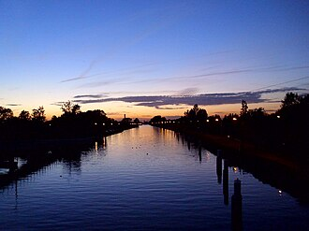
Why Learned?
3. Multi-(Language|Modal|etc.)
Machine learning allows us to map various modalities, languages, etc. into the same sparse representation space.
{canal: 1.6, …}
{canal: 1.6, …}
{canal: 1.6, …}
The city of Delft came into being aside a canal, the 'Delf', which comes from the word delven, ...
De stad Delft is ontstaan ​​langs een kanaal, de 'Delf', dat afkomstig is van het woord 'delven', wat 'graven' …
CC BY-SA 4.0 https://en.wikipedia.org/wiki/Delft
#/media/File:Delftse_Schie_at_sundown.JPG

Slide 27
Why Sparse?
Why Learned?
Why now?
← now

Slide 28
Why now?
The technology is getting pretty mature!
LSR models are often part of the best-performing systems in IR evaluations.
It’s being integrated into search engine products, e.g., OpenSearch, Pinecone, SentenceTransformers, Solr, etc.
But there’s still more to do!
Supporting richer types of inputs (e.g., multi-modal, multi-lingual, etc.)
Richer types of representations (beyond vocabulary-aligned)
Adaptation to LLMs
Maybe you could be the one to crack these problems in LSR!

Slide 29
Any Questions?

Slide 30
Datasets and Evaluation
(Crash Course)
ECIR 2026 Tutorial
presented by Sean MacAvaney

Slide 31
Schedule
Introduction
Datasets and Evaluation ← now
LSR Framework
Training LSR
Modalities
English Text
Multilingual Text
Multimodal Data
Indexing & efficiency
Hybrid dense-sparse retrieval
Conclusion

Slide 32
Relevance Models
model.scorer()
Retrieval Engines
Step 1: model.doc_encoder() >> indexer
Step 2: model.query_encoder() >> retriever

Slide 33
How do you know if your engine is any good?

Slide 34
…
…

Slide 35
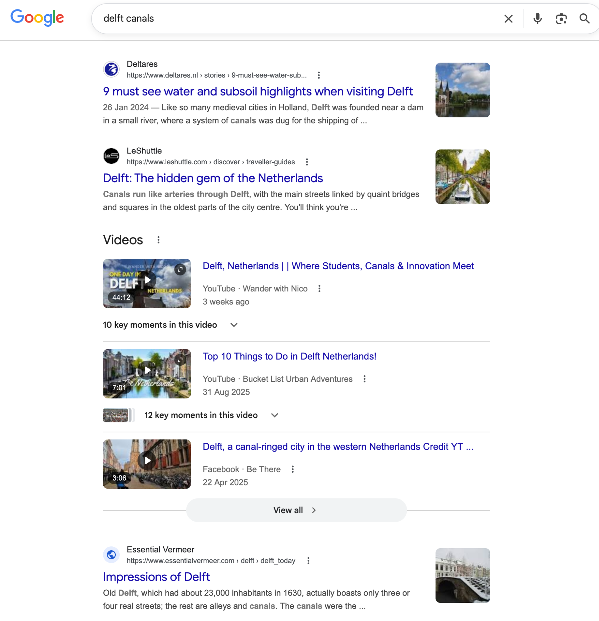
(document_id, score)
(document_id, score)
(document_id, score)
(document_id, score)
(document_id, score) ~=
(document_id, score)
(document_id, score)
(document_id, score)
(document_id, score)
(document_id, score)
…
…
…

Slide 36
(document_id, score)
(document_id, score)
(document_id, score)
(document_id, score)
(document_id, score) ~=
(document_id, score)
(document_id, score)
(document_id, score)
(document_id, score)
(document_id, score)
…
A user could assess if these result pages are good/bad…
…
…

Slide 37
(document_id, score) -
(document_id, score) +
(document_id, score) -
(document_id, score) +
(document_id, score) +
(document_id, score) -
(document_id, score) -
(document_id, score) -
(document_id, score) +
(document_id, score) -
…
For a reusable evaluation
…
…

Slide 38
(document_id, score) -
(document_id, score) +
(document_id, score) -
(document_id, score) +
(document_id, score) +
(document_id, score) -
(document_id, score) -
(document_id, score) -
(document_id, score) +
(document_id, score) -
…
Evaluation
Measure
e.g.,
RR=0.5
…
…

Slide 39
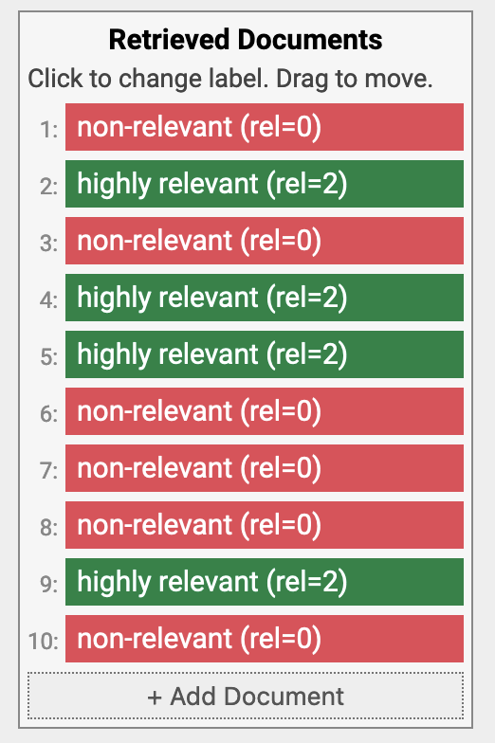
Common Evaluation Measures
(M)RR: (Mean) Reciprocal Rank:
1 / rank of first relevant document
(Take the mean over multiple queries in a test collection)
RR = 1/2 = 0.5
https://demo.ir-measur.es

Slide 40
Common Evaluation Measures
nDCG: normalized Discounted Cumulative Gain
Compares a ranking with its ideal ranking for the known relevant documents
(also considers different grades of relevance).
Järvelin & Kekäläinen. Cumulated gain-based evaluation of IR techniques. TOIS 2002.
nDCG = 0.683
https://demo.ir-measur.es

Slide 41
Measuring Efficiency
Sparsity: Number/proportion of non-zero dimensions of query/document
Related: Index Size (GB)
FLOPs: Average number of floating point operations to score a document
(i.e., average non-zero overlap between query and document representations)
Retrieval Latency: Mean response time over a set of queries

Slide 42
Common Test Collections
MS MARCO
Short passages (2-3 sentences) and web queries from Bing
100,000s of queries (including a train set)
Shallow assessments (only a few known relevant documents per query)
TREC Deep Learning
Uses MS MARCO corpus
100s of queries
Deep relevance assessments
BEIR
A suite of ~20 datasets (most of the time, people evaluate on a subset)
Primarily for testing out-of-domain generalization
Variable number of queries, documents, assessments across datasets
MS MARCO: A Human Generated MAchine Reading COmprehension Dataset. Bajaj et al. arXiv 2016.
Overview of the TREC 2019 Deep Learning Track. Craswell et al. TREC 2019.
BEIR: A Heterogenous Benchmark for Zero-shot Evaluation of Information Retrieval Models. Thankur et al. NeurIPS 2021.

Slide 43
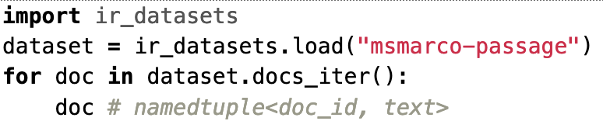
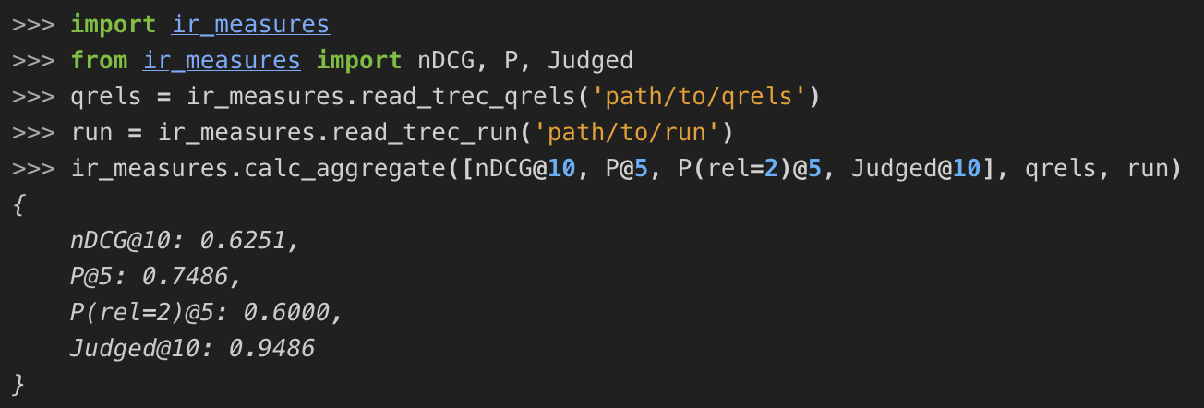
Resources
lsr-benchmark: https://github.com/reneuir/lsr-benchmark
testing efficiency of LSR models
ir-datasets: https://ir-datasets.com/
Loading and working with datasets
ir-measures: https://ir-measur.es/
Calculation of evaluation measures
List of LSR papers, software, datasets, etc:
https://github.com/TusKANNy/awesome-learned-sparse-retrieval

Slide 44
Any Questions?

Slide 45
Neural Lexical Search with Learned Sparse Retrieval
ECIR 2026 Tutorial

Slide 46
LSR Framework
ECIR 2026 Tutorial
presented by Andrew Yates

Slide 47
Schedule
Introduction
Datasets and Evaluation
LSR Framework ← now
Initialization of LSR
Modalities
English Text
Multilingual Text
Multimodal Data
Indexing & efficiency
Hybrid dense-sparse retrieval
Conclusion

Slide 48
Learned Sparse Retrieval Framework
Ingredients
Sparse Encoder
Sparse Regularizer
Supervision
Predicts term weights
(MLP, MLM, etc)
Limits non-zero weights
(FLOPs, TopK, etc)
Training
(negatives, distillation, etc)
A Unified Framework for Learned Sparse Retrieval. Nguyen, MacAvaney, Yates. ECIR 2023.

Slide 49
Learned Sparse Retrieval Framework
Ingredients
Sparse Encoder
Sparse Regularizer
Supervision
Predicts term weights
(MLP, MLM, etc)
Limits non-zero weights
(FLOPs, TopK, etc)
Training
(negatives, distillation, etc)
A Unified Framework for Learned Sparse Retrieval. Nguyen, MacAvaney, Yates. ECIR 2023.

Slide 50
Binary Encoder
“delft famous sites”
Binary Encoder

Slide 51
Binary Encoder
[CLS]
delft
famous
sites
[SEP]
Tokenizer
“delft famous sites”
Binary Encoder

Slide 52
Binary Encoder
sites
famous
delft
0
0
1
1
0
…
1
[CLS]
delft
famous
sites
[SEP]
Tokenizer
“delft famous sites”
Binary Encoder

Slide 53
Binary Encoder
sites
famous
delft
0
0
1
1
0
…
1
expansion
[CLS]
delft
famous
sites
[SEP]
weighting
Tokenizer
“delft famous sites”
Binary Encoder

Slide 54
Binary Encoder
sites
famous
delft
0
0
1
1
0
…
1
All terms are treated equally
“famous sites of Delft”
expansion
[CLS]
delft
famous
sites
[SEP]
weighting
Tokenizer
“delft famous sites”
Binary Encoder

Slide 55
Inference-Free Encoders
sites
famous
delft
0
0
1.5
1.3
0
…
1.4
expansion
[CLS]
delft
famous
sites
[SEP]
weighting
Tokenizer
“delft famous sites”
IDF Encoder

Slide 56

Inference-Free Encoders
sites
famous
Delft
0
0
1.5
1.3
0
…
1.4
expansion
Weighting based on collection statistics
(not based on semantic relevance)
[CLS]
delft
famous
sites
[SEP]
weighting
Tokenizer
Replace binary encoder with IDF encoder.
Towards Competitive Search Relevance For Inference-Free Learned Sparse Retrievers. Geng et al. arXiv 2025.
“delft famous sites”
IDF Encoder

Slide 57
Inference-Free Encoders
sites
famous
delft
0
0
1.5
1.3
0
…
1.4
expansion
Weighting based on collection statistics
(not based on semantic relevance)
[CLS]
delft
famous
sites
[SEP]
weighting
Tokenizer
Replace binary encoder with IDF encoder.
Towards Competitive Search Relevance For Inference-Free Learned Sparse Retrievers. Geng et al. arXiv 2025.
Replace IDF with learned static weights.
Effective Inference-Free Retrieval for Learned Sparse Representations. Nardini et al. SIGIR 2025.
“delft famous sites”
IDF Encoder

Slide 58
Inference-Free Encoders
sites
famous
delft
0
0
1.5
1.3
0
…
1.4
expansion
Weighting based on collection statistics
(not based on semantic relevance)
[CLS]
delft
famous
sites
[SEP]
weighting
Tokenizer
Replace binary encoder with IDF encoder.
Towards Competitive Search Relevance For Inference-Free Learned Sparse Retrievers. Geng et al. arXiv 2025.
Replace IDF with learned static weights.
Effective Inference-Free Retrieval for Learned Sparse Representations. Nardini et al. SIGIR 2025.
BM25 is also as an inference-free encoder.
“delft famous sites”
IDF Encoder

Slide 59
MLP Encoder
[CLS]
delft
famous
sites
[SEP]
Tokenizer
“delft famous sites”
MLP Encoder

Slide 60
MLP Encoder
Transformer Layers
[CLS]
delft
famous
sites
[SEP]
Tokenizer
“delft famous sites”
MLP Encoder

Slide 61
MLP Encoder
MLP
Transformer Layers
[CLS]
delft
famous
sites
[SEP]
Tokenizer
“delft famous sites”
MLP Encoder

Slide 62
MLP Encoder
sites
famous
delft
0
0
0.8
1.4
0
…
1.5
ReLU + Log1P
MLP
Transformer Layers
[CLS]
delft
famous
sites
[SEP]
Tokenizer
“delft famous sites”
MLP Encoder

Slide 63
MLP Encoder
sites
famous
Delft
0
0
0.8
1.4
0
…
1.5
Learning to score input terms by an MLP regression head
ReLU + Log1P
MLP
Transformer Layers
expansion
weighting
[CLS]
delft
famous
sites
[SEP]
Tokenizer
“delft famous sites”
MLP Encoder
Notes:
TFC2: The increase in the retrieval score due to an increase in TF should be smaller for larger TFs.

Slide 64
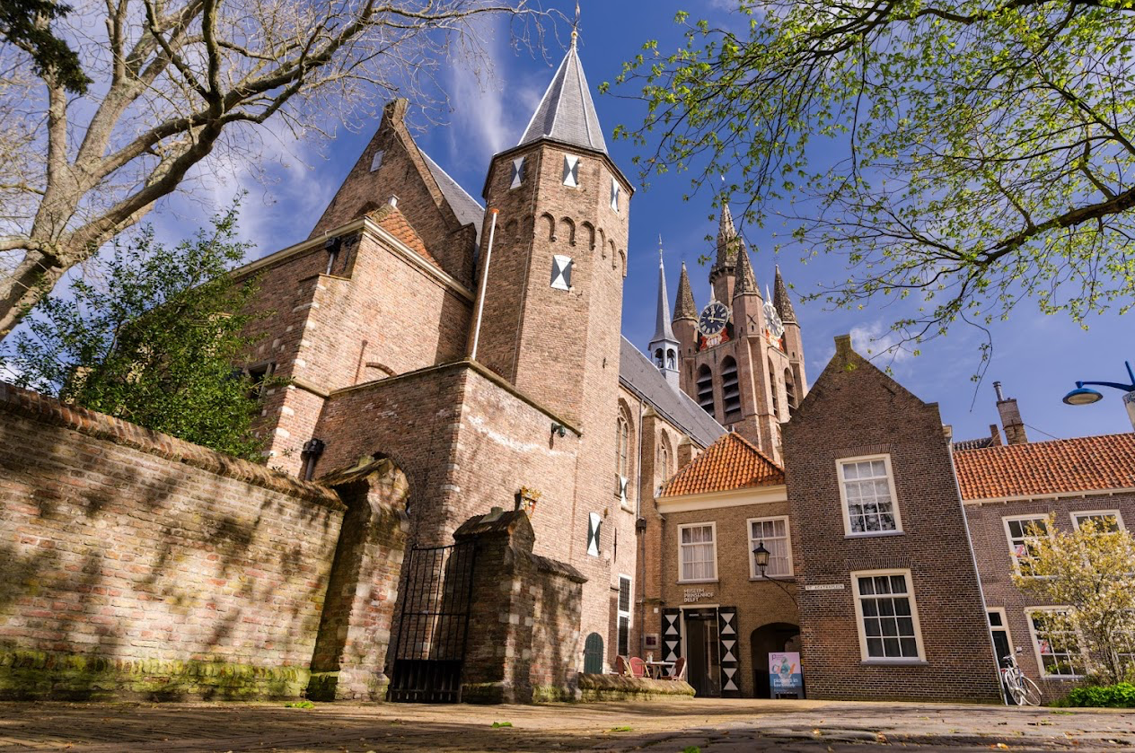
MLP Encoder
sites
famous
Delft
0
0
0.8
1.4
0
…
1.5
Learning to score input terms by an MLP regression head
ReLU + Log1P
MLP
Transformer Layers
expansion
Cannot handle term mismatch
(e.g., “famous sites” vs “prinsenhof”)
weighting
[CLS]
delft
famous
sites
[SEP]
Tokenizer
“delft famous sites”
MLP Encoder
Notes:
TFC2: The increase in the retrieval score due to an increase in TF should be smaller for larger TFs.

Slide 65
MLP Encoder + External Expansion
sites
famous
delft
0
0
0.8
1.4
0
…
1.5
ReLU + Log1P
MLP
Transformer Layers
expansion
weighting
[CLS]
delft
famous
sites
[SEP]
Tokenizer
“delft famous sites”
Expansion Module (e.g., Doc2Query)
MLP Encoder

Slide 66
MLP Encoder + External Expansion
sites
famous
delft
0
0
0.8
1.4
0
…
1.5
Learning to score input terms by an MLP regression head
MLP
Transformer Layers
expansion
weighting
[CLS]
delft
famous
sites
[SEP]
Tokenizer
“delft famous sites”
Expansion Module (e.g., Doc2Query)
MLP Encoder

Slide 67
MLP Encoder + External Expansion
DocT5Query
Generate queries given a document
Document

Slide 68
MLP Encoder + External Expansion
DocT5Query
Generate queries given a document
Document
Predicted Queries

Slide 69
MLP Encoder + External Expansion
DocT5Query
Generate queries given a document
Document
Predicted Queries
MLP Sparse Encoder

Slide 70
MLP Encoder + External Expansion
LLMs
(e.g., GPT)
Prompt LLMs to generate different types of information.
Input
Expansion
MLP Sparse Encoder

Slide 71
MLP Encoder + External Expansion
LLMs
(e.g., GPT)
Prompt LLMs to generate different types of information.
Input
Expansion
MLP Sparse Encoder
Not end-to-end differentiable

Slide 72
MLM Encoder
Transformer Layers
[CLS]
delft
famous
sites
[SEP]
Tokenizer
“delft famous sites”

Slide 73
MLM Encoder
MLM Head
Transformer Layers
[CLS]
delft
famous
sites
[SEP]
Tokenizer
“delft famous sites”

Slide 74
MLM Encoder
…
…
…
…
…
Logits over vocab
MLM Head
Transformer Layers
[CLS]
delft
famous
sites
[SEP]
Tokenizer
“delft famous sites”

Slide 75
MLM Encoder
sparse vector
Column-wise pooling
…
…
…
…
…
Logits over vocab
MLM Head
Transformer Layers
[CLS]
delft
famous
sites
[SEP]
Tokenizer
“Delft famous sites”

Slide 76
MLM Encoder
sparse vector
Column-wise pooling
…
…
…
…
…
Logits over vocab
expansion (differentiable)
MLM Head
weighting
Transformer Layers
[CLS]
delft
famous
sites
[SEP]
Tokenizer
“delft famous sites”

Slide 77
MLM Encoder
sparse vector
Column-wise pooling
…
…
…
…
…
Logits over vocab
expansion (differentiable)
MLM Head
weighting
Transformer Layers
[CLS]
delft
famous
sites
[SEP]
Tokenizer
“delft famous sites”

Slide 78
MLM Head for Expansion & Weighting
Vocab
Embedding
Table
…
Transformer Layers
[CLS]
delft
famous
sites
[SEP]
“delft famous sites”

Slide 79
MLM Head for Expansion & Weighting
x
delft
Vocab
Embedding
Table
…
delft
Transformer Layers
[CLS]
delft
famous
sites
[SEP]
“delft famous sites”

Slide 80
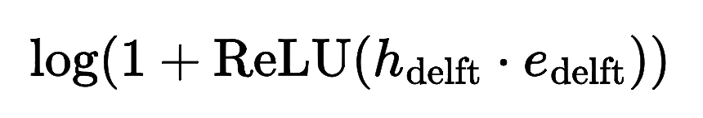
MLM Head for Expansion & Weighting
5.5
delft
Vocab
Embedding
Table
x
Output Sparse Vector
…
Term | Weight
delft | 5.5
delft
Transformer Layers
[CLS]
delft
famous
sites
[SEP]
“delft famous sites”

Slide 81
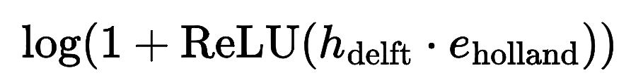
MLM Head for Expansion & Weighting
Vocab
Embedding
Table
3.2
holland
x
Output Sparse Vector
…
Term | Weight
delft | 5.5
holland | 3.2
delft
Transformer Layers
[CLS]
delft
famous
sites
[SEP]
“delft famous sites”

Slide 82
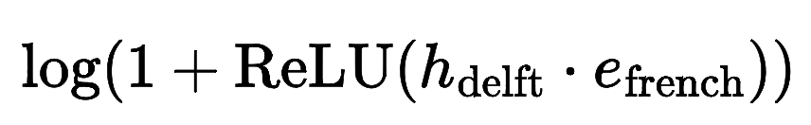
MLM Head for Expansion & Weighting
Vocab
Embedding
Table
0.0
french
x
Output Sparse Vector
…
Term | Weight
delft | 5.5
holland | 3.2
french | 0.0
delft
Transformer Layers
[CLS]
delft
famous
sites
[SEP]
“delft famous sites”

Slide 83
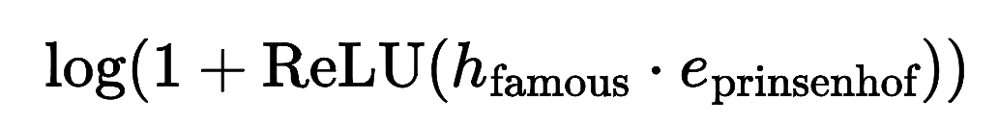
MLM Head for Expansion & Weighting
Vocab
Embedding
Table
Output Sparse Vector
4.1
…
x
prinsenhof
Term | Weight
delft | 5.5
holland | 3.2
french | 0.0
… | 0.0
prinsenhof | 4.1
… | …
famous
Transformer Layers
[CLS]
delft
famous
sites
[SEP]
“delft famous sites”

Slide 84
MLM Head for Expansion & Weighting
Vocab
Embedding
Table
Output Sparse Vector
4.1
…
x
prinsenhof
Term | Weight
delft | 5.5
holland | 3.2
french | 0.0
… | 0.0
prinsenhof | 4.1
… | …
famous
Positive
Most of them are zeros
Transformer Layers
[CLS]
delft
famous
sites
[SEP]
“delft famous sites”

Slide 85
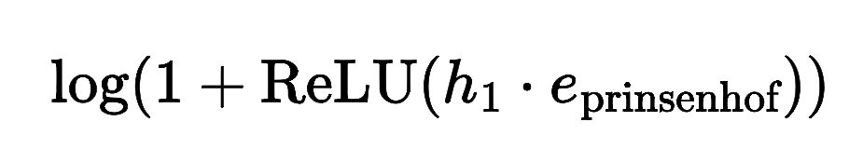
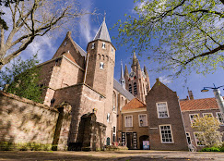
MLM Head with Multimodal Inputs
4.1
prinsenhof
x
Vocab
Embedding
Table
…
We can compare non-text inputs with an embedding table in the same way.
Image Patches
Output Sparse Vector
Term | Weight
prinsenhof | 4.1
… | …
… | …
Transformer Layers
Vision Model
(e.g., CLIP or Qwen-VL)
Input:
Image

Slide 86
Summary of Sparse Encoders
Binary Encoder: binary weights, no expansion.
Inference-Free Encoders: IDF weights, no expansion.
MLP Encoder: weighting by a transformer model, no expansion.
MLP Encoder with External Expansion: external expansion.
MLM: end-to-end weighting and expansion by transformer-based MLM.
Static weighting
Learning from
data

Slide 87
Dual Sparse Encoder
x
Shared Encoder
(e.g., MLP, MLM)
Query
Doc

Slide 88
Dual Sparse Encoder
x
x
Shared Encoder
Query Encoder
Document Encoder
(e.g., MLP, MLM)
(e.g, MLP)
(e.g, MLM)
Query
Doc
Query
Doc

Slide 89
Learned Sparse Retrieval Framework
Ingredients
Sparse Encoder
Sparse Regularizer
Supervision
Predicts term weights
(MLP, MLM, etc)
Limits non-zero weights
(FLOPs, TopK, etc)
Provides supervision
(negatives, distillation, etc).

Slide 90
Sparse Regularizers
Exact Sparsity Measure: L₀
0 | 0.5 | 0 | 1.5 | 0 | 8.3 | 0 | 0

Slide 91
Sparse Regularizers
Exact Sparsity Measure: L₀
0 | 0.5 | 0 | 1.5 | 0 | 8.3 | 0 | 0
L₀
0 | 1 | 0 | 1 | 0 | 1 | 0 | 0

Slide 92
Sparse Regularizers
Exact Sparsity Measure: L₀
0 | 0.5 | 0 | 1.5 | 0 | 8.3 | 0 | 0
L₀
Sum
0 | 1 | 0 | 1 | 0 | 1 | 0 | 0
3

Slide 93
Sparse Regularizers
Exact Sparsity Measure: L₀
0 | 0.5 | 0 | 1.5 | 0 | 8.3 | 0 | 0
L₀
Sum
0 | 1 | 0 | 1 | 0 | 1 | 0 | 0
3
Count of non-zero dimensions, not directly differentiable!

Slide 94
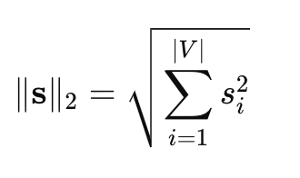
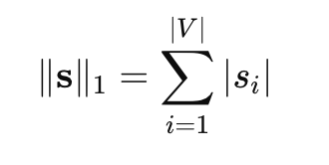
Sparse Regularizers
L₁, L₂:

Slide 95
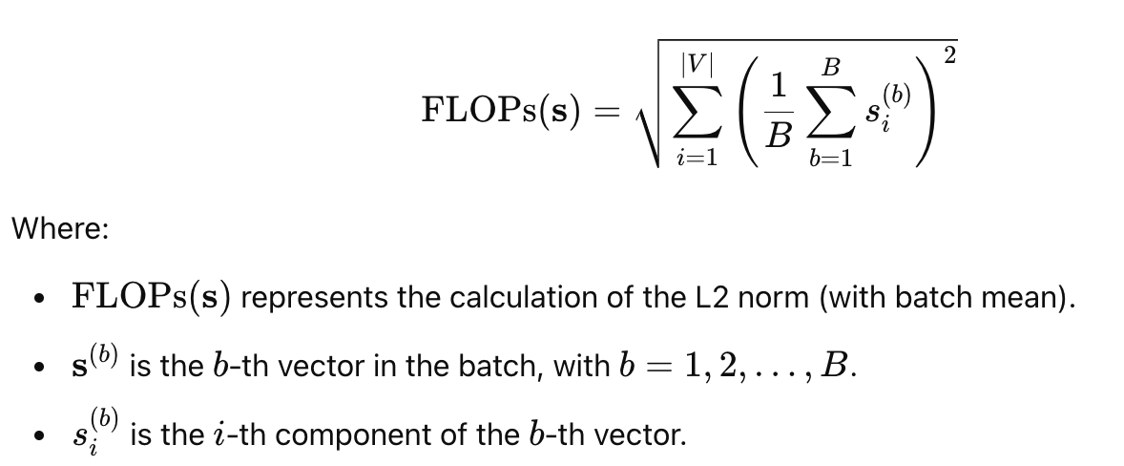
Sparse Regularizers
L₁, L₂:
FLOPs:

Slide 96
Sparse Regularizers
L₁, L₂:
FLOPs:
Top-K: Select top k dimensions with highest values

Slide 97
Sparse Regularizers
L₁, L₂:
FLOPs:
Top-K: Select top k dimensions with highest values
Side effect:
Encourage term weights to be small

Slide 98
Questions?
Next
Ingredients
Sparse Encoder
Sparse Regularizer
Supervision
Predicts term weights
(MLP, MLM, etc)
Limits non-zero weights
(FLOPs, TopK, etc)
Training
(negatives, distillation, etc)

Slide 99
Neural Lexical Search with Learned Sparse Retrieval
ECIR 2026 Tutorial

Slide 100
Initialization of LSR
Slides available at https://lsr-tutorial.github.io/
ECIR 2026 Tutorial
presented by Carlos Lassance

Slide 101
Schedule
Introduction
Datasets and Evaluation
LSR Framework
Initialization of LSR ← now
Modalities
English Text
Multilingual Text
Multimodal Data
Indexing & efficiency
Hybrid dense-sparse retrieval
Conclusion

Slide 102
Outline - LSR Initialization
Initialization of LSR with “MLM” Encoding:
  Masked Language Modelling
  Causal Language Modelling
  Sparse Autoencoders
Solving problems with initialization:
  Pretraining / Middle training
  Re-using previous models

Slide 103
Pre-initialized MLM Head
x
cherry
Vocab
Embedding
Table
…
[MASK]
Transformer Layers
[CLS]
tokyo
[MASK]
blossom
[SEP]
“tokyo [MASK] blossom”
“tokyo cherry blossom”

Slide 104
Pre-initialized MLM Head
x
cherry
Vocab
Embedding
Table
Output before softmax
…
Term | Weight
[MASK] | 3.5
japan | 3.2
cherry | 4.7
. | 3.0
sakura | 4.1
! | 1.0
[MASK]
Transformer Layers
[CLS]
tokyo
[MASK]
blossom
[SEP]
“tokyo [MASK] blossom”
“tokyo cherry blossom”

Slide 105
Sidenote - Transformer as an identity function
x
cherry
Vocab
Embedding
Table
Well trained vocab table
=
Good document expansion even with identity function
…
cherry]
Identity function
[CLS]
tokyo
cherry
blossom
[SEP]
“tokyo cherry blossom”

Slide 106
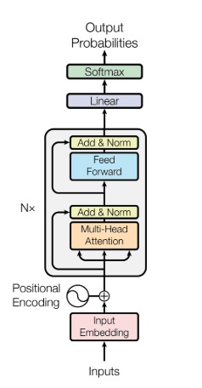
Sidenote on transformer layers
There are residual connections everywhere
=
Facilitates something closer to identity
Image from: https://towardsdatascience.com/a-complete-guide-to-bert-with-code-9f87602e4a11/

Slide 107
Pre-initialized CLM Head
x
blossom
Vocab
Embedding
Table
Output before softmax
…
Term | Weight
[MASK] | 3.5
japan | 3.2
blossom | 4.7
bloom | 3.0
tree | 4.1
! | 1.0
cherry
Transformer Layers
[CLS]
tokyo
[cherry]
blossom
“tokyo cherry blossom”

Slide 108
Pre-initialized CLM Head
Now token needs to generate next
Still good document expansion
Does not use what comes after to prime the expansion
x
blossom
Vocab
Embedding
Table
Output before softmax
…
Term | Weight
[MASK] | 3.5
japan | 3.2
blossom | 4.7
bloom | 3.0
tree | 4.1
! | 1.0
cherry
Transformer Layers
[CLS]
tokyo
[cherry]
blossom
“tokyo cherry blossom”
“tokyo cherry blossom”

Slide 109
Pre-initialized CLM Head
Models in this family:
CSPLADE
LION
LACONIC
SPLADE-Code
x
blossom
Vocab
Embedding
Table
Output before softmax
…
Term | Weight
[MASK] | 3.5
japan | 3.2
blossom | 4.7
bloom | 3.0
tree | 4.1
! | 1.0
cherry
Transformer Layers
[CLS]
tokyo
[cherry]
blossom
“tokyo cherry blossom”
“tokyo cherry blossom”

Slide 110
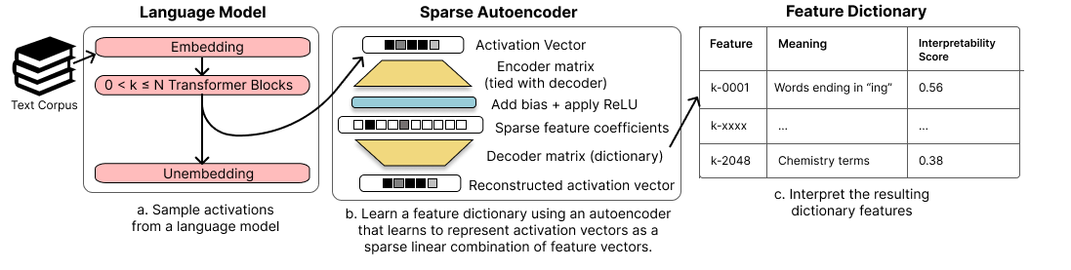
Sparse autoencoders
Huben, Robert, et al. "Sparse autoencoders find highly interpretable features in language models." The Twelfth International Conference on Learning Representations. 2023.

Slide 111
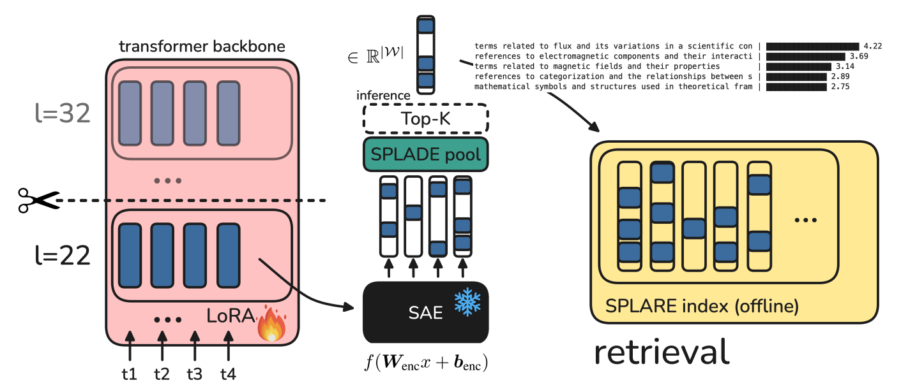
Sparse autoencoders - SPLARE
Formal, Thibault, et al. "Learning Retrieval Models with Sparse Autoencoders." The Fourteenth International Conference on Learning Representations.

Slide 112
Sparse autoencoders - SPLARE
Concepts instead of words
Easier multilingual
Inconclusive if can exact match
Formal, Thibault, et al. "Learning Retrieval Models with Sparse Autoencoders." The Fourteenth International Conference on Learning Representations.

Slide 113
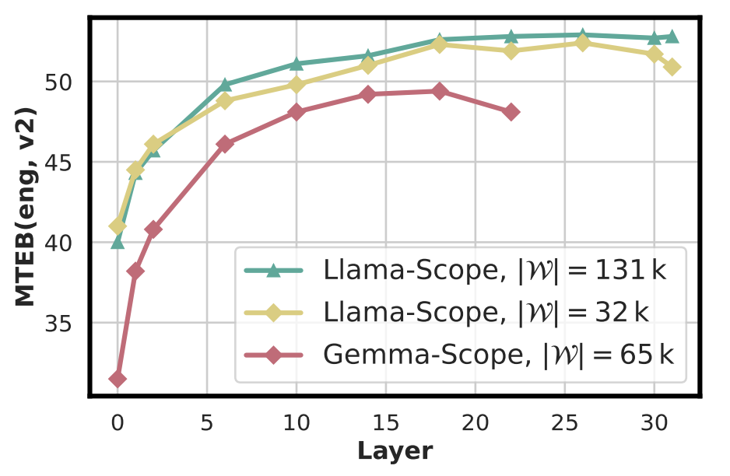
Sparse autoencoders - SPLARE
Concepts instead of words
Easier multilingual
Inconclusive if can exact match
Formal, Thibault, et al. "Learning Retrieval Models with Sparse Autoencoders." The Fourteenth International Conference on Learning Representations.

Slide 114
Outline - LSR Initialization
Initialization of LSR with “MLM” Encoding:
  Masked Language Modelling
  Causal Language Modelling
  Sparse Autoencoders
Solving problems with initialization:
  Pretraining / Middle training
  Re-using previous models

Slide 115
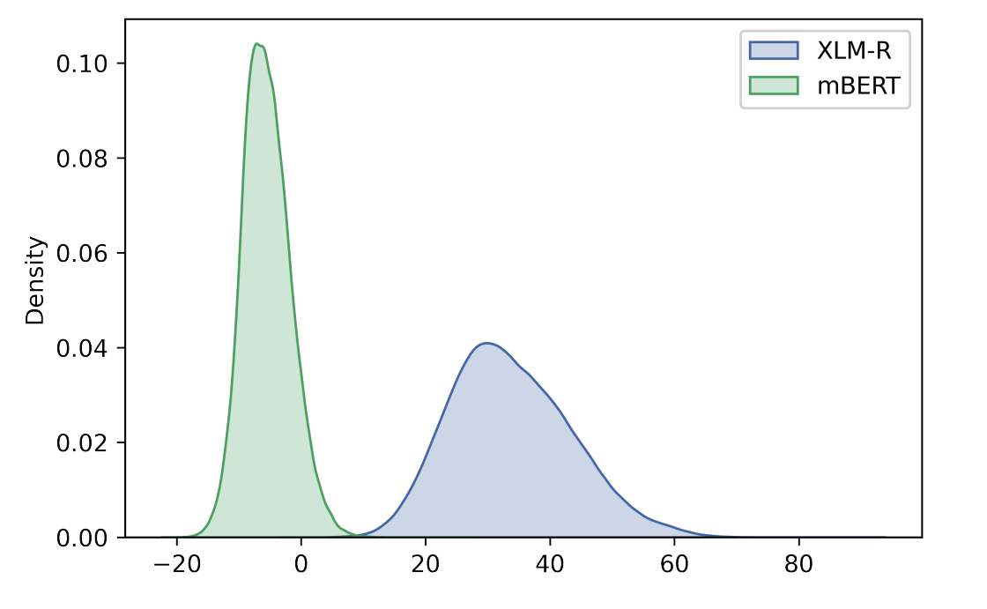
When initialization causes problems - SPLADE-X
MLM score
Learning a Sparse Representation Model for Neural CLIR.
Nair, Yang, Lawrie, Mayfield and Oard. DESIRES. 2022.

Slide 116
When initialization causes problems - SPLADE-X
Pretrained model has unsuited scores
Hard to bring mass down
MLM score
Learning a Sparse Representation Model for Neural CLIR.
Nair, Yang, Lawrie, Mayfield and Oard. DESIRES. 2022.

Slide 117
Pretraining / Middle Training
Integrate FLOPS regularization with MLM (MLM+FLOPS)
  “Pushing the score mass to the left in the previous figure”
Masked Next Token Prediction (LION):
  Align decoder-models to use bidirectional attention
Sparse Alignment Pretraining (MILCO)
  Maps multilingual input into English
Unsupervised contrastive training (LACONIC):
  Calibrates scores in simpler cases
  Dense models mostly use this one.
MLM+FLOPS: Lassance et al. An Experimental Study on Pretraining Transformers from Scratch for IR. ECIR 2023
LION: Zeng, et al. "Scaling sparse and dense retrieval in decoder-only llms." SIGIR 2025
LACONIC: Xu, et al. "LACONIC: Dense-Level Effectiveness for Scalable Sparse Retrieval via a Two-Phase Training Curriculum." arXiv
MILCO: Thong et al. MILCO: Learned Sparse Retrieval Across Languages via a Multilingual Connector. ICLR 2026.

Slide 118
Re-using previous models
One way to avoid initialization issues is to use a well initialized model
  Also it is a greener approach
SPLADE-v3 starts from SPLADE++
  Initializing from scratch was too finicky
MILCO intelligently mixes:
  Pre-initialized (english only) head from SPLADE-v3
  Pre-initialized (multilingual) encoder from BGE-m3
Thong Nguyen, Yibin Lei, Jia-Huei Ju, Eugene Yang, & Andrew Yates (2026). MILCO: Learned Sparse Retrieval Across Languages via a Multilingual Connector. In The Fourteenth International Conference on Learning Representations.

Slide 119
Re-using previous models
One way to avoid initialization issues is to use a well initialized model
  Also it is a greener approach
SPLADE-v3 starts from SPLADE++
  Initializing from scratch was too finicky
MILCO intelligently mixes:
  Pre-initialized (english only) head from SPLADE-v3
  Pre-initialized (multilingual) encoder from BGE-m3
We will talk more about MILCO later
Thong Nguyen, Yibin Lei, Jia-Huei Ju, Eugene Yang, & Andrew Yates (2026). MILCO: Learned Sparse Retrieval Across Languages via a Multilingual Connector. In The Fourteenth International Conference on Learning Representations.

Slide 120
Conclusion
Models may be initially easier to train
  MLM is closer to LSR than to dense retrieval
  More closed linked to transformer architecture
LSR training can be finicky
  MLM-encoder can collapse / lead to over-expansion (more on that on multimodal!)
Some things can make your life easier
  Training on easier tasks before hand
  Re-using other models

Slide 121

Questions

Slide 122
Neural Lexical Search with Learned Sparse Retrieval
ECIR 2026 Tutorial
Notes:
Hi everyone. If we haven’t met before I’m Siddharth.
I’m a PhD student at the University of Amsterdam, supervised by the notoriously infamous Dr. Andrew Yates.
I’d like to thank you all for coming out today and sticking around ;I have the distinct pleasure of kicking off the next part of the tutorial.
I’m really excited to share this stuff with you guys. Not in the least because I think LSR is really, really interesting.
I should say: before I came to cruel, twisted world of information retrieval, I was a linguist. And I think this is a fascinating topic not only from CS background, but also philosophically - as Sean touched upon in the introduction.
“Is the difference that makes a difference, representable by words and weights?” Another way of putting it is: “of all the ways
And I can’t think of anything more interesting than being able to capture that in an empirical way.
The point is, whatever your background, I’m confident you’ll find my presentation rewarding, or at the very least thought provoking.

Slide 123
Modalities: Text LSR
ECIR 2026 Tutorial
Siddharth Singh
Notes:
Ok, cominciamo!

Slide 124
Schedule
Introduction
Datasets and Evaluation
LSR Framework
Initialization of LSR
Modalities
(English) Text ← Now
Multilingual Text
Multimodal Data
Indexing & Efficiency
Hybrid Dense-Sparse Retrieval
Conclusion
Notes:
To recap our schedule, the infamously notorious Sean MacAvaney hooked us with a gripping introduction to LSR. He who shall not be named has shown us a very nice three-pronged framework for analyzing LSR models, and talked about different types of encoders.
And the legendary Dr. Lassance has shown us how to get started training LSR models.
We’re now going to switch gears a bit and talk about what retrieval modalities we can use LSR for. This is a vibrant area of focus with a lot going on, and my section today is going to focus on LSR for monolingual text retrieval. As much I’d like to do Dutch, our guinea pig language today will be English. For the Anglophobic among you, Eugene will thankfully adding some linguistic diversity in the next section.
Since we’re talking about actual models today, I’ll be doing some switching between higher level ideas and some pretty technical descriptions. So, please don’t hesitate to ask for clarification.

Slide 126
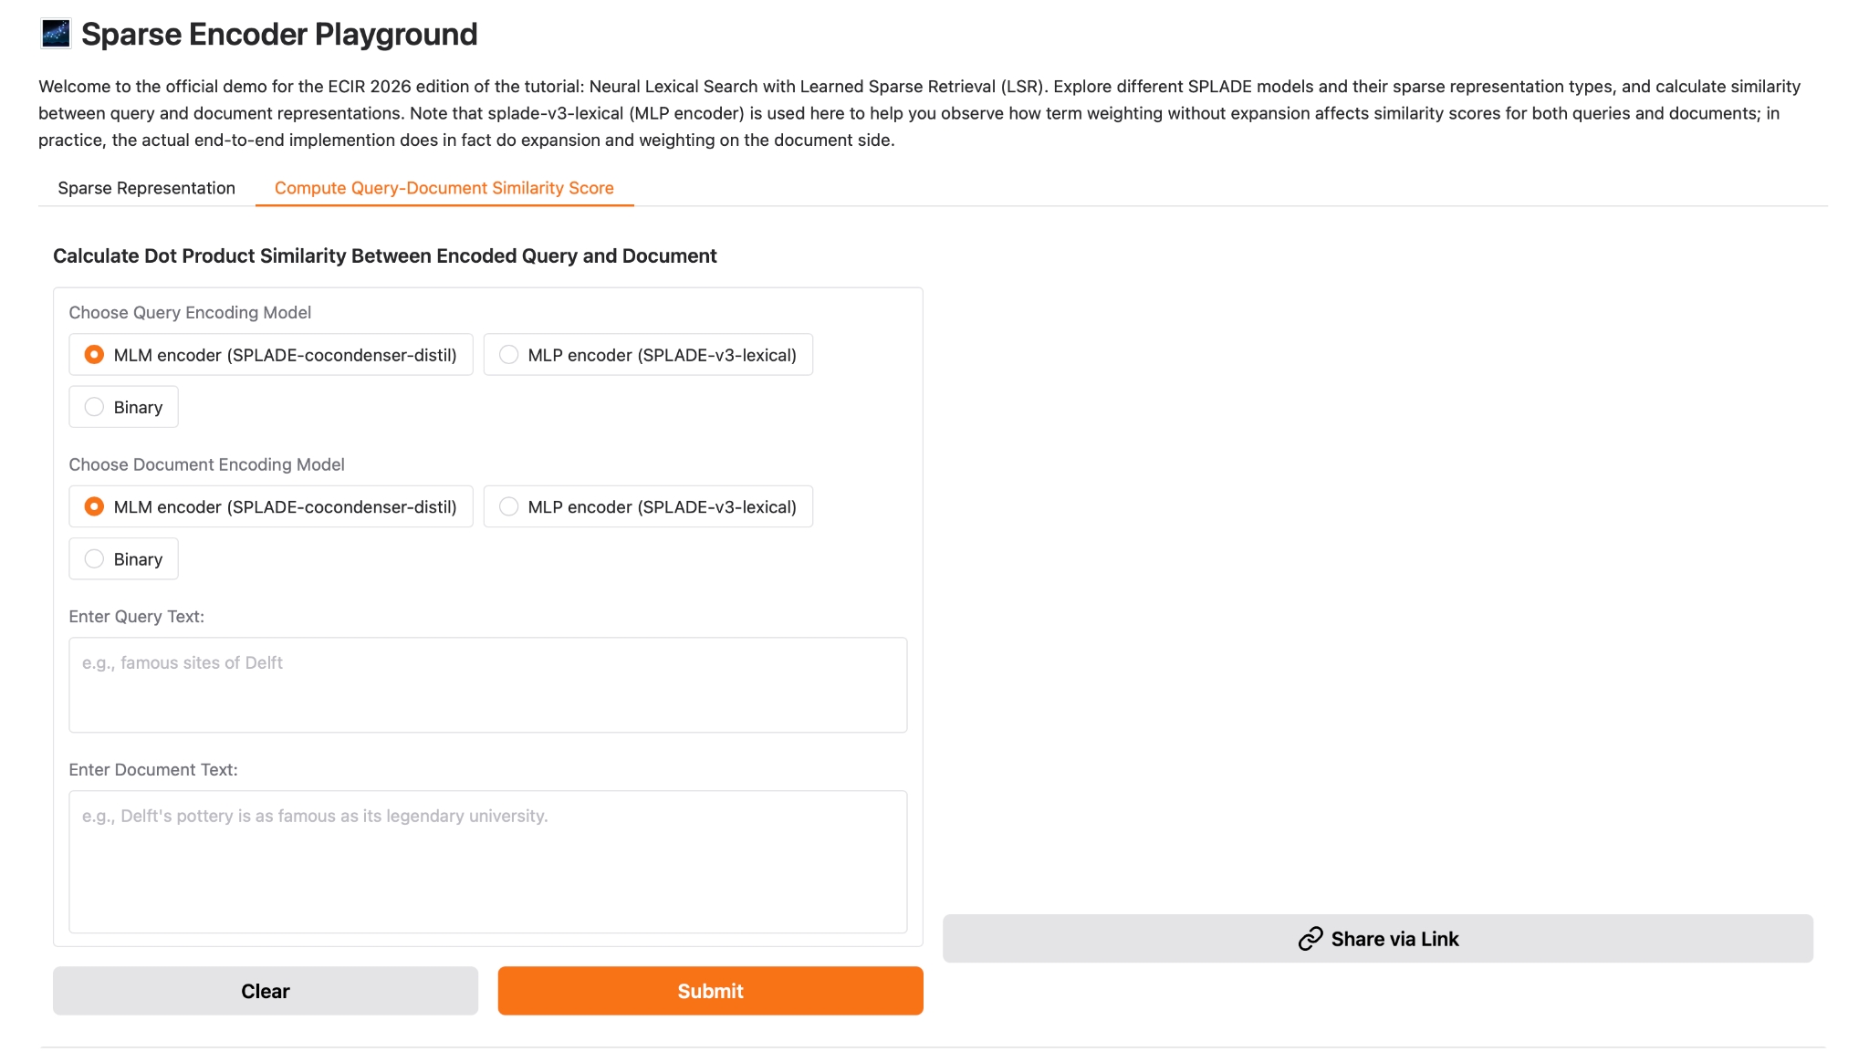

Slide 127
The Most Important Slide
How do we output a sparse vector with weighted, non-negative dimensions?
What parts of the LSR framework matter to get the right terms and the right weights?
Hint: Mostly the encoder!
…and what aspects of the text retrieval setup affect LSR performance?
Hint: Mostly how we encode the query side or the document side - or both!
Notes:
The first is our overarching goal: we to input some information to our LSR system, and output a representation vector with weighted, non-negative dimensions.
The second point is a question: what parts of the LSR Framework will help us make sure we get the right terms and the right weighting for these terms. You guys have seen that the framework consists of a sparse encoder, a sparse regularizer, and the right kind of supervision.
What I’d really like to communicate today is that good expansion and weighting are really important, and are mostly dependent on what type of encoder we choose, though training and supervision are of course important.
The final point is another question: having chosen the right architecture for our LSR system, we want to to think about the particularities of the text retrieval task. We want to know what aspects of LSR system design most affect performance. And what I’d really like to communicate about this is: this really has to do with how we use our encoder to encode either the query side, document side, or both.
We’ve also put together a really fun, interactive demo that synthesizes these concepts. So I urge you guys to mess around with it during the coffee break!

Slide 128
Roadmap
Background
Architectures
Results
Notes:
Presentation-wise, I’ve mapped these three points to three subsections. We’ll start out by talking about some key concepts and landmarks in the development of Text LSR systems.
We’ll then talk about a number of contemporary LSR systems, while comparing and contrasting their architectures and approaches.
Finally, we’ll talk about how these approaches impact retrieval performance on well-known benchmarks. And we’ll briefly discuss some directions of interest in Text LSR research.

Slide 129
Background
Notes:
So let’s start with some background!

Slide 130
Following Up
“How do we output a sparse vector with weighted, non-negative dimensions?”
Do these dimensions need to correspond to words?
Let’s look at one of the first LSR systems.
What made this method unique?
Notes:
I’d like to follow up on our first key idea. How do we output a sparse vector with weighted, non-negative dimensions?
As many of you are now aware, most LSR systems have these dimensions correspond to words in natural language. I have a thought-provoking question for you guys.
Do these dimensions actually need to correspond to words in natural language?
If I can get a show of hands: who thinks they do? Who thinks they don’t?
If you think they don’t, I suppose you are an original thinker. In fact, what could be considered the first LSR system did NOT use words as dimensions in its sparse vector.
Let’s take a look, and think about what makes our system important in the LSR lineage.

Slide 131
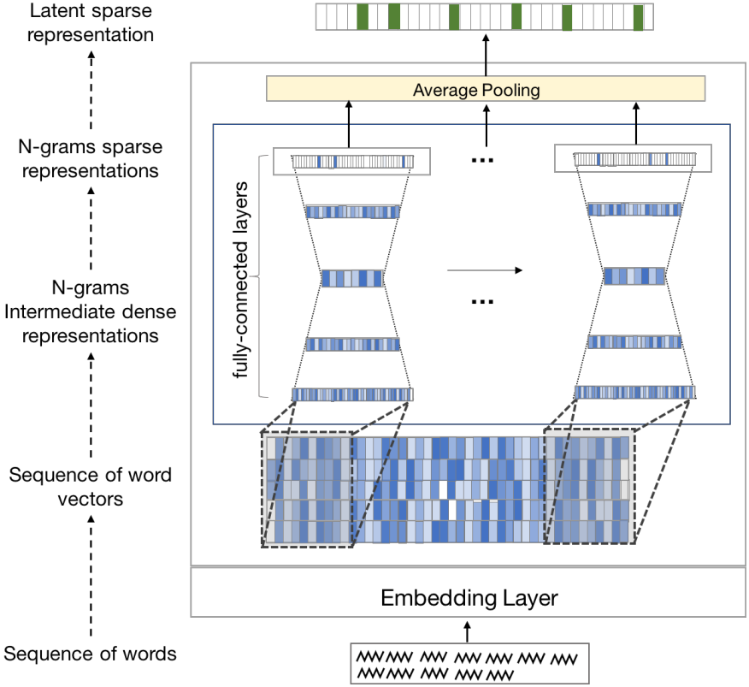
Standalone Neural Ranking Model (SNRM)
Approach
  Windows of static embeddings
  N-grams to sparse vector
  (similar to MLM head)
Sparse vector is not grounded (latent)
From Neural Re-Ranking to Neural Ranking: Learning a Sparse Representation for Inverted Indexing. Zamani, Dehghani, Croft, Learned-Miller, Kamps. CIKM 2018
Notes:
The model in question is called “Standalone Neural Ranking Model” or SNRM.
Beyond being a first in LSR, it's notable in that it’s NOT a Transformer-based architecture.
Instead, It uses a feedforward neural network to process text by first looking at ngrams.
For each ngram, the model grabs the pre-learned word embeddings for each word in that sequence from its embedding layer.
These individual word vectors are then concatenated together to form one larger vector representing that specific ngram.
This concatenated vector is then fed through the feedforward neural network itself.
This network first compresses the information and then expands it into a high-dimensional, but sparse, vector.
This gives us a sparse representation for that single ngram.
To get the representation for the whole document or query, SNRM simply averages the sparse vectors from all the ngrams within it.
The key output is this final high-dimensional sparse vector.
Each dimension in this vector space is called by them as a 'latent term' – it represents some learned semantic concept rather than just a word-token.
These latent terms are sparse enough that SNRM can build our efficient inverted index over them.

Slide 132
Standalone Neural Ranking Model (SNRM)
Approach
  Windows of static embeddings
  N-grams to sparse vector
  (similar to MLM head)
Sparse vector is not grounded (latent)
Related work using latent vectors:
KALE: Using a K-Sparse Projector for Lexical Expansion.
Borges, Martins, Callan. ICTIR 2023.
Zamani et al. (See Slide 6)
Notes:
Another similar, notable paper - from a bit later - that explores this idea of using latent or artificial terms for efficient retrieval is KALE.
KALE takes a different approach starting from dense vectors, specifically the output from a DistilBERT language model.
It uses a simple projector applied to these dense vectors, followed by a TopK operation to generate sparse representations.
These sparse vectors essentially create terms over a new vocabulary space – these artificial terms not found in the original text. Like SNRM, the benefit is that these artificial terms can then be stored efficiently in standard inverted indices.
At query time, KALE also generates corresponding new query terms to be searched alongside the original lexical terms.
So in sum, SNRM isn’t the only LSR system using latent terms, but is pioneering because it was the first to use a neural base model and we get our inverted index in the end.
It’s also pioneering in that it uses a type of expansion, in that we are activating related terms beyond exact matches.
This is the last thing I’ll be saying artificial terms but I think I should add that based on some conversations with people, there seems to be a resurgence of interest in 2025 using latent terms.

Slide 133
Grounding
But why might (representations or dimensions corresponding to) words be good?
Let’s consider information in the abstract
Humans already have ways of sending and receiving information
Generally speaking, these can include: symbols, images, and words
“Grounding” for the purposes of LSR: exploiting the fundamental units of these structured systems for an inverted index
Notes:
Ok, so the opposite question, why might it be a good idea to have vector dimensions correspond to terms in a vocabulary?
I think one compelling argument is for Grounding. In an abstract sense, we can either have a latent representation of information, or can have it relate to an existing, structured system; like words!
This act of relating the representation to an existing system is called “grounding.”
Now, grounding isn't necessary to use an inverted index, because posting lists could be attached to a latent “dimension 1” rather than the grounded “Padua”, as we just saw.
It also isn't required for a LSR encoder, but the transparency and interpretability are nice.
Though it's a nice to have rather than a strict requirement, performant modern LSR methods are all currently grounded.

Slide 134
Grounding LSR
Interpretable and amenable to SoA neural architectures (Transformer pre- -training is word-based)
Term expansion and weighting easily done with a Transformer backbone
Let’s look at the first Transformer-based method
Notes:
Moreover, grounding in natural language goes hand-in-hand with the Start of the Art in NLP, here meaning Transformer pretraining with either masked language modeling or causal language modeling.
And a transformer backbone has proven to work quite well for weighting and expansion.
As we said, SNRM didn’t use vector dimensions corresponding to subunits of meaning grounded in a larger meaning making system, but set the stage for the “learned sparse” part of LSR. I reiterate that it wasn’t a Transformer-based model.
So, let’s take a look at the first Transformer-based LSR system, and we’ll see from there how the advantages it confers for term weighting and expansion, and later how those advantages have been built upon.

Slide 135
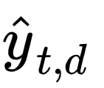
Indexing with DeepCT
Index
New document: "Researchers Researchers … finding finding … that that … cinnamon cinnamon ... reduces ... "
Term Frequencies:
10 0 20 10 90 80 90 100 40 20 0 10 40
Predicted Scores
0.1 0.0 0.2 0.1 0.9 0.8 0.9 1.0 0.4 0.2 0.0 0.1 0.4
D × 1
D × 1
...
D × 1
DeepCT (BERT)
Text d:
Researchers are finding that cinnamon reduces blood sugar levels naturally when taken daily...
Context-Aware Sentence/Passage Term Importance Estimation for First Stage Retrieval. Dai, Callan. arXiv 2019
Notes:
This pioneering Transformer-based model is called the Deep Contextualized Term Weighting Framework, or DeepCT.
DeepCT is not only innovative as a Transformer-based model, but also because it predicts term weights. The training objective here is to predict a contextual importance weight.
To get this objective, the DeepCT model is run over every single passage in the collection. For each term within a passage, it predicts this contextual importance weight – basically, how important that word is in that specific context.
Since standard indexes use integer counts, these predicted weights are then scaled, maybe multiplied by 100 and rounded, to create an integer value we call TF_DeepCT. This new TF_DeepCT value then directly replaces the original term frequency (TF) in the inverted index postings.
Later, Cosimo will talk about inverted indexes designed for LSR that don’t have this integer value requirement.
Because DeepCT is the ancestor of all performant LSR models, we’ll revisit it in just a second when we compare architectures. The point here is that it was the first LSR system to use words and predict term weights. Let’s remember though, that DeepCT doesn’t do expansion on either the query or document side.

Slide 136
2. Architectures
Notes:
Ok, we got a solid background in the conceptual and design history of Text LSR. We covered SNRM, a pioneering pre-transformer model to get a sense of higher-level design choices for LSR, namely the “learned” part of LSR. We also saw that SNRM had a type of term expansion, albeit with latent terms.
We also discussed grounding. We then saw DeepCT, which was groundbreaking in that it gave us the Transformer backbone and showed us how to weight terms contextually therein. But it also raised bigger questions that define today's LSR landscape: what if we don't just weight existing terms contextually, but expand them too? Should we process queries and documents the same way? How do we balance performance with efficiency?
These questions really mark our shift from understanding LSR's foundations to examining how modern systems have answered them. Today's LSR models all build on DeepCT's Transformer approach, but they've pushed far beyond simple term weighting. What we'll see next is how different answers to these core questions - expansion versus weighting, query-side versus document-side processing - have created distinct families of LSR systems. Each family represents a different philosophical approach to our three-pronged framework, and understanding these differences is key to choosing the right system for your needs.
To reiterate, the things to look out for are the encoding strategy (weighting, expansion, or just a binary encoder), and whether this happens on the document, query side, or both.

Slide 137
Transformer-based LSR methods that…
Weight query & document tokens** (no expansion)
Method | Query Encoder | Document Encoder | Supervision: Level | Supervision: Negatives | Supervision: Labels
DeepCT | MLP | MLP | Term | - | -
uniCOIL | MLP | MLP | Passage | BM25 (m) | Human
Padua
dishes
best
0
0
0.8
1.4
0
…
1.5
MLP
**SPLADE-Lexical also works like this! Check out the demo :-)
Transformer Layers
[CLS]
Padua
best
dishes
[SEP]
Tokenizer
Context-Aware Sentence/Passage Term Importance Estimation for First Stage Retrieval. Dai, Callan. arXiv 2019
“Padua best dishes”
A Few Brief Notes on DeepImpact, COIL, and a Conceptual Framework for Information Retrieval Techniques. Lin, Ma. arXiv 2021
MLP Encoder
Notes:
We can now revisit DeepCT, and compare it with uniCOIL, another model that only has document and query weighting, without term expansion. In other words, both of these have the same encoding strategy.
Let’s stop for a second and think about the supervision approach - the third pillar of our LSR conceptual framework - used for DeepCT.
DeepCT uses term-level supervision, where it learns weights based on ground truth weight generated by 'query term-recall' - the percentage of relevant queries containing each term for a given document. For each term in a document, DeepCT calculates QTR(t,d) = |Qd,t| / |Qd|, where Qd is the set of all queries for which the document d is judged relevant, and Qd,t is the subset of those queries that contain term t.
The key insight is that terms frequently appearing in queries that successfully retrieve a document are likely more important to that document's meaning. This provides a supervision signal derived from actual search behavior.
For example, if the word "diabetes" appears in 80% of the queries for which a particular medical document was judged relevant, DeepCT would learn to give "diabetes" a high weight in that document.
In contrast, a UniCOIL employs passage-level supervision with document-query relevance pairs. So rather than optimizing individual term weights, UniCOIL trains end-to-end to distinguish relevant passages, and you get term weights emerging naturally from the retrieval objective.
This distinction means DeepCT requires more granular supervision data, while UniCOIL uses simpler relevance judgments that align more directly with the final task - making it generally easier to implement and more effective.
But again, these models are similar in that they only do weighting, and they do it both on the query and document side.

Slide 138
Transformer-based LSR methods that…
Expand document tokens (& weight query tokens)
sparse vector
…
…
…
…
…
Method | Query Encoder | Document Encoder | Supervision: Level | Supervision: Negatives | Supervision: Labels
uniCOIL w/ dT5q | MLP | expMLP | Passage | BM25 (m) | Human
EPIC | MLP | MLM | Passage | BM25 | Human
MLM Head
Transformer Layers
Expands input text before using an MLP encoder
[CLS]
Padua
best
dishes
[SEP]
Tokenizer
Expansion via Prediction of Importance with Contextualization. MacAvaney, Nardini, Perego, Tonelloto, Goharian, Frieder. SIGIR 2020.
“Padua best dishes”
A Few Brief Notes on DeepImpact, COIL, and a Conceptual Framework for Information Retrieval Techniques. Lin, Ma. arXiv 2021
MLM Encoder
Notes:
Now moving on to models that on the document side expand and weight terms, and on the query side weight terms.
Two well-known models here are EPIC and uniCOIL, uniCOIL with a doc2query variant using T5.
Referring now back to our LSR framework, we can see that these models differ on the choice of sparse encoder for the document side.
While EPIC uses a masked language model, uniCOIL uses an expansion MLP head.
This just adds a preprocessing step to expand the document with relevant terms, which can be used from source external to the model (in this case doc2query with T5).
This output can then be encoded with an MLP to get our weights!

Slide 139
Transformer-based LSR methods that…
Expand document tokens (& only tokenize the query)
**MLM using only BERT’s CLS token
Method | Query Encoder | Document Encoder | Supervision: Level | Supervision: Negatives | Supervision: Labels
DeepImpact | Binary | expMLP | Passage | BM25 | Human
TILDE | Binary | clsMLM** | Term | - | -
TILDEv2 | Binary | expMLP | Passage | BM25 (m) | Human
SPARTA | Binary | MLM | Passage | BM25 | Human
Learning Passage Impacts for Inverted Indexes. Mallia, Khattab, Tonellotto, Suel. SIGIR 2021
TILDE: Term Independent Likelihood Model for Passage Re-Ranking. Zhuang, Zuccon. SIGIR 2021
Fast Passage Re-Ranking with Contextualized Exact Term Matching and Efficient Passage Expansion. Zhuang, Zuccon. ReNeuIR 2022
SPARTA: Efficient Open-Domain Question Answering via Sparse Transformer Matching Retrieval. Zhao, Lu, Lee. NAACL 2021
Notes:
Next, we see a family of models that don’t do any weighting, and expansion on the document side.
We can conceive of this family of models as a simplification of the previous.
The MLP encoder used for queries on the previous slide are thrown out.
In fact DeepImpact can be viewed as the uniCOILdT5q without a query encoder.
Likewise, SPARTA could be seen as EPIC without a query encoder.
Comparing “within the family” that we see here, TILDE replaces the MLM head in SPARTA using an clsMLM head.
As Andrew - sorry, he who shall not be named - covered, this type of encoder is a simplified version of the MLM encoder that only takes the logits of the [CLS] token as the output vector.

Slide 140
Transformer-based LSR methods that…
Expand query and document tokens
*Negatives & loss
improved
**Additional
datasets
Method | Query Encoder | Document Encoder | Supervision: Level | Supervision: Negatives | Supervision: Labels
SPLADEv2 | MLM | MLM | Passage | BM25 (m) | Human
Distil SPLADE | MLM | MLM | Passage | Hard | Teacher
SPLADE v3* | MLM | MLM | Passage | Hard | Teacher
Mistral** SPLADE | MLM | MLM | Passage | In-batch | Human
SPLADE v2: Sparse Lexical and Expansion Model for Information Retrieval. Formal, Piwowarski, Lassance, Clinchant. arXiv, 2021
SPLADE-v3: New Baselines for SPLADE. Lassance, Dejean, Formal, Clinchant. arXiv, 2024
Mistral-SPLADE: LLMs for Better Learned Sparse Retrieval. Doshi, Kumar, Murthy, Vignesh, Sen. arXiv, 2024
CSPLADE: Learned Sparse Retrieval with Causal Language Models. Zhichao Xu, Aosong Feng, Yijun Tian, Haibo Ding, Lin Lee Cheong. arXiv:2504.10816, 2025.
Scaling Sparse and Dense Retrieval in Decoder-Only LLMs. Hansi Zeng, Julian Killingback, Hamed Zamani. arXiv:2502.15526, 2025.
Notes:
For the final subfamily of models, we have weighting and expansion for both query and document sides.
You can see that these are all SPLADE variants, which some of you are probably familiar with.
Unlike EPIC that just picks the top-k terms, these Splade models use FLOPs regularizer - part of our sparse regularizer toolkit - during training to keep things sparse.
It's a second loss used during training, saying 'let's not get too wild with adding terms.'
Both Splade-max and distilSplade-max use the same MLM setup for queries and documents. What's neat here is they do end-to-end expansion and weighting for everything - no separate steps needed.
The main difference between the two is about training. Regular Splade-max trains with in-batch BM25 negatives, while distilSplade-max uses this distillation approach with hard negatives they've mined.
In a nutshell, they're giving us full expansion and weighting, but making sure we don't pay too heavy a computational price for it by avoiding a separate doc2query step for expansion.
I’d also like to draw your attention the two papers at the bottom. These are CSplade: Learned Sparse Retrieval with Causal Language Models and Scaling Sparse and Dense Retrieval in Decoder-Only LLMs.
These two papers are from 2025, and both are similar to Mistral-Splade in that they use an autoregressive setup for the backbone. We’ll be talking more about other interesting lines of work for LSR at the end of this section.

Slide 141
Method | Query Encoder | Document Encoder | Supervision: Level | Supervision: Negatives | Supervision: Labels
DeepCT | MLP | MLP | Term | - | -
uniCOIL | MLP | MLP | Passage | BM25 (m) | Human
uniCOIL dT5q | MLP | expMLP | Passage | BM25 (m) | Human
EPIC | MLP | MLM | Passage | BM25 | Human
DeepImpact | Binary | expMLP | Passage | BM25 | Human
TILDE | Binary | clsMLM | Term | - | -
TILDE v2 | Binary | expMLP | Passage | BM25 (m) | Human
SPARTA | Binary | MLM | Passage | BM25 | Human
SPLADE variants | MLM | MLM | Passage | BM25 / Hard | Teacher
Notes:
So this is our overall summary of the Transformer models we’ve looked at. Query encoders are one of three options:
(i) binary (ii) MLP or (iii) MLM.
Document encoders have a little more variety, with the expMLP doing term expansion before encoding, and clsMLM using the output logits of the CLS token as our vector.
Supervision here is at the passage level, where the term weights emerge as a byproduct of the model learning to distinguish relevant from non-relevant passages. These models say, 'I need to identify relevant documents,' and the term weights are whatever values help accomplish that goal. The weights arise organically through end-to-end optimization.
The exceptions here are, DeepCT and TILDE, which explicitly supervise those term weights directly. They specifically train to predict 'this term should have X importance' based on predetermined signals like term recall. They're optimizing for getting those specific term weight values right, not just the final retrieval outcome.
Less importantly, I’ve also included the supervision annotation strategy in the rightmost two columns.
As we covered, DeepCT uses term labels. everything else is supervised at the document level. And some approaches like the newest splade are done using distillation

Slide 142
3. Results

Slide 143
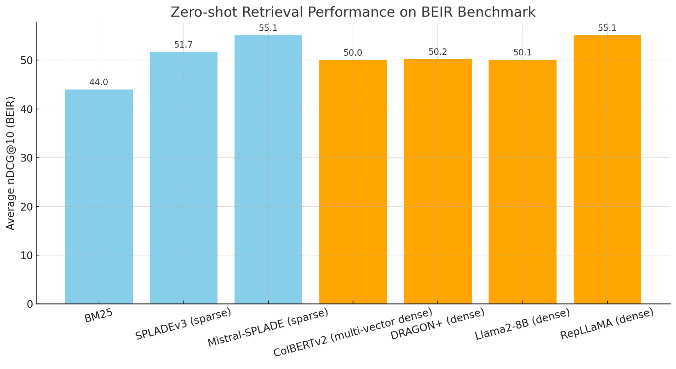
Is LSR competitive?
How to Train Your DRAGON: Diverse Augmentation Towards Generalizable Dense Retrieval. Lin, Chen, Zhao, Yu, King, Li, Ji. arXiv 2024
Making Large Language Models a Better Foundation for Dense Retrieval. Zeng, Zhang, Chen, Yang, Zhao, Lin. arXiv 2024
Fine-Tuning LLaMA for Multi-Stage Text Retrieval. Ma, Luan, Xu, Lin. SIGIR 2024
Notes:
And before we move on. I’ve just added some top 5 scorers from the BEIR leaderboard.
This the average NDCG@10 across 13 out of domain datasets.
And we can see that systems employing LSR come in with pretty competitive performance.
It’s cool that Mistral-SPLADE has the same performance as RepLLaMA.
And also that splade-v3, which I think is about 100M parameters, beats out Llama-8B. So you’re getting a lot of bang for your computational buck.
Very exciting I think!

Slide 144
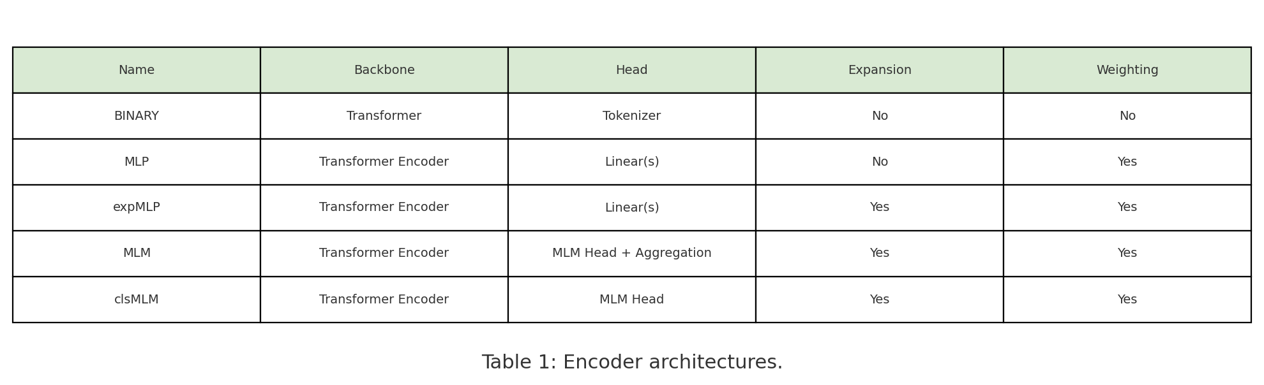
Quick Refresher
‘
A Unified Framework for Learned Sparse Retrieval. Nguyen, MacAvaney, Yates. ECIR 2023
Notes:
Now, to connect the architectures we’ve covered to our results. We’ve seen a number of Transformer-based models, grouped together by their approaches to weighting and expansion. We spent some contrasting between these groupings and within them, and tied everything back to our LSR Framework.
This was an overview to get ourselves acquainted with the essentials and lineage of some of the most popular models for LSR.
Let’s now think how these characteristics impact performance. Are these approaches competitive on benchmark datasets?
Again, we’ll be mostly looking at the effects of weighting vs. expansion on the query vs. document side. This is a summary of only the most important points.
We're going to freeze the setup and make single changes to see the difference in performance. And, there are 11 experiments in total, again controlling for variations in weighting and expansion on the query and document side. I’ve included the five here that really hammer home the main idea, which you are about to see!
And this is just a refresher of the different types of architectures that we looked at.
They all fundamentally use a transformer backbone.
I think the most interesting part of the table are the final two columns, that review whether each encoding strategy weights tokens, expands them, or neither.
Let’s look at some keys findings about this, with the added variable of document vs. query weighting incorporated.

Slide 145
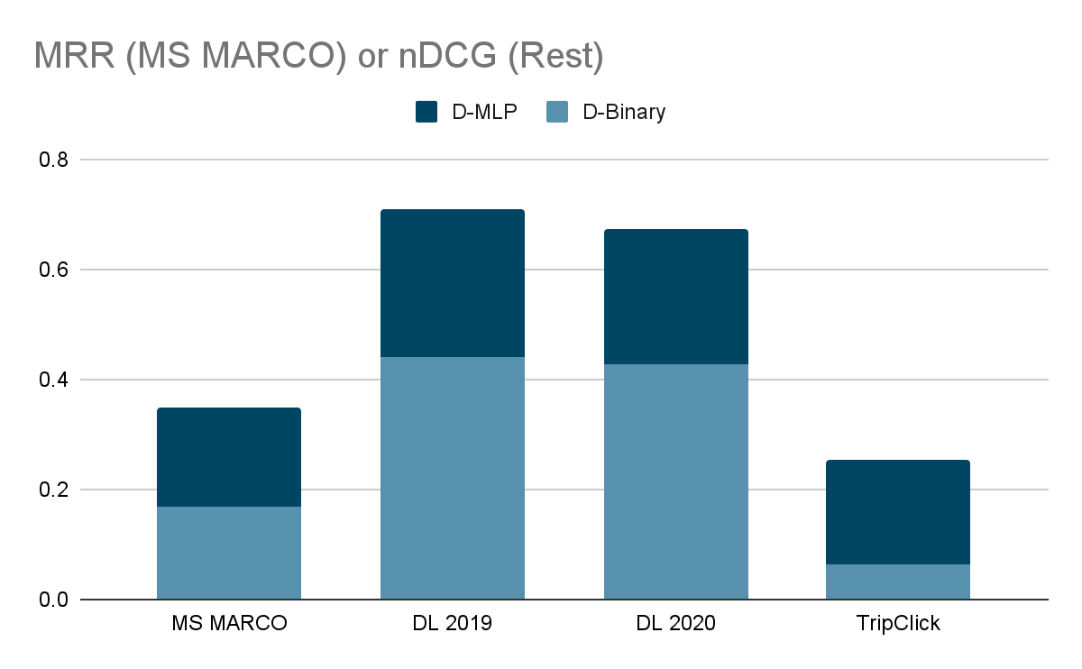
Document weighting is important
(though without, about 10% lower than BM25)
Query
expansion
weighting
Document
No weighting (binary)
Weighting
Notes:
This is our first controlled experiment. We want to see how document weighting using an MLP affects our results, so we have expansion and weighting on the query side, that’s controlled.
Then we introduce a binary baseline. The results are a
Significant increase in performance
Our metric for the first is MSMARCO mean reciprocal rank; for the other 3 it’s NDCG.
We have the performance of a binary document weighting in light blue, and an MLP using weighting in Navy.
We can see considerable improvement across the board when we only use document weighting.
And actually, as we’ll see, document weighting ends up being the crucial determinant of performance because models without this fail on all MSMarco, DL 2019, and DL 2020.
It’s worth noting that even with a binary encoder, results are only about 10% lower than with BM25. This isn’t a great approach, but only using expansion/weighting on the query side does get you somewhere. The model isn’t totally failing with a binary doc encoder, though you’d be a little better off just using BM25.
Curious, let’s look Now at expansion.

Slide 146
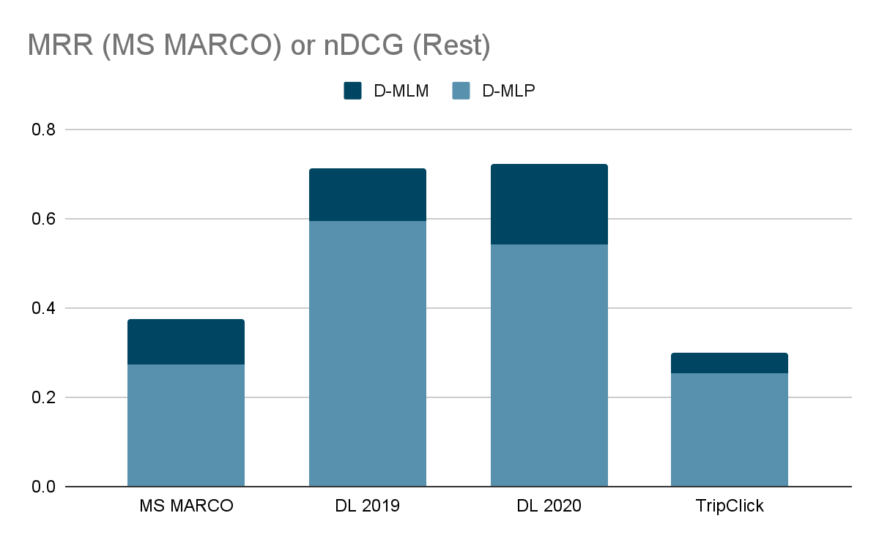
Document expansion helps…
Query
expansion
weighting
Document
Weighting
Weighting + Expansion
Notes:
Here, we are weighting query terms, but not expanding them. On the document side, we are comparing how expansion and weighting improves against just weighting.
We can see here that performance improves across the board, Indicating the importance of document expansion.
And guys, this is probably the biggest takeaway for the rest of this subsection. The second most important slide of the presentation, if you will.

Slide 147
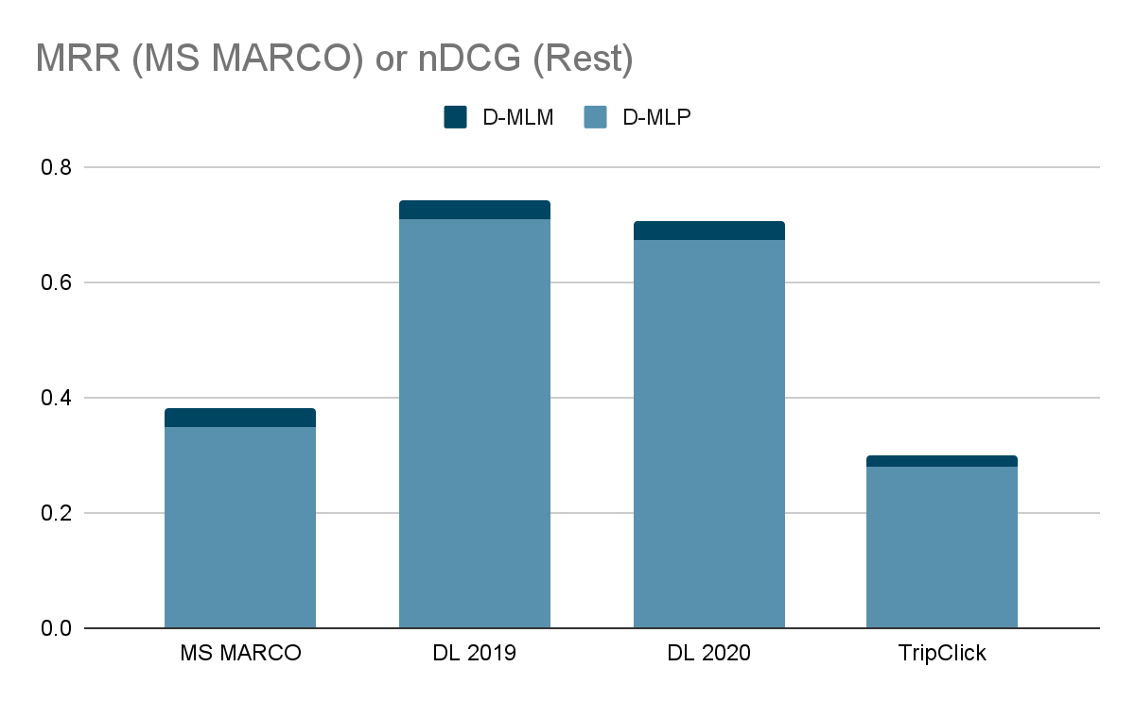
…but only a little when query expansion also present
Query
expansion
weighting
Document
Weighting
Weighting + Expansion
Notes:
However, the performance only increases a small amount when queries are also weighted and expanded.
Now, what happens when our query is already expanded and weighted, and we want to see what happens when we do document expansion?
Against, a weighted document baseline, we don’t see much improvement.
The point here being that adding D expansion doesn't help much when Q is already expanded. There's a slight increase, but you get most of the performance improvement from expansion as long as Q or D has it. It’s not essential to have expansion on both the query and the document side.

Slide 148
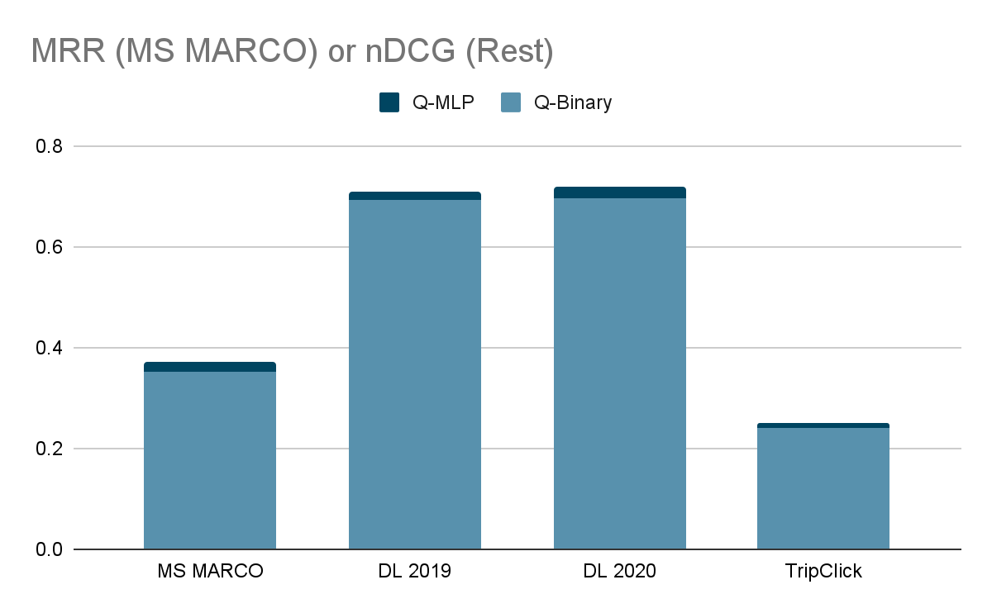
Limited gains from weighting the query w/ doc exp.
Document
expansion
weighting
Query
No weighting (binary)
Weighting
Notes:
Ok, let’s look at what happens when we mess with the query configuration in different ways.
We already know about the cancellation effect of weighting and expansion on both sides. Let’s see what happens when we only weight queries against a weighted and expanded document.
We again see minimal improvements compared to the baseline.
But another way of looking at it is, that on these in-domain datasets, performance is very high with a binary query encoder as long as you have document expansion!

Slide 149
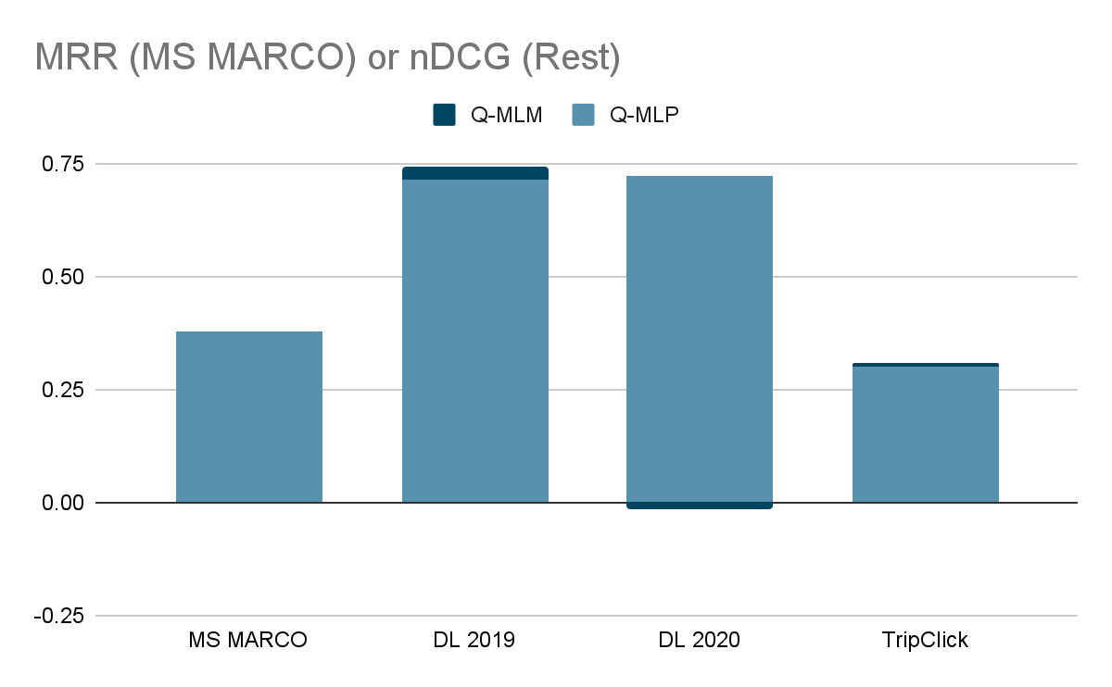
Limited gains from expanding the query w/ doc exp.
Document
expansion
weighting
Query
Weighting
Weighting + Expansion
Notes:
And finally, looking at the query side again, but specifically weighting AND expansion,we see the cancellation effect at work. The navy bit going below zero over DL 2020 - that difference is the performance decrease when weighting and expansion are added, it was just hard to illustrate.
If you're already doing document expansion, adding query expansion barely improves the ranking results but makes the system much slower – latency jumped significantly, by almost 300% on MSMarco and 82% on TripClick.
This cancellation effect suggests that you might not need to implement both expansion methods.

Slide 150
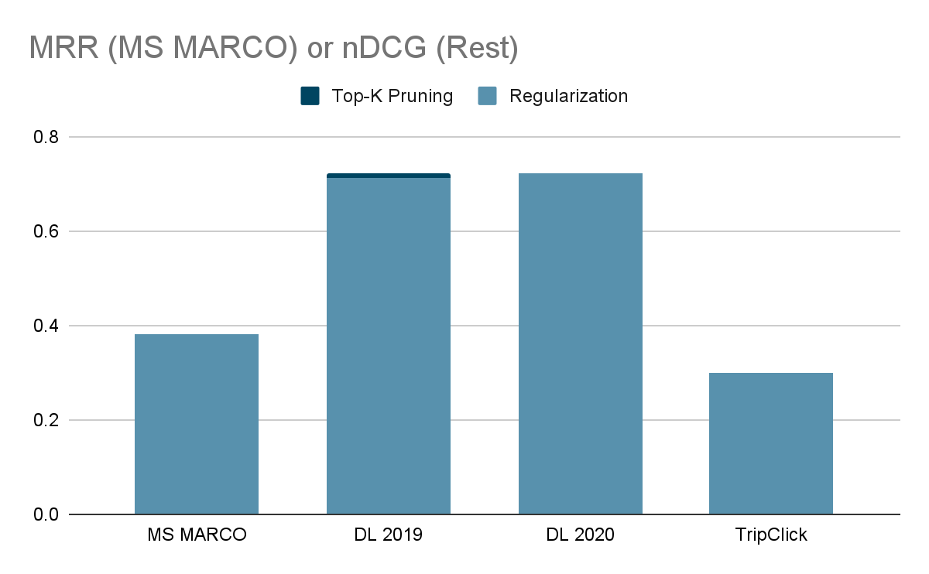
Top-K pruning can be effective
Query
expansion
weighting
Document
expansion
weighting
Pruning vs.
Loss Reg.
Notes:
Finally, in line with the LSR Framework, we look at how changing the choice of sparse regularizer affects our
results.
We see that moving to a top-k pruning strategy at inference time has no impact on performance, save a very minor improvement for DL 2019.
Before we move on to other work, I’d like to summarize a few key findings.

Slide 151
Takeaways
Including document term weighting is most important for a method’s eﬀectiveness
Including query weighting has a small positive impact
Document expansion and query expansion have a cancellation eﬀect.
But you do need document expansion to be competitive
Notes:
Just to reiterate our key takeaways.
With regards to weighting:
Document term weighting is the most important.
Query weighting has a positive impact, but small.
With regards to expansion:
Document expansion and query expansion have a cancellation effect.
You do need expansion - really on the document side - to have a solid performance increase.

Slide 152
Other work (not exhaustive!)
Training without (human-)labeled data.
Enhancing Sparse Retrieval via Unsupervised Learning. Ma, Fun, Yin, Mallia, Lin. SIGIR-AP 2023.
Prompting a LLM to generate sparse representations zero-shot.
PromptReps: Prompting Large Language Models to Generate Dense and Sparse Representations for Zero-Shot Document Retrieval. Zhuang, Ma, Koopman, Lin, Zuccon. EMNLP 2024.
Aggregating passage representations across long documents.
Adapting Learned Sparse Retrieval for Long Documents. Nguyen, MacAvaney, Yates. SIGIR 2023.
Replacing the LSR vocabulary.
1. Learning Sparse Lexical Representations Over Specified Vocabularies for Retrieval.
Dudek, King, Li, Zhang, Bendersky. CIKM 2023.
2. Improved Learned Sparse Retrieval with Corpus-Specific Vocabularies. Yu, Mallia, Petri. ECIR 2024.
Augmenting the LSR vocabulary.
DyVo: Dynamic Vocabularies for Learned Sparse Retrieval with Entities.
Nguyen, Chatterjee, MacAvaney, Mackie, Dalton, Yates. EMNLP 2024.
Notes:
Alright, so beyond the core LSR techniques we've discussed, there's a lot of really interesting work extending these ideas in different directions.
In terms of supervision, getting rid of the need for human labels is a big one. Ma and colleagues showed in 2023 how we can actually enhance sparse retrieval using unsupervised learning – which could save a lot of annotation effort.
Another cool direction leverages the power of Large Language Models. With PromptReps, Zhuang et al. demonstrated you can actually just prompt an LLM to generate sparse representations directly, zero-shot, without needing specific retrieval training for the LLM itself. [This is cool, but you all should know that these zero-shot sparse representations don’t perform nearly as well as supervised models like Mistral-SPLADE and SPLADEv3.
Thinking practically, we often need LSR to work on long documents. Nguyen and the team at SIGIR '23 tackled this, developing ways to aggregate passage representations effectively across longer texts.
Then there's the vocabulary itself – the terms the LSR model uses. Some are exploring completely replacing the standard vocabulary, either using custom ones like Dudek et al. or corpus-specific ones like Yu et al. showed more recently.
And building on that, instead of just replacing, Nguyen and others are looking at augmenting the vocabulary. Their DyVo system dynamically pulls in important entities, like names or places, to enrich the representation. This is done using an MLM head so you can get specific domain vocab.
So, as you can see, it's a really active area with lots of different approaches being explored to boost performance and applicability.

Slide 153
Conclusion: LSR on (English) Text
Questions?
Input: text
Output: sparse vector representation (weighted bag of words)
We looked at
Pioneering pre-transformer method: SNRM
Pioneering transformer-based method: DeepCT
Transformer-based methods and their architectures
Document term weighting is most important for a method’s eﬀectiveness
… but document expansion is also important!
Next: Multilingual LSR
Notes:
So sum up. We just looked at approaches to Text LSR.
We reviewed our three-pronged framework for LSR, and how it applies to designing LSR systems for text.
A pioneering pre-transformer model (SNRM)
A pioneering transformer based model (Deep CT)
A general overview of transformer-based models, and their differences grouped along characteristics of expansion vs. weighting on the document vs. query side.
We also looked at how these transformer based models differ within their architectures and how we can conceptualize these differences in terms of our LSR framework.
We looked at the effects of these differences on performance, across several controlled experiments, and concluded that document weighting is the most important.
Finally, we briefly discussed future directions for LSR work.
I’ll now cede the floor to questions and later, Multilingual LSR - thank you!

Slide 154
Neural Lexical Search with Learned Sparse Retrieval
ECIR 2026 Tutorial

Slide 155
Multilingual LSR
ECIR 2026 Tutorial
presented by Eugene Yang
(previously by Carlos Lassance)

Slide 156
Schedule
Introduction
Datasets and Evaluation
LSR Framework
Initialization of LSR
Modalities
English Text
Multilingual Text ← now
Multimodal Data
Indexing & efficiency
Hybrid dense-sparse retrieval
Conclusion

Slide 157
Multilingual retrieval

Slide 158




Monolingual retrieval: English
EN
EN
Who was
Jan Vermeer?
EN
EN
EN
{Who: 3, Jan: 5, Vermeer: 5, was: 1, artist: 1, ...}

Slide 159



Monolingual retrieval: Dutch
NL
NL
Wie was Jan Vermeer ?
NL
NL
NL
{Wie: 3, Jan: 5, Vermeer: 5, was: 1, kunstenaar: 1, …}

Slide 160
Cross-lingual retrieval, bilingual system
For accessing information in another language
Cross-language encoding
NL->EN
NL
Wie was Jan Vermeer ?
EN
EN
EN
Less useful for the users without translation
{who, 3, Jan: 5, Vermeer: 5, artist: 1, …}

Slide 161
Cross-lingual retrieval, bilingual system
For accessing information in another language
NL
NL
Wie was Jan Vermeer ?
EN->NL
NL
EN->NL
{Wie: 3, Jan: 5, Vermeer: 5, was: 1, kunstenaar: 1, …}
Document Translation

Slide 162
Baseline: Translation + monolingual retrieval
EN
EN
Who was
Jan Vermeer?
NL->EN
EN
NL->EN
{Who: 3, Jan: 5, Vermeer: 5, was: 1, artist: 1, …}

Slide 163


Multilingual retrieval - one model per language
NL
EN
EN
Who was Jan Vermeer?
PT
EN
EN
EN
{Who: 3, Jan: 5, Vermeer: 5, was: 1, artist: 1, …}
PT
NL

Slide 164
Multilingual retrieval - one model per language
NL
EN
NL
Wie was Jan Vermeer ?
PT
NL
EN
NL
{Wie: 3, Jan: 5, Vermeer: 5, was: 1, kunstenaar: 1, …}
PT
NL

Slide 165

Multilingual retrieval - ideal scenario
EN+NL+PT…
NL
Wie was Jan Vermeer ?
EN+NL+PT…
EN,NL
EN
{Wie: 3, who: 3, Jan: 5, Vermeer: 5, was: 1, artist: 1, kunstenaar: 1, …}
NL

Slide 166
Multilingual sparse retrieval: challenges
Lexical matching
  How do you perform lexical match over multiple languages?
Size of MLM encoder
  Number of tokens increases massively (30k->250k)
Training data
  How to distribute training data between languages.

Slide 167
MLP Encoder + External Expansion
Recall from earlier
sites
famous
delft
0
0
0.8
1.4
0
…
1.5
Learning to score input terms by an MLP regression head
MLP
Transformer Layers
expansion
Could not handle term mismatch
(e.g., “famous sites” vs “prinsenhof”)
weighting
[CLS]
delft
famous
sites
[SEP]
Tokenizer
“delft famous sites”
Expansion Module (e.g., Doc2Query)
MLP Encoder

Slide 168
MLM Encoder
sparse vector
Column-wise pooling
…
…
…
…
…
Logits over vocab
expansion (differentiable)
MLM Head
weighting
Transformer Layers
Recall from earlier
[CLS]
delft
famous
sites
[SEP]
Tokenizer
“delft famous sites”

Slide 169
MLM Encoder
sparse vector
Column-wise pooling
…
…
…
…
…
Logits over vocab
expansion (differentiable)
MLM Head
30k vocab: 23M params
250k vocab: 192M params
weighting
Transformer Layers
Recall from earlier
[CLS]
delft
famous
sites
[SEP]
Tokenizer
“delft famous sites”

Slide 170
Multilingual sparse retrieval: challenges
Lexical matching
  How do you perform lexical match over multiple languages?
Size of MLM encoder
  Number of tokens increases massively (30k->250k)
Training data
  How to distribute training data between languages.

Slide 171
SPLADE-X
Cross-lingual retrieval, bilingual system
  English queries, passages in other languages
Based on SPLADE (MLM encoder, expansion)
Changes encoder from BERT to mBERT
  Size increases (32k -> 110k)
  Filters tokens, so that only “english tokens” are used
Training with translated passages through translate-train
Learning a Sparse Representation Model for Neural CLIR. Nair, Yang, Lawrie, Mayfield and Oard. DESIRES. 2022.

Slide 172
Cross-lingual retrieval, english encoded
EN+NL+PT…
NL
Wie was Jan Vermeer?
EN
EN
EN
{who, 3, Jan: 5, Vermeer: 5, artist: 1, …}
NL
NL*

Slide 173
SPLADE-X - results
Models |  | CLEF-03 (English -> Language), mAP
Model | description | French | Italian | German | Spanish
BM25 | Manual query translation | 40.6 | 38.7 | 29.6 | 43.1
 | Automatic query translation | 37.0 | 30.6 | 26.0 | 40.0
PSQ-HMM | Document translation + HMM ranking | 36.3 | 30.7 | 32.2 | 34.7
SPLADE-X |  | 39.3 | 31.4 | 31.7 | 33.1
Learning a Sparse Representation Model for Neural CLIR. Nair, Yang, Lawrie, Mayfield and Oard. DESIRES. 2022.

Slide 174
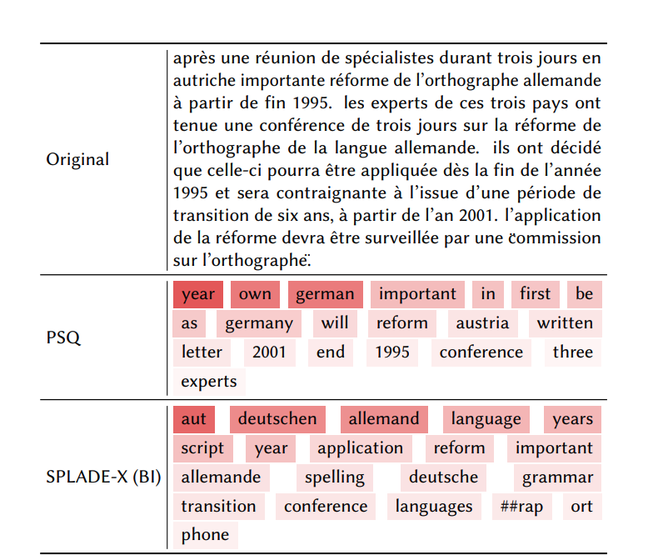
SPLADE-X - examples
Example: positive document for
“german spelling reform”
On the french corpus
Learning a Sparse Representation Model for Neural CLIR. Nair, Yang, Lawrie, Mayfield and Oard. DESIRES. 2022.

Slide 175
SPLADE-X - Not all MLM heads are created equal
MLM initialization matters!
MLM score
Learning a Sparse Representation Model for Neural CLIR.
Nair, Yang, Lawrie, Mayfield and Oard. DESIRES. 2022.

Slide 176
BLADE, improving over SPLADE-X
Cross-lingual retrieval, bilingual system
  English queries, passages in other languages
Changes MLM encoder tokens filtering
  Bi-lingual model, only “English” and “target” tokens are used
Adds MLM and parallel pretraining
  (Sort of) Fix the MLM initialization problem from before
  Trains with comparable passages in Wikipedia
BLADE: combining vocabulary pruning and intermediate pretraining for scaleable neural CLIR Nair, Yang, Lawrie, Mayfield and Oard. SIGIR. 2023.

Slide 177
BLADE - Results
Model |  | CLEF-03 (English -> Language), mAP
 |  | French | Italian | German | Spanish
SPLADE-X | Reproduction Better training | 40.2 | 35.5 | 34.0 | 33.2
BLADE | "+" Bilingual Tokens (BT) | 43.4 | 36.1 | 34.0 | 15.2
 | BT + Comparable Passages | 44.8 | 38.9 | 38.6 | 38.7
Improvements all around
Need better training data
  Translating docs to English and using SPLADE is better (but slower and $$)
BLADE: combining vocabulary pruning and intermediate pretraining for scaleable neural CLIR Nair, Yang, Lawrie, Mayfield and Oard. SIGIR. 2023.

Slide 178
MILCO - Using pivot language for multilingual
Support monolingual and cross-language (one or multiple doc lang)
Represent all text in English
Representation distillation from English to non-English text
  A form of middle training
  Making sure the model can represent non-English text with English tokens
But suffer from named entity issues
MILCO: Learned Sparse Retrieval Across Languages via a Multilingual Connector. Nguyen, T., Lei, Y., Ju, J.H., Yang, E. and Yates, A. ICLR 2026

Slide 179
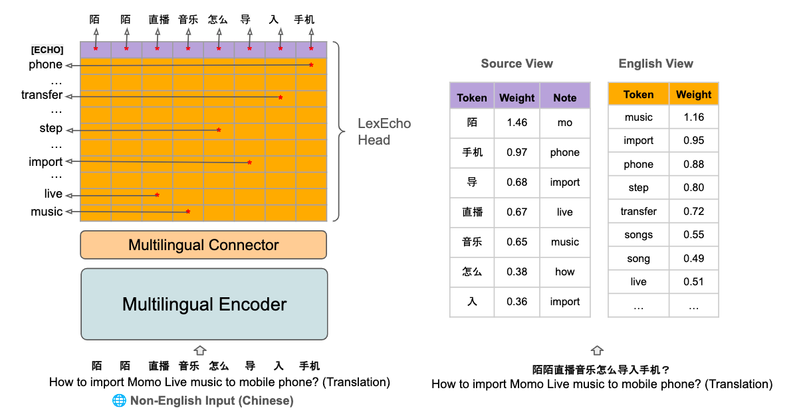
Add tokens from query language to help
MILCO: Learned Sparse Retrieval Across Languages via a Multilingual Connector. Nguyen, T., Lei, Y., Ju, J.H., Yang, E. and Yates, A. ICLR 2026

Slide 180
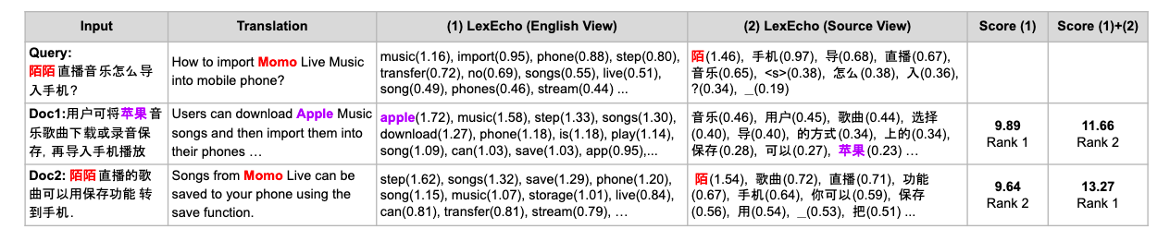
MILCO: Learned Sparse Retrieval Across Languages via a Multilingual Connector. Nguyen, T., Lei, Y., Ju, J.H., Yang, E. and Yates, A. ICLR 2026

Slide 181
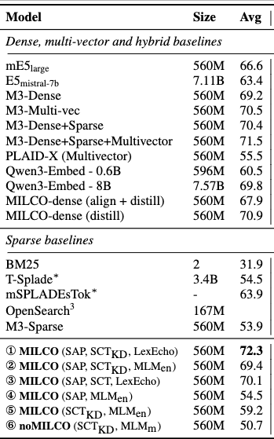
One model for many monolingual problems
MILCO: Learned Sparse Retrieval Across Languages via a Multilingual Connector. Nguyen, T., Lei, Y., Ju, J.H., Yang, E. and Yates, A. ICLR 2026

Slide 182
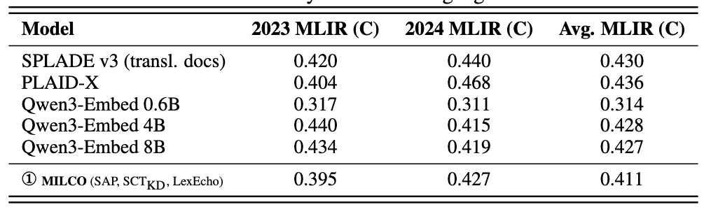
On NeuCLIR MLIR
MILCO: Learned Sparse Retrieval Across Languages via a Multilingual Connector. Nguyen, T., Lei, Y., Ju, J.H., Yang, E. and Yates, A. ICLR 2026

Slide 183
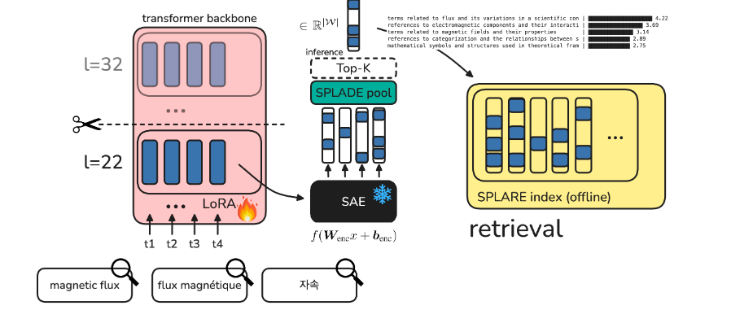
Or a different route…
Completely rely on multilingual backbone
And only train for retrieval and sparsity
Learning Retrieval Models with Sparse Autoencoders Formal, T., Louis, M., Dejean, H. and Clinchant, S., ICLR 2026

Slide 184
SPLARE on NeuCLIR MLIR
Model | nDCG@20
MILCO (XLMR-Large Based) | 0.395
PLAID-X (XLMR-Large Based) | 0.396
Qwen3 8B Embed | 0.423
SPLARE 7B (Llama-based) | 0.444
Naver Labs Europe@ WSDM CUP | Multilingual Retrieval. Formal, T., Louis, M., Déjean, H. and Clinchant, S., 2026. arXiv preprint arXiv:2602.20986.

Slide 185
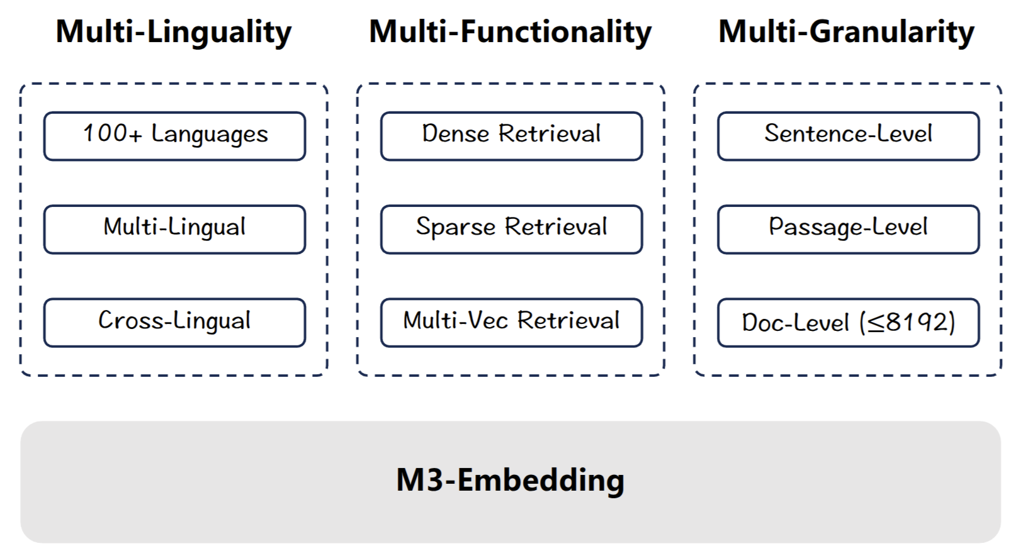
BGE-M3 - Multi Headed retrieval
BGE M3-Embedding: Multi-Lingual, Multi-Functionality, Multi-Granularity Text Embeddings Through Self-Knowledge Distillation
Zhang, Zhang, Long, Xie, Dai, Tang, Lin, Yang, Xie, Huang, Zhang, Li and Zhang, ArXiv 2024

Slide 186
BGE-M3 - Multi Headed retrieval
Will talk more about multi-functionality later
MLP encoder
Focus on Multilinguality here
BGE M3-Embedding: Multi-Lingual, Multi-Functionality, Multi-Granularity Text Embeddings Through Self-Knowledge Distillation
Zhang, Zhang, Long, Xie, Dai, Tang, Lin, Yang, Xie, Huang, Zhang, Li and Zhang, ArXiv 2024

Slide 187
Multilingual retrieval - monolingual, multilingual
NL
EN
EN
Who was
Jan Vermeer?
PT
EN
EN
EN
[(who, 3), (Jan, 5), (Vermeer, 5), (artist, 1)
NL
PT

Slide 188

BGE-M3 - Training procedure
More Later
BGE M3-Embedding: Multi-Lingual, Multi-Functionality, Multi-Granularity Text Embeddings Through Self-Knowledge Distillation
Zhang, Zhang, Long, Xie, Dai, Tang, Lin, Yang, Xie, Huang, Zhang, Li and Zhang, ArXiv 2024

Slide 189
BGE-M3 - Results
Model |  | MLDR MonoLingual, 13 languages nDCG@10
BM25 | XLM-R tokenizer | 53.6
mE5-Large |  | 34.2
M3 | Dense | 52.5
 | Sparse | 62.2
BGE M3-Embedding: Multi-Lingual, Multi-Functionality, Multi-Granularity Text Embeddings Through Self-Knowledge Distillation
Zhang, Zhang, Long, Xie, Dai, Tang, Lin, Yang, Xie, Huang, Zhang, Li and Zhang, ArXiv 2024

Slide 190
BGE-M3 - Results
Model |  | MLDR Monolingual, 13 languages nDCG@10
BM25 | XLM-R tokenizer | 53.6
 | Analyzer | 64.1
mE5-Large |  | 34.2
M3 | Dense | 52.5
 | Sparse | 62.2
BGE M3-Embedding: Multi-Lingual, Multi-Functionality, Multi-Granularity Text Embeddings Through Self-Knowledge Distillation
Zhang, Zhang, Long, Xie, Dai, Tang, Lin, Yang, Xie, Huang, Zhang, Li and Zhang, ArXiv 2024

Slide 191
BGE-M3 - Results
Model |  | MLDR Monolingual, 13 languages nDCG@10 | MIRACL Monolingual, 18 languages nDCG@10
BM25 | XLM-R tokenizer | 53.6 | 31.9
 | Analyzer | 64.1 | 38.5
mE5-Large |  | 34.2 | 66.6
M3 | Dense | 52.5 | 69.2
 | Sparse | 62.2 | 53.9
BGE M3-Embedding: Multi-Lingual, Multi-Functionality, Multi-Granularity Text Embeddings Through Self-Knowledge Distillation
Zhang, Zhang, Long, Xie, Dai, Tang, Lin, Yang, Xie, Huang, Zhang, Li and Zhang, ArXiv 2024

Slide 192
BGE-M3 - Results
Model |  | MLDR Monolingual, 13 languages nDCG@10 | MIRACL Monolingual, 18 languages nDCG@10 | MKQA Cross-lingual, 25 languages nDCG@10 | Average
BM25 | XLM-R tokenizer | 53.6 | 31.9 | 39.9 | 41.8
 | Analyzer | 64.1 | 38.5 | 40.9 | 47.8
mE5-Large |  | 34.2 | 66.6 | 70.9 | 57.2
M3 | Dense | 52.5 | 69.2 | 75.1 | 65.6
 | Sparse | 62.2 | 53.9 | 45.3 | 53.8
BGE M3-Embedding: Multi-Lingual, Multi-Functionality, Multi-Granularity Text Embeddings Through Self-Knowledge Distillation
Zhang, Zhang, Long, Xie, Dai, Tang, Lin, Yang, Xie, Huang, Zhang, Li and Zhang, ArXiv 2024

Slide 193
BGE-M3 - Results
Model |  | MLDR Monolingual, 13 languages nDCG@10 | MIRACL Monolingual, 18 languages nDCG@10 | MKQA Cross-lingual, 25 languages nDCG@10 | Average
BM25 | XLM-R tokenizer | 53.6 | 31.9 | 39.9 | 41.8
 | Analyzer | 64.1 | 38.5 | 40.9 | 47.8
mE5-Large |  | 34.2 | 66.6 | 70.9 | 57.2
M3 | Dense | 52.5 | 69.2 | 75.1 | 65.6
 | Sparse | 62.2 | 53.9 | 45.3 | 53.8
 | Dense + Sparse | 64.8 | 70.4 | 75.3 | 70.2
BGE M3-Embedding: Multi-Lingual, Multi-Functionality, Multi-Granularity Text Embeddings Through Self-Knowledge Distillation
Zhang, Zhang, Long, Xie, Dai, Tang, Lin, Yang, Xie, Huang, Zhang, Li and Zhang, ArXiv 2024

Slide 194
Multilingual retrieval: challenges and “solutions”
Lexical matching
  How do you perform lexical match over multiple languages?
  Solutions:
    One language at a time
      MLP (no expansion): BGE-m3, mGTE
      MLM (one model per language): NeuCLIR-SPLADE, MLM+FLOPS SPLADE
    Cross-lingual: Does not work without expansion (“this” -> “isso” does not match)
      Direct training w/ IR objectives: SPLADE-X
      Pivot language: BLADE, MILCO
      Concepts through SAE: SPLARE
    Training approach
      Co-training: BLADE
      Representation distillation: MILCO
BGE M3-Embedding: Multi-Lingual, Multi-Functionality, Multi-Granularity Text Embeddings Through Self-Knowledge Distillation, Zhang et al, ArXiv 2024
mGTE: mGTE: Generalized Long-Context Text Representation and Reranking Models for Multilingual Text Retrieval, Zhang et al, ArXiv 2024
NeuCLIR-SPLADE: NAVER LABS EUROPE @ TREC NEUCLIR 2022 and 2023, Lassance and Clinchant, TREC 2022 and 2023
MLM+FLOPS SPLADE: An Experimental Study on Pretraining Transformers from Scratch for IR. Lassance, Dejean and Clinchant, ECIR 2023

Slide 195
Multilingual retrieval: challenges and “solutions”
Size of MLM encoder
  Number of tokens increases massively (30k->250k)
  Memory cost increases on the output head
    MLM models encode the following matrix: (bs, sequence_length, tokens)
    When tokens increase, this causes OOM
    E.g:
      bs=16, sequence_length=256, tokens=30k -> 122M “numbers”
      bs=16, sequence_length=256, tokens=250k -> 1B “numbers”
  Current solutions:
    mAggRetriever: Enforce representations to convert to only one language.
    mSPLADE-sTok: Create a tokenizer specific to a subset of languages
    Just English
    Just use an MLP: Previous slide
mAggRetriever: mAggretriever: A Simple yet Effective Approach to Zero-Shot Multilingual Dense Retrieval Lin, Ahmad and Lin. EMNLP 2023
mSPLADE-sTok: Extending English IR methods to multi-lingual IR. Carlos Lassance. ArXiV / WSDM Cup 2023

Slide 196
Conclusion
Still work in progress
  Lexical match is a strong prior
  Keeping it through languages is not trivial
Current solutions either:
  Consider one language at a time
  Need to encode everything in a common language
However, even current solution can achieve good performance (sometimes)
  MILCO and SPLARE achieve good results
Next: multimodal LSR

Slide 197
Questions

Slide 198
Neural Lexical Search with Learned Sparse Retrieval
ECIR 2026 Tutorial

Slide 199
Indexing and Retrieving
ECIR 2026 Tutorial
Cosimo Rulli

Slide 200
Schedule
Introduction
Datasets and Evaluation
LSR Framework
Initialization of LSR
Modalities
English Text
Multilingual Text
Multimodal Data
Indexing & efficiency ← now
Hybrid dense-sparse retrieval
Conclusion

Slide 201
The Inverted Index
LSR encodes text into learned bag of words,
represented as sparse vectors (> 99%).
Maximum Inner Product Search (MIPS).
The most convenient data structure to store
and search sparse vectors is an inverted index.
Johannes
was
Vermeer
who
0
1.5
1.9
0
0
0.5
0.7
“who was Johannes Vermeer”

Slide 202

The Inverted Index
Document ids where terms appear.
E.g., the term “Cat” appears in doc #1, #12
etc..
Collection terms

Slide 203

The Inverted Index
Each term appears with an associated
score, for each document.
The score can be:
  The term frequency (e.g., for BM25).
  The LSR score
At query processing, scan only the inverted lists
of the active query terms.

Slide 204
DaaT vs SaaT
Document-at-a-time
  scan posting lists of all query terms in parallel
  compute score when the same document is seen in one or more postings
  advance in many postings list simultaneously
  maintains a sorted list of results
Score-at-a-time
  visit posting list segments in decreasing order of impact score
  expand the documents in each segment
  update the score of every document

Slide 205

The inefficiency of Inverted Indexes
Inverted Indexes are inefficient on LSR
embeddings due to:
up to 26.5x
slower
up to 19.8x
slower
Wacky Weights in Learned Sparse Representations and the Revenge of Score-at-a-Time Query Evaluation. Mackenzie, Trotman, Lin. arXiv 2021.

Slide 206
The inefficiency of Inverted Indexes
Inverted Indexes are inefficient on LSR
embeddings due to:
  Document expansion
|D| = 30
|D| = 229
Wacky Weights in Learned Sparse Representations and the Revenge of Score-at-a-Time Query Evaluation. Mackenzie, Trotman, Lin. arXiv 2021.

Slide 207
The inefficiency of Inverted Indexes
Inverted Indexes are inefficient on LSR
embeddings due to:
  Document expansion
  Query expansion
|D| = 30
|Q| = 6
|D| = 229
|Q| = 25
Wacky Weights in Learned Sparse Representations and the Revenge of Score-at-a-Time Query Evaluation. Mackenzie, Trotman, Lin. arXiv 2021.

Slide 208
The inefficiency of Inverted Indexes
Inverted Indexes are inefficient on LSR
embeddings due to:
  Document expansion
  Query expansion
  Distributional differences
|D| = 30
|Q| = 6
|V| = 2.6M
|D| = 229
|Q| = 25
|V| = 30K
Wacky Weights in Learned Sparse Representations and the Revenge of Score-at-a-Time Query Evaluation. Mackenzie, Trotman, Lin. arXiv 2021.

Slide 209
The inefficiency of Inverted Indexes
Inverted Indexes are inefficient on LSR
embeddings due to:
  Document expansion
  Query expansion
  Distributional differences
  Wacky Weights
Wacky Weights in Learned Sparse Representations and the Revenge of Score-at-a-Time Query Evaluation. Mackenzie, Trotman, Lin. arXiv 2021.

Slide 210

Wacky Weights
Query: “Androgen receptor define”
Wacky Weights in Learned Sparse Representations and the Revenge of Score-at-a-Time Query Evaluation. Mackenzie, Trotman, Lin. arXiv 2021.
Efficient Document-at-a-Time and Score-at-a-Time Query Evaluation for Learned Sparse Representations. Mackenzie, Trotman, Lin. TOIS 2022.

Slide 211

Wacky Weights
Query: “Androgen receptor define”
and
helen
Wacky Weights in Learned Sparse Representations and the Revenge of Score-at-a-Time Query Evaluation. Mackenzie, Trotman, Lin. arXiv 2021.
Efficient Document-at-a-Time and Score-at-a-Time Query Evaluation for Learned Sparse Representations. Mackenzie, Trotman, Lin. TOIS 2022.

Slide 212
Wacky Weights
Query: “Androgen receptor define”
and
helen
Wacky Weights in Learned Sparse Representations and the Revenge of Score-at-a-Time Query Evaluation. Mackenzie, Trotman, Lin. arXiv 2021.
Efficient Document-at-a-Time and Score-at-a-Time Query Evaluation for Learned Sparse Representations. Mackenzie, Trotman, Lin. TOIS 2022.

Slide 213

The New Generation of Data Structures
Two design principles in mind.
Trade exactness for major speedups
In dense k-NN, exact methods (e.g. KD-tree) are replaced by ANN solutions (HNSW).
2) Selection Index + Forward Index
Use SI to identify candidate vectors, the FI
to compute the dot product.

Slide 214
Exact vs Approximate Search
Exact search is too slow.
We can give up on exactness for major
efficiency improvements.
A lesson learned from dense k-NN.
Exact methods (e.g. KD-tree) are replaced by
ng-ANN solutions (HNSW).

Slide 215



How can we approximate?
Approximate the representations.
Pruning query and/or documents.
Blocking.
Group together documents and skip
irrelevant blocks.
Proximity Graph
A navigable graph connecting similar
documents.

Slide 216

Pruning
Scores distribution suggests that
we can discard some terms.
Several Strategies:
  per Document
  per Posting Lists
  per Absolute value.
max 2% loss of mRR@10 -> 2x speedup.
max 8% loss of mRR@10 -> 4x speedup.
Lassance, Carlos, et al. "A static pruning study on sparse neural retrievers." SIGIR 2023.
Lassance, Carlos, et al. “Two-Step SPLADE: Simple, Efficient and Effective Approximation of SPLADE”. ECIR 2024.

Slide 217

Concentration of Importance (COI)
L₁ norm concentrated in few
components.
Few components yields good
dot product approximation.
Quick candidate identification!
80% of L1 with ~25% of terms.
Bruch, Nardin, Rulli, Venturini, Efficient inverted indexes for approximate retrieval over learned sparse representations. SIGIR 2024.

Slide 218

Concentration of Importance (COI)
L₁ norm concentrated in few
components.
Few components yields good
dot product approximation.
Quick candidate identification!
80% of L1 with ~25% of terms.
90% of dp with 15% of terms
Bruch, Nardin, Rulli, Venturini, Efficient inverted indexes for approximate retrieval over learned sparse representations. SIGIR 2024.

Slide 219

How to exploit COI
Static Pruning.
  Build the posting lists.
  Sort them by decreasing score.
  Prune at λ entries.
Query Pruning.
  Sort terms by score.
  Prune at query_cut .

Slide 220

Validating the Concentration of Importance
𝜆 = 4000
% of true closest
documents

Slide 221
Blocking (or Dynamic Pruning)
Crucial Component in Inverted Indexes.
Group, compute an upper bound, safely skips blocks.
🏛️ MaxScore, WAND, BMW, VBMW
Milestones data structures in IR exploit blocking.
Turtle, H., & Flood, J. Query evaluation: strategies and optimizations. Information Processing & Management, 1995.
Broder, A. Z. et al. Efficient query evaluation using a two‑level retrieval process. CIKM 2003.
Ding, S., & Suel, T. Faster top‑k document retrieval using block‑max indexes. SIGIR 2011.
Mallia, A., Ottaviano, G., Porciani, E., Tonellotto, N., & Venturini, R. Faster BlockMax WAND with variable‑sized blocks. SIGIR 2017.

Slide 222
Blocking (or Dynamic Pruning)
Crucial Component in Inverted Indexes.
Group, compute an upper bound, safely skips blocks.
🚀 ASC, BMP, Seismic, DSP.
Modern indexes for LSR use it as well (paired with the Forward Index).
Qiao, Yifan, et al. "Threshold-driven Pruning with Segmented Maximum Term Weights for Approximate Cluster-based Sparse Retrieval." EMNLP 2024.
Mallia, Antonio, Torsten Suel, and Nicola Tonellotto. "Faster learned sparse retrieval with block-max pruning." SIGIR 2024.
Bruch, Sebastian, et al. "Efficient inverted indexes for approximate retrieval over learned sparse representations." SIGIR. 2024.
Carlson, Parker, et al. "Dynamic Superblock Pruning for Fast Learned Sparse Retrieval." SIGIR 2025.

Slide 223

Seismic - Blocking
Blocking.
Group documents in lists
in β blocks (shallow K-Means)

Slide 224


Seismic - Blocking
Blocking.
Group documents in lists
in β blocks (shallow K-Means)
Summary.
A vector that is an upper-bound for the
dot product.

Slide 225

Seismic - Compress the Summaries
Summary sizes grow quickly.
Block Pruning.
We prune ɸ(B) keeping its
ꭤ-mass subvector.
Scalar quantization on ɸ(B).
cut here to keep the 50% (𝞪=0.5) of the l1-norm

Slide 226

Proximity Graphs
Widely used in dense ANN.
The most common is HNSW.
Link each document with its friends.
Explore the graph using greed search.
Effectively applied to sparse vectors.
BigANN@NeurIPS 2023.
Malkov, Yu A., and Dmitry A. Yashunin. "Efficient and robust approximate nearest neighbor search using hierarchical navigable small world graphs." IEEE TPAMI 2018.

Slide 227

The Forward Index
Stores the sparse collection.
as components and values.
Enables fast, exact dot products
on the vectors selected by the indexes.
Core Function: given (q, i), returns dp(q, x_{i})

Slide 228

From Milliseconds to Microseconds
2021
2026
Splade-v3

Slide 229

MSMARCO-v2
Scaling up the size of the collections
Bruch, Nardini, Rulli, Venturini, Venuta Investigating the Scalability of Approximate Sparse Retrieval Algorithms to Massive Datasets. ECIR 2024.

Slide 230

The Forward Index
Memory-intensive
it stores all non-zero components
and values of the collection.
Compression is important!
reduce memory footprint
but preserving query latency.
Components are integers.
Vast literature of lossless compression.
Bruch et al. Forward Index Compression for Learned Sparse Retrieval. ECIR 2026.

Slide 231

Comparison with Dense Retrieval
Snowflake.
1024-dim, MRR@10: 38.2
Splade (cocondenser)
MRR@10: 38.3
Sparse retrieval can rival or outperform
dense retrieval!

Slide 232
Training Efficiency
Dense Encoder
[CLS]
The main training bottleneck compared to dense and multi-vector.
Main cause: The LM Head.
+20% time, +30% peak memory
compared to backbone alone.
Transformer Backbone
Multi Vector Encoder
[h x d]
Transformer Backbone
[h x |V|]
LSR
Transformer Backbone

Slide 233


Sparton - Kernel for LSR
No materialization of the LM Head in GPU Memory (B x S x |V|)
Tiles the computation (B X |V|).
S-fold memory saving in forward and backward.
Larger batches, longer sequences, better training!
Nguyen, Rulli, Nardini, Venturini, Yates. Sparton: Fast and Memory-Efficient Triton Kernel for Learned Sparse Retrieval. Arxiv 2026.

Slide 234
More related approaches
Accelerating Learned Sparse Indexes Via Term Impact Decomposition. Mackenzie, Mallia, Moffat, Petri. Findings of EMNLP 2022.
Dual Skipping Guidance for Document Retrieval with Learned Sparse Representations. Qiao, Yang, Lin, Xiong, Wang, Yang. arXiv 2022.
Faster Learned Sparse Retrieval with Guided Traversal. Mallia, Mackenzie, Suel, Tonelloto. SIGIR 2022.
Optimizing Guided Traversal for Fast Learned Sparse Retrieval. Qiao, Yang, Lin, Yang. WWW 2023.
Gou, Jinrui, et al. "Fast and Effective Early Termination for Simple Ranking Functions." SIGIR 2025.

Slide 235
Inverted indexes are natural for sparse vectors, but LSR breaks them: expansion and wacky weights cause up to 26x slowdowns.
New data structures exploit two principles: approximation for candidate selection, forward index for exact scoring.
LSR with modern indexes is competitive with dense retrieval.

Slide 236
Questions?
Inverted indexes are natural for sparse vectors, but LSR breaks them: expansion and wacky weights cause up to 26x slowdowns.
New data structures exploit two principles: approximation for candidate selection, forward index for exact scoring.
LSR with modern indexes is competitive with dense retrieval.

Slide 237
Neural Lexical Search with Learned Sparse Retrieval
ECIR 2026 Tutorial

Slide 238
Modalities: Multimodal LSR
ECIR 2026 Tutorial
presented by Thong Nguyen

Slide 239
Schedule
Introduction
Datasets and Evaluation
LSR Framework
Initialization of LSR
Modalities
English Text
Multilingual Text
Multimodal Data ← now
Indexing & efficiency
Hybrid dense-sparse retrieval
Conclusion
Notes:
This is the whole agenda of our LSR tutorial.
I will be responsible for the Multimodal Section, which will last for 20 minutes.

Slide 240



Multimodal LSR
Main goal:
Bridge semantic and modality gap via lexical repersentations.
bike
dutch
canal
canal
delft
boat
dutch
delft canal
Notes:
The main goal of multimodal LSR is to bridge the semantic and modality gap betwen queries and documents using lexical represenations.
Given the text query “delft canal" and the “image"
We want to

Slide 241
Multimodal LSR: Timeline of Development
[1] VisualSparta: An Embarrassingly Simple Approach to Large-scale Text-to-Image Search with Weighted Bag-of-words, ACL 2021
[2] STAIR: Learning Sparse Text and Image Representation in Grounded Tokens, EMNLP 2023
[3] LexLIP: Lexicon-Bottlenecked Language-Image Pre-Training for Large-Scale Image-Text Retrieval, ICCV 2023
[4] Multimodal Learned Sparse Retrieval with Probabilistic Expansion Control, ECIR 2024
[5] Retrieval-based Disentangled Representation Learning with Natural Language Supervision, ICLR 2024
[6] Rethinking Sparse Lexical Representations for Image Retrieval in the Age of Rising Multi-modal Large Language Models, ECCV 2024
[7] Unified Lexical Representation for Interpretable Visual-Language Alignment, NeurIPS 2024
[8] Interpreting CLIP with Sparse Linear Concept Embeddings, NeurIPS 2024
[9] Towards Unified Human Motion-Language Understanding via Sparse Interpretable Characterization, ICLR 2025
Wide interest in different communities!
Notes:
Go through this slide more quickly

Slide 242
Multimodal LSR: Covered in this tutorial.
[1] VisualSparta: An Embarrassingly Simple Approach to Large-scale Text-to-Image Search with Weighted Bag-of-words, ACL 2021
Using a simple Binary Text Encoder, MLM Image Encoder; Highly efficient.
Notes:
Go through this slide more quickly

Slide 243
Multimodal LSR: Covered in this tutorial.
[1] VisualSparta: An Embarrassingly Simple Approach to Large-scale Text-to-Image Search with Weighted Bag-of-words, ACL 2021
Using a simple Binary Text Encoder, MLM Image Encoder; Highly efficient.
[2] STAIR: Learning Sparse Text and Image Representation in Grounded Tokens, EMNLP 2023
MLM Text-Image Encoder; Large scale three-step training.
Notes:
Go through this slide more quickly

Slide 244
Multimodal LSR: Covered in this tutorial.
[1] VisualSparta: An Embarrassingly Simple Approach to Large-scale Text-to-Image Search with Weighted Bag-of-words, ACL 2021
Using a simple Binary Text Encoder, MLM Image Encoder; Highly efficient.
[2] STAIR: Learning Sparse Text and Image Representation in Grounded Tokens, EMNLP 2023
MLM Text-Image Encoder; Large scale three-step training.
[3] LexLIP: Lexicon-Bottlenecked Language-Image Pre-Training for Large-Scale Image-Text Retrieval, ICCV 2023
MLM Text-Image Encoder; Lexicon-Bottlenecked Pretraining.
Notes:
Go through this slide more quickly

Slide 245
Multimodal LSR: Covered in this tutorial.
[1] VisualSparta: An Embarrassingly Simple Approach to Large-scale Text-to-Image Search with Weighted Bag-of-words, ACL 2021
Using a simple Binary Text Encoder, MLM Image Encoder; Highly efficient.
[2] STAIR: Learning Sparse Text and Image Representation in Grounded Tokens, EMNLP 2023
MLM Text-Image Encoder; Large scale three-step training.
[3] LexLIP: Lexicon-Bottlenecked Language-Image Pre-Training for Large-Scale Image-Text Retrieval, ICCV 2023
MLM Text-Image Encoder; Lexicon-Bottlenecked Pretraining.
[4] Multimodal Learned Sparse Retrieval with Probabilistic Expansion Control, ECIR 2024
MLM; Convert Dense to Sparse Retrieval.
Notes:
Go through this slide more quickly

Slide 246

Multimodal LSR: Timeline of Development
MSCOCO 5k

Slide 247
Multimodal LSR: Timeline of Development
MSCOCO 5k
Splade v1
(Jul 2021)

Slide 248
Multimodal LSR: Timeline of Development
MSCOCO 5k
Splade v1
(Jul 2021)
2 years with no new work!

Slide 249
Multimodal LSR: Timeline of Development
MSCOCO 5k
Splade v1
(Jul 2021)
Splade v2
(May 2022)

Slide 250
Multimodal LSR: Timeline of Development
MSCOCO 5k
Splade v1
(Jul 2021)
Splade v2
(May 2022)
Success in text LSR has encouraged adaptation to multimodal domain

Slide 251
MSCOCO 5k
Covered in this tutorial

Slide 252
Common benchmarks and metrics
Datasets: MSCOCO 5k [10], Flickr30K
  Caption-image datasets
  Two sub-tasks: Text-2-Image Retrieval, Image-2-Text Retrieval
Metrics:
  Report metric: R@k
  Actual implementation: Hit@k
  In this presentation: R@5 means Hit@5
Dataset | # Images | # Captions | # Captions/image
MSCOCO 5k | 5000 | 25000 | 5
[10] Deep Visual-Semantic Alignments for Generating Image Descriptions CVPR 2015
Notes:
Before going into details about each methods.
In this slide, I will present a foundation for comparison, including datasets and metrics.
For datasets, the literature usually includes MSCOCO 5k and Flickro30k.
Metrics: R@K = Hit@K

Slide 253
MSCOCO 5k
Notes:
This that, I would like to start with visual sparta.

Slide 254
VisualSparta, ACL 2021
VisualSparta extends Sparta [11] from text retrieval to text-to-image retrieval.
“Our method is embarrassingly simple because its image representation is essentially a weighted bag-of-words, and can be indexed in a standard Inverted Index for fast retrieval”.
[11] SPARTA: Efficient Open-Domain Question Answering via Sparse Transformer Matching Retrieval NAACL 2021

Slide 255

VisualSparta, ACL 2021
delft
canal
0
0
1
0
0
…
1
Binary Query Encoder
“delft canal”
NO EXPANSION
Notes:
The presentation on the Image Encoder is not very fluent.

Slide 256
VisualSparta, ACL 2021
MLM: Learn to map the image to relevant terms.
+
External Expansion: from Object Recognition model.
delft
dutch
canal
canal
bike
boat
(keep top k)
0
0
1
0
0
…
1
7.8
0
11.9
1.7
0
…
2.5
Binary Query Encoder
MLM Image Encoder
“delft canal”
image patches
NO EXPANSION
WITH EXPANSION
Notes:
The presentation on the Image Encoder is not very fluent.

Slide 257
VisualSparta, ACL 2021
MLM: Learn to map the image to relevant terms.
+
External Expansion: from object recognition models.
spaghetti
dutch
canal
with
ketchup
bike
boat
(keep top k)
0
0
1
1
0
…
1
7.8
0
11.9
1.7
0
…
2.5
Binary Query Encoder
MLM Image Encoder
car boat house …
“spaghetti with ketchup”
image patches
Object Recognition
NO EXPANSION
WITH EXPANSION
Notes:
The presentation on the Image Encoder is not very fluent.

Slide 258
VisualSparta, ACL 2021
State of the art at the time!
Method | MSCOCO 5k (R@5)
CAMP (Dense, 2019) | 68.9
SCAN (Dense, 2018) | 69.3
CVSE (Dense, 2020) | 66.4
VisualSparta (Sparse, 2021) | 73.0
+6%
Effectiveness (R@5 / Hit@5)

Slide 259
VisualSparta, ACL 2021
State of the art at the time!
Method | MSCOCO 5k (R@5)
CAMP (Dense, 2019) | 68.9
SCAN (Dense, 2018) | 69.3
CVSE (Dense, 2020) | 66.4
VisualSparta (Sparse, 2021) | 73.0
# Images | CVSE (GPU) | CVSE (CPU) | VisualSparta (CPU)
1K | 195.1 | 177.4 | 451.3
5k | 191.0 | 162.0 | 390.5
113K | 101.2 | 5.4 | 275.5
1M | 21.7 | 0.3 | 117.3
Effectiveness (R@5 / Hit@5)
Efficiency ( Query/s)

Slide 260
VisualSparta, ACL 2021
State of the art at the time!
Method | MSCOCO 5k (R@5)
CAMP (Dense, 2019) | 68.9
SCAN (Dense, 2018) | 69.3
CVSE (Dense, 2020) | 66.4
VisualSparta (Sparse, 2021) | 73.0
# Images | CVSE (GPU) | CVSE (CPU) | VisualSparta (CPU)
1K | 195.1 | 177.4 | 451.3
5k | 191.0 | 162.0 | 390.5
113K | 101.2 | 5.4 | 275.5
1M | 21.7 | 0.3 | 117.3
x6 times faster
Effectiveness (R@5 / Hit@5)
Efficiency ( Query/s)

Slide 261
VisualSparta, ACL 2021
Binary Encoder (inference-free)
State of the art at the time!
Method | MSCOCO 5k (R@5)
CAMP (Dense, 2019) | 68.9
SCAN (Dense, 2018) | 69.3
CVSE (Dense, 2020) | 66.4
VisualSparta (Sparse, 2021) | 73.0
# Images | CVSE (GPU) | CVSE (CPU) | VisualSparta (CPU)
1K | 195.1 | 177.4 | 451.3
5k | 191.0 | 162.0 | 390.5
113K | 101.2 | 5.4 | 275.5
1M | 21.7 | 0.3 | 117.3
x6 times faster
Effectiveness (R@5 / Hit@5)
Efficiency ( Query/s)

Slide 262
VisualSparta, ACL 2021
dutch
canal
bike
boat
7.8
0
11.9
1.7
0
…
2.5
MLM Image Encoder
Interpretability: How the MLM learn to map the image to relevant terms?
image patches
Next

Slide 263
Expansion and Semantic Deviation
…..
…
“delft canal”
need to match query with image

Slide 264
One-side Expansion
…..
…
“delft canal”
NO EXPANSION
VisualSparta
WITH EXPANSION

Slide 265
One-side Expansion
delft
canal
…..
…
“delft canal”
NO EXPANSION
VisualSparta
WITH EXPANSION

Slide 266
One-side Expansion
delft
canal
delft
canal
…..
…
“delft canal”
NO EXPANSION
VisualSparta
WITH EXPANSION

Slide 267
One-side Expansion
delft
canal
delft
canal
…..
…
“delft canal”
NO EXPANSION
VisualSparta
WITH EXPANSION
May hurt effectiveness!

Slide 268
Two-side Expansion
…..
…
“delft canal”
WITH EXPANSION
WITH EXPANSION
[4] Multimodal Learned Sparse Retrieval with Probabilistic Expansion Control, ECIR 2024

Slide 269
Two-side Expansion
Key Challenge:
Semantic Deviation [4]
matching via a randomly activated token
pizza
pizza
…..
…
“delft canal”
WITH EXPANSION
WITH EXPANSION
[4] Multimodal Learned Sparse Retrieval with Probabilistic Expansion Control, ECIR 2024
Notes:
There are recent VLMs model that were trained with a language model head on both text and images.
However the semantic division is unclear.

Slide 270

Two-side Expansion
Key Challenge:
Semantic Deviation [4]
matching via a fixed set of random tokens
pizza
pizza
…..
…
“delft canal”
…
…
WITH EXPANSION
WITH EXPANSION
[4] Multimodal Learned Sparse Retrieval with Probabilistic Expansion Control, ECIR 2024

Slide 271
When, Why, How?
Key Challenge:
Semantic Deviation [4]
When does it happen?
  Free expansion on both sides (e.g., MLM encoder).
Why does it NOT happen with SPLADE (MLM architecture)?
  SPLADE starts with BERT which has good MLM head initialization. Training starts with most relevant terms activated.
Why does it happen with multimodal data?
  The MLM head (for images) has a randomly initialization! Random terms activated at the beginning.
How to fix it?
Next
[4] Multimodal Learned Sparse Retrieval with Probabilistic Expansion Control, ECIR 2024
Notes:
Optional to present this here:
There are recent VLMs model that were trained with a language model head on both text and images.
However the semantic division is unclear.

Slide 272
Key Challenge:
Semantic Deviation [4]
MSCOCO 5k

Slide 273
LexLIP, ICCV 2023
Key Challenge:
Semantic Deviation [4]
Architecture: MLM Encoder fo both text/image sides
Solution to semantic deviation:
  Pretraining Text/Image Encoder with Masked Token Prediction Task.
Pretraining Data:
  14.3 M text-image pairs.
Methods | MSCOCO (R@5)
VisualSparta | 73.0
LexLIP | 79.1
+8%
[3] LexLIP: Lexicon-Bottlenecked Language-Image Pre-Training for Large-Scale Image-Text Retrieval, ICCV 2023
Notes:
13 miutes

Slide 274
Key Challenge:
Semantic Deviation [4]
MSCOCO 5k

Slide 275
STAIR, EMNLP 2023
Key Challenge:
Semantic Deviation [4]
Architecture: (separate) MLM Encoder for text/image sides
Solution to semantic deviation: Three-step training
  Step 1: Freeze Text Encoder (+Remove Expansion), Train Image Encoder
  Step 2: Freeze Image Encoder, Train Text Encoder with Expansion
  Step 3: Train both Text Encoder and Image Encoder with Expansion
Training Data:
  1.1B text-image pairs
Methods | Zero-shot MSCOCO (R@5)
CLIP | 62.2
STAIR | 65.4
+5%
[2] STAIR: Learning Sparse Text and Image Representation in Grounded Tokens, EMNLP 2023

Slide 276
Training Efficiency
Key Challenge:
Training Efficiency
Training needs a lot of data using large GPU clusters:
  LexLIP: 14.3M text-image pairs
  STAIR: 1.1B text-image pairs
Still not as strong as dense models, trained on even more data.
Dense training is more efficient and easier to scale to larger data.
Methods | MSCOCO (R@5)
VisualSparta (LSR) | 73.0
LexLIP (LSR) | 79.1
BLIP (dense) | 81.8
BLIP-2 (dense) | 87.7

Slide 277
Key Challenge:
Training Efficiency
MSCOCO 5k

Slide 278
D2S (Dense to Sparse)
Key Challenge:
Training Efficiency
Take a pretrained dense encoder and add a MLM head on top
Fine-tune only the MLM head
Use Probabilistic Expansion Control to reduce Semantic Deviation
2 hours of training with 12GB of VRAM
Methods | MSCOCO (R@5)
VisualSparta | 73.0
LexLIP | 79.1
D2S | 80.6
MLM head
Dense Encoder
(Frozen)
D2S
Text/Image
[4] Multimodal Learned Sparse Retrieval with Probabilistic Expansion Control, ECIR 2024

Slide 279
Summary
Training a Multimodal LSR is more difficult than training a text LSR, due to Semantic Deviation and Training Efficiency.
To reduce Semantic Deviation, several strategies can be employed:
  (1) No Query Expansion (e.g., Visual Sparta)
  (2) Extensive Image Pretraining with MLM (e.g., LexLIP)
  (3) Multi-step or Controlled Expansion (e.g., STAIR, D2S)
We can transform a strong off-the-shelf dense model to an effective LSR model (e.g., D2S).

Slide 280
Discussion: Open Challenges
Beyond Images:
  Audio, Video, Table, Mixed Modality (e.g., Text-and-Image).
Limit of lexical representation:
  An image can only be represented lexically if it can be effectively and precisely described in words.
  In some cases, this is difficult.

Slide 281
Discussion: Open Challenges
Beyond Images:
  Audio, Video, Table, Mixed Modality (e.g., Text-and-Image).
Limits of lexical representation:
  An image can only be represented lexically if it can be effectively described in words.

Slide 282
Discussion: Open Challenges
Beyond Images:
  Audio, Video, Table, Mixed Modality (e.g., Text-and-Image).
Limits of lexical representation:
  An image can only be represented lexically if it can be effectively described in words.
  In some cases, this can be difficult.

Slide 283
Discussion: Open Challenges
Beyond Images:
  Audio, Video, Table, Mixed Modality (e.g., Text-and-Image).
Limits of lexical representation:
  An image can only be represented lexically if it can be effectively described in words.
  In some cases, this can be difficult.

Slide 284

Discussion: Limits of Lexical Representation
Task: Image Search
Can you describe this image by words in detail so someone else (or a model) could find the same or similar images from the same location?

Slide 285


Gemini
This image captures a quintessential canal scene in Utrecht, Netherlands, specifically showcasing the city's unique wharf-level terraces.
Suggested queries:
"Utrecht canal wharf terrace"
"Oudegracht Utrecht cafes water level"
"Utrecht canal cellar restaurants"
"Floating restaurant Utrecht canal"

Slide 286
Gemini
This image captures a quintessential canal scene in Utrecht, Netherlands, specifically showcasing the city's unique wharf-level terraces.
Suggested queries:
"Utrecht canal wharf terrace"
"Oudegracht Utrecht cafes water level"
"Utrecht canal cellar restaurants"
"Floating restaurant Utrecht canal"
Relevant images, but not at the same location!

Slide 287

Google Image Search
Google Search (image as a query) can find the exact image/location in Delft, Netherlands.
Can this be solved by lexical presentations alone?

Slide 288

Any Questions?
Next: Indexing & Efficiency
Notes:
Prepare some slides for potential questions (for example, how to convert D2S)?
The benefits of LSR in multimodal?
Time should be around 19 minutes, to give us some buffer!

Slide 289
D2S: Expansion as a Bernoulli random variable
🔺High efficiency
🔺Interpretable output
⟱ Decent effectiveness
w\o expansion
w\ expansion
exp=0

Slide 290
D2S: Expansion as a Bernoulli random variable
🔺High efficiency
🔺Interpretable output
⟱ Decent effectiveness
w\o expansion
⟱ Low efficiency
⟱ Random latent output
🔺High effectiveness
w\ expansion
exp=0 |  |  |  |  |  |  |  |  | exp=1

Slide 291
D2S: Expansion as a Bernoulli random variable
🔺High efficiency
🔺Interpretable output
⟱ Decent effectiveness
w\o expansion
⟱ Low efficiency
⟱ Random latent output
🔺High effectiveness
w\ expansion
exp=0 |  | exp=0.2 | exp=0.3 | exp=0.4 | exp=0.5 | exp=0.6 | …. | exp=0.9 | exp=1
Training epochs

Slide 292
D2S: Expansion as a Bernoulli random variable
🔺High efficiency
🔺Interpretable output
⟱ Decent effectiveness
⟱ Low efficiency
⟱ Random latent output
🔺High effectiveness
exp=0 | exp=0.1 | exp=0.2 | exp=0.3 | exp=0.4 | exp=0.5 | exp=0.6 | …. | exp=0.9 | exp=1
Training epochs

Slide 293
D2S: Expansion as a Bernoulli random variable
🔺High efficiency
🔺Interpretable output
⟱ Decent effectiveness
⟱ Low efficiency
⟱ Random latent output
🔺High effectiveness
exp=0 | exp=0.1 | exp=0.2 | exp=0.3 | exp=0.4 | exp=0.5 | exp=0.6 | …. | exp=0.9 | exp=1
Training epochs

Slide 294
D2S: Expansion as a Bernoulli random variable
🔺High efficiency
🔺Interpretable output
⟱ Decent effectiveness
⟱ Low efficiency
⟱ Random latent output
🔺High effectiveness
exp=0 | exp=0.1 | exp=0.2 | exp=0.3 | exp=0.4 | exp=0.5 | exp=0.6 | …. | exp=0.9 | exp=1
Training epochs

Slide 295
D2S: Expansion as a Bernoulli random variable
🔺High efficiency
🔺Interpretable output
⟱ Decent effectiveness
⟱ Low efficiency
⟱ Random latent output
🔺High effectiveness
exp=0 | exp=0.1 | exp=0.2 | exp=0.3 | exp=0.4 | exp=0.5 | exp=0.6 | …. | exp=0.9 | exp=1
Training epochs

Slide 296
D2S: Expansion as a Bernoulli random variable
🔺High efficiency
🔺Interpretable output
⟱ Decent effectiveness
⟱ Low efficiency
⟱ Random latent output
🔺High effectiveness
exp=0 | exp=0.1 | exp=0.2 | exp=0.3 | exp=0.4 | exp=0.5 | exp=0.6 | …. | exp=0.9 | exp=1
Training epochs

Slide 297
D2S: Expansion as a Bernoulli random variable
🔺High efficiency
🔺Interpretable output
⟱ Decent effectiveness
⟱ Low efficiency
⟱ Random latent output
🔺High effectiveness
exp=0 | exp=0.1 | exp=0.2 | exp=0.3 | exp=0.4 | exp=0.5 | exp=0.6 | …. | exp=0.9 | exp=1
Training epochs

Slide 298
D2S: Expansion as a Bernoulli random variable
🔺High efficiency
🔺Interpretable output
⟱ Decent effectiveness
⟱ Low efficiency
⟱ Random latent output
🔺High effectiveness
exp=0 | exp=0.1 | exp=0.2 | exp=0.3 | exp=0.4 | exp=0.5 | exp=0.6 | …. | exp=0.9 | exp=1
Training epochs

Slide 299
D2S: Expansion as a Bernoulli random variable
🔺High efficiency
🔺Interpretable output
⟱ Decent effectiveness
⟱ Low efficiency
⟱ Random latent output
🔺High effectiveness
exp=0 | exp=0.1 | exp=0.2 | exp=0.3 | exp=0.4 | exp=0.5 | exp=0.6 | …. | exp=0.9 | exp=1
Training epochs
299

Slide 300
Neural Lexical Search with Learned Sparse Retrieval
ECIR 2026 Tutorial

Slide 301
Indexing and Retrieving
ECIR 2026 Tutorial
Cosimo Rulli

Slide 302
Schedule
Introduction
Datasets and Evaluation
LSR Framework
Initialization of LSR
Modalities
English Text
Multilingual Text
Multimodal Data
Indexing & efficiency ← now
Hybrid dense-sparse retrieval
Conclusion

Slide 303
The Inverted Index
LSR encodes text into learned bag of words,
represented as sparse vectors (> 99%).
Maximum Inner Product Search (MIPS).
The most convenient data structure to store
and search sparse vectors is an inverted index.
Johannes
was
Vermeer
who
0
1.5
1.9
0
0
0.5
0.7
“who was Johannes Vermeer”

Slide 304
The Inverted Index
Document ids where terms appear.
E.g., the term “Cat” appears in doc #1, #12
etc..
Collection terms

Slide 305
The Inverted Index
Each term appears with an associated
score, for each document.
The score can be:
  The term frequency (e.g., for BM25).
  The LSR score
At query processing, scan only the inverted lists
of the active query terms.

Slide 306
DaaT vs SaaT
Document-at-a-time
  scan posting lists of all query terms in parallel
  compute score when the same document is seen in one or more postings
  advance in many postings list simultaneously
  maintains a sorted list of results
Score-at-a-time
  visit posting list segments in decreasing order of impact score
  expand the documents in each segment
  update the score of every document

Slide 307
The inefficiency of Inverted Indexes
Inverted Indexes are inefficient on LSR
embeddings due to:
up to 26.5x
slower
up to 19.8x
slower
Wacky Weights in Learned Sparse Representations and the Revenge of Score-at-a-Time Query Evaluation. Mackenzie, Trotman, Lin. arXiv 2021.

Slide 308
The inefficiency of Inverted Indexes
Inverted Indexes are inefficient on LSR
embeddings due to:
  Document expansion
|D| = 30
|D| = 229
Wacky Weights in Learned Sparse Representations and the Revenge of Score-at-a-Time Query Evaluation. Mackenzie, Trotman, Lin. arXiv 2021.

Slide 309
The inefficiency of Inverted Indexes
Inverted Indexes are inefficient on LSR
embeddings due to:
  Document expansion
  Query expansion
|D| = 30
|Q| = 6
|D| = 229
|Q| = 25
Wacky Weights in Learned Sparse Representations and the Revenge of Score-at-a-Time Query Evaluation. Mackenzie, Trotman, Lin. arXiv 2021.

Slide 310
The inefficiency of Inverted Indexes
Inverted Indexes are inefficient on LSR
embeddings due to:
  Document expansion
  Query expansion
  Distributional differences
|D| = 30
|Q| = 6
|V| = 2.6M
|D| = 229
|Q| = 25
|V| = 30K
Wacky Weights in Learned Sparse Representations and the Revenge of Score-at-a-Time Query Evaluation. Mackenzie, Trotman, Lin. arXiv 2021.

Slide 311
The inefficiency of Inverted Indexes
Inverted Indexes are inefficient on LSR
embeddings due to:
  Document expansion
  Query expansion
  Distributional differences
  Wacky Weights
Wacky Weights in Learned Sparse Representations and the Revenge of Score-at-a-Time Query Evaluation. Mackenzie, Trotman, Lin. arXiv 2021.

Slide 312
Wacky Weights
Query: “Androgen receptor define”
Wacky Weights in Learned Sparse Representations and the Revenge of Score-at-a-Time Query Evaluation. Mackenzie, Trotman, Lin. arXiv 2021.
Efficient Document-at-a-Time and Score-at-a-Time Query Evaluation for Learned Sparse Representations. Mackenzie, Trotman, Lin. TOIS 2022.

Slide 313
Wacky Weights
Query: “Androgen receptor define”
and
helen
Wacky Weights in Learned Sparse Representations and the Revenge of Score-at-a-Time Query Evaluation. Mackenzie, Trotman, Lin. arXiv 2021.
Efficient Document-at-a-Time and Score-at-a-Time Query Evaluation for Learned Sparse Representations. Mackenzie, Trotman, Lin. TOIS 2022.

Slide 314
Wacky Weights
Query: “Androgen receptor define”
and
helen
Wacky Weights in Learned Sparse Representations and the Revenge of Score-at-a-Time Query Evaluation. Mackenzie, Trotman, Lin. arXiv 2021.
Efficient Document-at-a-Time and Score-at-a-Time Query Evaluation for Learned Sparse Representations. Mackenzie, Trotman, Lin. TOIS 2022.

Slide 315
The New Generation of Data Structures
Two design principles in mind.
Trade exactness for major speedups
In dense k-NN, exact methods (e.g. KD-tree) are replaced by ANN solutions (HNSW).
2) Selection Index + Forward Index
Use SI to identify candidate vectors, the FI
to compute the dot product.

Slide 316
Exact vs Approximate Search
Exact search is too slow.
We can give up on exactness for major
efficiency improvements.
A lesson learned from dense k-NN.
Exact methods (e.g. KD-tree) are replaced by
ng-ANN solutions (HNSW).

Slide 317
How can we approximate?
Approximate the representations.
Pruning query and/or documents.
Blocking.
Group together documents and skip
irrelevant blocks.
Proximity Graph
A navigable graph connecting similar
documents.

Slide 318
Pruning
Scores distribution suggests that
we can discard some terms.
Several Strategies:
  per Document
  per Posting Lists
  per Absolute value.
max 2% loss of mRR@10 -> 2x speedup.
max 8% loss of mRR@10 -> 4x speedup.
Lassance, Carlos, et al. "A static pruning study on sparse neural retrievers." SIGIR 2023.
Lassance, Carlos, et al. “Two-Step SPLADE: Simple, Efficient and Effective Approximation of SPLADE”. ECIR 2024.

Slide 319
Concentration of Importance (COI)
L₁ norm concentrated in few
components.
Few components yields good
dot product approximation.
Quick candidate identification!
80% of L1 with ~25% of terms.
Bruch, Nardin, Rulli, Venturini, Efficient inverted indexes for approximate retrieval over learned sparse representations. SIGIR 2024.

Slide 320
Concentration of Importance (COI)
L₁ norm concentrated in few
components.
Few components yields good
dot product approximation.
Quick candidate identification!
80% of L1 with ~25% of terms.
90% of dp with 15% of terms
Bruch, Nardin, Rulli, Venturini, Efficient inverted indexes for approximate retrieval over learned sparse representations. SIGIR 2024.

Slide 321
How to exploit COI
Static Pruning.
  Build the posting lists.
  Sort them by decreasing score.
  Prune at λ entries.
Query Pruning.
  Sort terms by score.
  Prune at query_cut .

Slide 322
Validating the Concentration of Importance
𝜆 = 4000
% of true closest
documents

Slide 323
Blocking (or Dynamic Pruning)
Crucial Component in Inverted Indexes.
Group, compute an upper bound, safely skips blocks.
🏛️ MaxScore, WAND, BMW, VBMW
Milestones data structures in IR exploit blocking.
Turtle, H., & Flood, J. Query evaluation: strategies and optimizations. Information Processing & Management, 1995.
Broder, A. Z. et al. Efficient query evaluation using a two‑level retrieval process. CIKM 2003.
Ding, S., & Suel, T. Faster top‑k document retrieval using block‑max indexes. SIGIR 2011.
Mallia, A., Ottaviano, G., Porciani, E., Tonellotto, N., & Venturini, R. Faster BlockMax WAND with variable‑sized blocks. SIGIR 2017.

Slide 324
Blocking (or Dynamic Pruning)
Crucial Component in Inverted Indexes.
Group, compute an upper bound, safely skips blocks.
🚀 ASC, BMP, Seismic, DSP.
Modern indexes for LSR use it as well (paired with the Forward Index).
Qiao, Yifan, et al. "Threshold-driven Pruning with Segmented Maximum Term Weights for Approximate Cluster-based Sparse Retrieval." EMNLP 2024.
Mallia, Antonio, Torsten Suel, and Nicola Tonellotto. "Faster learned sparse retrieval with block-max pruning." SIGIR 2024.
Bruch, Sebastian, et al. "Efficient inverted indexes for approximate retrieval over learned sparse representations." SIGIR. 2024.
Carlson, Parker, et al. "Dynamic Superblock Pruning for Fast Learned Sparse Retrieval." SIGIR 2025.

Slide 325
Seismic - Blocking
Blocking.
Group documents in lists
in β blocks (shallow K-Means)

Slide 326
Seismic - Blocking
Blocking.
Group documents in lists
in β blocks (shallow K-Means)
Summary.
A vector that is an upper-bound for the
dot product.

Slide 327
Seismic - Compress the Summaries
Summary sizes grow quickly.
Block Pruning.
We prune ɸ(B) keeping its
ꭤ-mass subvector.
Scalar quantization on ɸ(B).
cut here to keep the 50% (𝞪=0.5) of the l1-norm

Slide 328
Proximity Graphs
Widely used in dense ANN.
The most common is HNSW.
Link each document with its friends.
Explore the graph using greed search.
Effectively applied to sparse vectors.
BigANN@NeurIPS 2023.
Malkov, Yu A., and Dmitry A. Yashunin. "Efficient and robust approximate nearest neighbor search using hierarchical navigable small world graphs." IEEE TPAMI 2018.

Slide 329
The Forward Index
Stores the sparse collection.
as components and values.
Enables fast, exact dot products
on the vectors selected by the indexes.
Core Function: given (q, i), returns dp(q, x_{i})

Slide 330
From Milliseconds to Microseconds
2021
2026
Splade-v3

Slide 331
MSMARCO-v2
Scaling up the size of the collections
Bruch, Nardini, Rulli, Venturini, Venuta Investigating the Scalability of Approximate Sparse Retrieval Algorithms to Massive Datasets. ECIR 2024.

Slide 332
The Forward Index
Memory-intensive
it stores all non-zero components
and values of the collection.
Compression is important!
reduce memory footprint
but preserving query latency.
Components are integers.
Vast literature of lossless compression.
Bruch et al. Forward Index Compression for Learned Sparse Retrieval. ECIR 2026.

Slide 333
Comparison with Dense Retrieval
Snowflake.
1024-dim, MRR@10: 38.2
Splade (cocondenser)
MRR@10: 38.3
Sparse retrieval can rival or outperform
dense retrieval!

Slide 334
Training Efficiency
Dense Encoder
[CLS]
The main training bottleneck compared to dense and multi-vector.
Main cause: The LM Head.
+20% time, +30% peak memory
compared to backbone alone.
Transformer Backbone
Multi Vector Encoder
[h x d]
Transformer Backbone
[h x |V|]
LSR
Transformer Backbone

Slide 335
Sparton - Kernel for LSR
No materialization of the LM Head in GPU Memory (B x S x |V|)
Tiles the computation (B X |V|).
S-fold memory saving in forward and backward.
Larger batches, longer sequences, better training!
Nguyen, Rulli, Nardini, Venturini, Yates. Sparton: Fast and Memory-Efficient Triton Kernel for Learned Sparse Retrieval. Arxiv 2026.

Slide 336
More related approaches
Accelerating Learned Sparse Indexes Via Term Impact Decomposition. Mackenzie, Mallia, Moffat, Petri. Findings of EMNLP 2022.
Dual Skipping Guidance for Document Retrieval with Learned Sparse Representations. Qiao, Yang, Lin, Xiong, Wang, Yang. arXiv 2022.
Faster Learned Sparse Retrieval with Guided Traversal. Mallia, Mackenzie, Suel, Tonelloto. SIGIR 2022.
Optimizing Guided Traversal for Fast Learned Sparse Retrieval. Qiao, Yang, Lin, Yang. WWW 2023.
Gou, Jinrui, et al. "Fast and Effective Early Termination for Simple Ranking Functions." SIGIR 2025.

Slide 337
Inverted indexes are natural for sparse vectors, but LSR breaks them: expansion and wacky weights cause up to 26x slowdowns.
New data structures exploit two principles: approximation for candidate selection, forward index for exact scoring.
LSR with modern indexes is competitive with dense retrieval.

Slide 338
Questions?
Inverted indexes are natural for sparse vectors, but LSR breaks them: expansion and wacky weights cause up to 26x slowdowns.
New data structures exploit two principles: approximation for candidate selection, forward index for exact scoring.
LSR with modern indexes is competitive with dense retrieval.

Slide 339
Neural Lexical Search with Learned Sparse Retrieval
ECIR 2026 Tutorial

Slide 340
Conclusion
ECIR 2026 Tutorial
presented by Sean MacAvaney

Slide 341
Schedule
Introduction
Datasets and Evaluation
LSR Framework
Training LSR
Modalities
English Text
Multilingual Text
Multimodal Data
Indexing & efficiency
Hybrid dense-sparse retrieval
Conclusion ← now

Slide 342
It’s a great time for LSR!
The technology is getting pretty mature!
LSR models are often part of the best-performing systems in IR evaluations.
It’s being integrated into search engine products, e.g., OpenSearch, Pinecone, SentenceTransformers, Solr, etc.

Slide 343
It’s a great time for LSR!
But there’s still more to do!
Supporting richer types of inputs (e.g., multi-modal, multi-lingual, etc.)
Richer types of representations (beyond vocabulary-aligned)
Maybe you could be the one to crack these problems in LSR!

Slide 344
Any Questions?

Slide 345
Neural Lexical Search with Learned Sparse Retrieval
ECIR 2026 Tutorial

Slide 346
Hybrid dense-sparse retrieval
ECIR 2026 Tutorial
presented by Yibin Lei

Slide 347
Schedule
Introduction
Datasets and Evaluation
LSR Framework
Initialization of LSR
Modalities
English Text
Multilingual Text
Multimodal Data
Indexing & Efficiency
Hybrid Dense-Sparse Retrieval ← now
Conclusion

Slide 348
Hybrid dense-sparse retrieval
Sparse retrievers:
Bag-of-words representations as sparse vectors.
Facilitate lexical matching signal.
Dense retrievers
Low-dimensional latent space vectors as dense vectors.
Facilitate fuzzy semantic matching signal.
This section
Get best of both worlds for superior performance!

Slide 349

How to combine dense and sparse retrievers?
A simple linear-combination method (used in various works).
Compute Dense Scores: Use the dense model to calculate relevance scores.
Compute Sparse Scores: Use the sparse model to calculate relevance scores.
Normalize Scores: Apply min-max normalization to both dense and sparse scores.
Combine Scores: The final score is a simple linear combination of the dense and sparse scores.
Generate Ranking: Rank documents based on the final scores
BERT-based Dense Retrievers Require Interpolation with BM25 for Effective Passage Retrieval. Wang, Zhuang, Zuccon. ICTIR 2021
In-Batch Negatives for Knowledge Distillation with Tightly-Coupled Teachers for Dense Retrieval. Lin, Yang, Lin. Repl4nlp 2021.
A Few Brief Notes on DeepImpact, COIL, and a Conceptual Framework for Information Retrieval Techniques. Lin, Yang, Lin. Arxiv
A Proposed Conceptual Framework for a Representational Approach to Information Retrieval. Lin. SIGIR Forum 2021.

Slide 350
Hybrid dense-sparse performance
Dataset: MSMARCO
Metric: MRR@10
BM25 performs not so well on MSMARCO.
Unsupervised Sparse Retriever | Expansion | MSMARCO (MRR@10)
BM25 | None | 18.4
A Proposed Conceptual Framework for a Representational Approach to Information Retrieval. Lin. SIGIR Forum 2021.

Slide 351
Hybrid dense-sparse performance
Dataset: MSMARCO
Metric: MRR@10
Leanred sparse representations leads to significant improvements!
Unsupervised Sparse Retriever | Expansion | MSMARCO (MRR@10)
BM25 | None | 18.4
Learned Sparse Retriever | Expansion
BM25 (Nogueira et al., 2019) | doc2query–T5 | 27.7
DeepImpact (Mallia et al., 2021) | doc2query–T5 | 32.6
uniCOIL (Lin et al., 2021) | doc2query–T5 | 35.2
DistilSPLADE-max (Formal et al., 2021) | MLM-based | 36.8
A Proposed Conceptual Framework for a Representational Approach to Information Retrieval. Lin. SIGIR Forum 2021.

Slide 352
Hybrid dense-sparse performance
Dataset: MSMARCO
Metric: MRR@10
Learned dense and sparse representations are on par on the MSMARCO dataset!
Learned Sparse Retriever | Expansion | MSMARCO (MRR@10)
BM25 (Nogueira et al., 2019) | doc2query–T5 | 27.7
DeepImpact (Mallia et al., 2021) | doc2query–T5 | 32.6
uniCOIL (Lin et al., 2021) | doc2query–T5 | 35.2
DistilSPLADE-max (Formal et al., 2021) | MLM-based | 36.8
Learned Dense Retriever
TCT-ColBERTv2 (Lin et al., 2021) |  | 35.9
TAS-B (Hofstätte et al., 2021) |  | 34.7
ColBERT (Khattab et al., 2020) |  | 36.0
A Proposed Conceptual Framework for a Representational Approach to Information Retrieval. Lin. SIGIR Forum 2021.

Slide 353
Hybrid dense-sparse performance
Dataset: MSMARCO
Metric: MRR@10
Hybrid leads to a siginigicant performance boost!
From (27.7, 35.9) to 37.5!
Learned Sparse Retriever | Expansion | MSMARCO (MRR@10)
BM25 (Nogueira et al., 2019) | doc2query–T5 | 27.7
DeepImpact (Mallia et al., 2021) | doc2query–T5 | 32.6
uniCOIL (Lin et al., 2021) | doc2query–T5 | 35.2
Learned Dense Retriever
TCT-ColBERTv2 (Lin et al., 2021) |  | 35.9
Hybrid Dense-Sparse Retriever | Expansion
TCT-ColBERTv2 + BM25 | doc2query–T5 | 37.5
TCT-ColBERTv2 + DeepImpact | doc2query–T5 | 37.8
TCT-ColBERTv2 + uniCOIL | doc2query–T5 | 37.8
A Proposed Conceptual Framework for a Representational Approach to Information Retrieval. Lin. SIGIR Forum 2021.

Slide 354
Hybrid dense-sparse performance
Dataset: MSMARCO
Metric: MRR@10
Hybrid is not sensitive to the effectiveness of individual models!
DeepImpact ≈ uniCOIL
Learned Sparse Retriever | Expansion | MSMARCO (MRR@10)
BM25 (Nogueira et al., 2019) | doc2query–T5 | 27.7
DeepImpact (Mallia et al., 2021) | doc2query–T5 | 32.6
uniCOIL (Lin et al., 2021) | doc2query–T5 | 35.2
Learned Dense Retriever
TCT-ColBERTv2 (Lin et al., 2021) |  | 35.9
Hybrid Dense-Sparse Retriever | Expansion
TCT-ColBERTv2 + BM25 | doc2query–T5 | 37.5
TCT-ColBERTv2 + DeepImpact | doc2query–T5 | 37.8
TCT-ColBERTv2 + uniCOIL | doc2query–T5 | 37.8
A Proposed Conceptual Framework for a Representational Approach to Information Retrieval. Lin. SIGIR Forum 2021.

Slide 355
Challenges
Two separate models are required to generate dense and sparse scores, doubling the encoding time.
The dense and sparse representations need to be stored in two different systems (e.g., Lucene and Faiss).
Learning representations still relies on a massive amount of human-labeled data.

Slide 356
Challenges
Two separate models are required to generate dense and sparse scores, doubling the encoding time.
The dense and sparse representations need to be stored in two different systems (e.g., Lucene and Faiss).
Learning representations still relies on a massive amount of human-labeled data.

Slide 357
M3-Embedding: Multi-Functionality Text Embeddings
A single model for producing both dense and sparse representations.
Shared Transformer layers for producing hidden states.
Dense: hidden state of [CLS].
Sparse: representation with MLP Encoder.
dishes
best
padua
Sparse reps
0
0
0.8
1.4
0
…
1.5
MLP
Dense reps
h_[CLS]
h_padua
h_best
h_dishes
h_[SEP]
Transformer Layers
[CLS]
padua
best
dishes
[SEP]
Tokenizer
BGE M3-Embedding: Multi-Lingual, Multi-Functionality, Multi-Granularity Text Embeddings Through Self-Knowledge Distillation. Chen et al. ACL 2024 Findings.
“padua best dishes”

Slide 358
M3-Embedding: Multi-Functionality Text Embeddings
Dense-sparse hybrid leads to substantial improvements across various datasets.
Linear-combination approach.
No clear winner between dense and sparse representations.
Retriever Type | MIRACL (NDCG@10) | MLDR (NDCG@10) | NarrativeQA (NDCG@10)
Dense | 69.2 | 52.5 | 48.7
Sparse | 53.9 | 62.2 | 57.5
Dense + Sparse | 70.4 | 64.8 | 60.1

Slide 359
Challenges
Two separate models are required to generate dense and sparse scores, doubling the encoding time.
The dense and sparse representations need to be stored in two different systems (e.g., Lucene and Faiss) and perform retrieval seperately.
Learning representations still relies on a massive amount of human-labeled data.

Slide 360
Retrieval systems for dense and sparse retrieval
Sparse retrieval:
High-dimensional sparse vectors → Inverted index (Lucene)
Dense retrieval:
Low-dimensional dense vectors → Nearest-neighbour search (FAISS）
Now: Low-dimensional lexical representations for unified retrieval

Slide 361

DHR: Dense Representation Framework for Lexical and Semantic Matching
A Dense Representation Framework for Lexical and Semantic Matching. Lin, Lin. TOIS.

Slide 362
DHR: Dense Representation Framework for Lexical and Semantic Matching

Slide 363
DHR: Dense Representation Framework for Lexical and Semantic Matching

Slide 364
DHR: Dense Representation Framework for Lexical and Semantic Matching

Slide 365
DHR: Dense Representation Framework for Lexical and Semantic Matching

Slide 366
DHR: Dense Representation Framework for Lexical and Semantic Matching
 | #DIM | MSMARCO (MRR@10)
DHR-SPLADE | 30K | 34.0
DHR-SPLADE | 768 | 34.3
DHR-SPLADE | 256 | 33.8
DHR-SPLADE | 128 | 33.2
DHR substantially reduce the number of dimension while preserving effectiveness.

Slide 367
DHR: Dense Representation Framework for Lexical and Semantic Matching
Method | Dense #Dim | Sparse #Dim | MSMARCO (MRR@10) | Latency (ms/q)
Linear combination (uniCOIL, ANCE) | 768 | 30K | 37.5 | 291
DHR (uniCOIL, ANCE) | 768 | 768 | 37.8 | 60
DHR (uniCOIL, ANCE) | 768 | 256 | 37.5 | 58
DHR (uniCOIL, ANCE) | 768 | 128 | 36.9 | 57
DHR concatenates the dense and densified sparse representations to form the new representation and support unified retrieval on GPUs.
Large latency gain while preserving the effectiveness.

Slide 368

LENS：Lexical Representations with Bags of Clusters
K-means clustering results on vocab embeddings of the LM head.
Enhancing lexicon-based text embeddings with large language models. . Lei, Shen, Cao, Yates. ACL 2025.

Slide 369
LENS：Lexical Representations with Bags of Clusters
sparse vector
sparse vector
(reviews, review, reviewed, Review, …)
…
…
…
0.3
0.0
0.0
…
0.8
0.9
reviews
review
reviewed
Logits over token
Logits over cluster
Review
LM Head
Token
embedding
matrix
LM Head
Cluster embedding
(K-means cluster centroid)
matrix
Transformer Layers
Transformer Layers
“padua best dishes”

Slide 370

LENS：Lexical Representations with Bags of Clusters
Reducing dimensionality can even lead to performance improvements.
Combination approach similar to DHR.
Hybrid retrieval achieves SOTA results on BEIR, even outperform NV-Embed v2.
Demonstrate the effetiveness of hybrid retrieval wiht a 7B model.

Slide 371

LENS：Lexical Representations with Bags of Clusters
Bold indicates improvement after dense–sparse fusion.
Combination approach similar to DHR.
Hybrid retrieval achieves SOTA results on BEIR, even outperform NV-Embed v2.
Demonstrate the effetiveness of hybrid retrieval wiht a 7B model.

Slide 372
LENS：Lexical Representations with Bags of Clusters
Model | # Dim | Retrieval | Reranking | Clustering | PairClass. | Class. | STS | Summ. | Avg. (56 task)
BGE-EN-ICL (dense) | 4096 | 61.67 | 59.66 | 57.51 | 86.93 | 88.62 | 83.74 | 30.75 | 71.24
LENS-4K | 4000 | 60.76 | 60.86 | 57.92 | 87.93 | 88.13 | 84.35 | 31.56 | 71.22
LENS-8K | 8000 | 61.86 | 60.91 | 58.02 | 87.98 | 88.43 | 84.67 | 29.54 | 71.63
Results on Massive Text Embeddings Benchmark (56 datasets)
Covering Retrieval & Classification, STS, Clustering, …
LENS and BGE-EN-ICL are trained on the same data.
LENS remains competitive with dense embeddings across diverse tasks.

Slide 373
Challenges
Two separate models are required to generate dense and sparse scores, doubling the encoding time.
The dense and sparse representations need to be stored in two different systems (e.g., Lucene and Faiss) and perform retrieval seperately.
Learning representations still relies on a massive amount of human-labeled data.

Slide 374
Prompting Large Language Models to Generate Dense and Sparse Representations for Zero-Shot Document Retrieval
Prompting large language models to produce zero-shot text representations in a training-free way.
Hybrid dense-sparse retrieval is the key to achieve decent performance!
PromptReps: Prompting Large Language Models to Generate Dense and Sparse Representations for Zero-Shot Document Retrieval. Zhuang, Ma, Koopman, Lin, Zuccon. EMNLP 2024.

Slide 375
PromptReps: Prompt
<System> You are an AI assistant that can understand human language.
<User> Passage: “[text]”. Use one word to represent the passage in a retrieval task. Make sure your word is in lowercase.
<Assistant> The word is: “
The output hidden state of the last token “ is used for predicting next token.
[text] is replaced by the text input.

Slide 376

PromptReps: Method
Dense representation: the last hidden state of the last token “.
Sparse representation: LM head output of the last token “.
The final relevance score is a linear combination of both scores.

Slide 377
PromptReps: Dense and sparse representations are highly complementary!
Method | LLM | Rep Type | BEIR (NDCG@10)
BM25 |  |  | 43.7
PromptReps | Llama3-8B | Dense | 36.6
PromptReps | Llama3-8B | Sparse | 34.6
PromptReps | Llama3-8B | D + S | 44.4
PromptReps | Llama3-70B | Dense | 38.5
PromptReps | Llama3-70B | Sparse | 35.8
PromptReps | Llama3-70B | D + S | 46.0
PromptReps, without any training, achieve good results better than BM25.
Hybrid leads to almost 10 points gain!

Slide 378
Other work (not exhaustive!)
Dense-sparse hybrid retrieval works well for multi-field adaptive retrieval.
Multi-Field Adaptive Retrieval. Millicent Li, Tongfei Chen, Benjamin Van Durme, Patrick Xia. ICLR 2025.
“Dense-sparse” retrieval with a salient phrase aware dense retrieval.
Salient Phrase Aware Dense Retrieval: Can a Dense Retriever Imitate a Sparse One? Chen et al. EMNLP 2022 Findings.
Complement desne retriever with sparse retriever during training time.
Complementing Lexical Retrieval with Semantic Residual Embedding. Luyu Gao, Zhuyun Dai, Tongfei Chen, Zhen Fan, Benjamin Van Durme, Jamie Callan. ECIR 2021.
Use RM3 to combine dense retrievers and BM25.
Leveraging Semantic and Lexical Matching to Improve the Recall of Document Retrieval Systems: A Hybrid Approach. Saar Kuzi, Mingyang Zhang, Cheng Li, Michael Bendersky, Marc Najork. arXiv 2020.
Unified retrieval for producing dense and sparse representations in one model.
UnifieR: A Unified Retriever for Large-Scale Retrieval. Shen et al.KDD ADS 2023.

Slide 379
Hybrid dense-sparse retrieval: Conclusion
Learned sparse and dense representations capture distinct relevance signals, and a simple linear combination or concatenation of the two can significantly enhance performance.
Challenges persist, including increased encoding and search time, the need for separate retrieval systems, and the requirement for massive amounts of training data.
Next: Conclusion

Slide 380
Any Questions?

